Slide 1

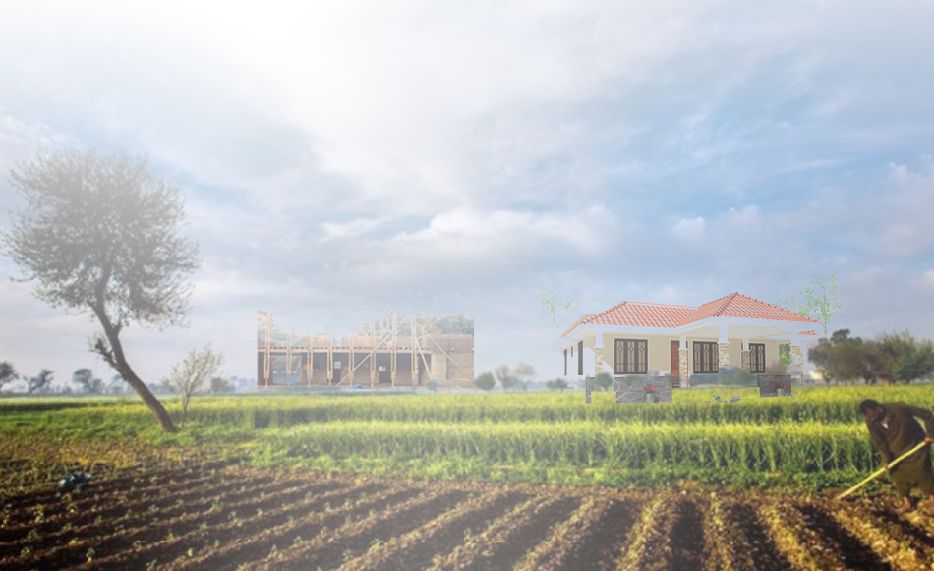
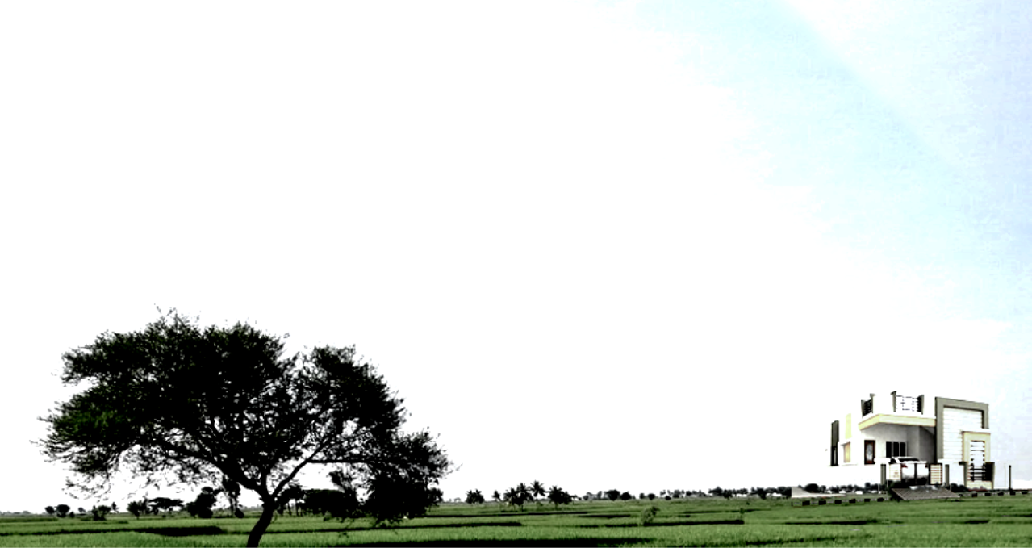
Affordable Housing Models
Asian Scenario at
Global Housing Foundation
“Innovative Ideas to Transform the Global Workforce Housing”
October 24, 2022
By
Zaigham M. Rizvi
Ambassador, GHF Asia

Slide 2
Housing is a number Game
Population, Area, Population Density
Challenge of Food Clothing and Shelter
World:
Land size/area remains the same for a country, but demand for land is always on the rise for producing “Food, Clothing and Shelter”, the basic “Social Needs”.
The world population in 1804 was 0ne billon (bn), by 1900 was around 2 billion, 4 billion by 1974, and today in the year 2022 it stands at 8 billion and by 2050 expected to be 9.8 bn.
Malthusian Theory of population Growth in full action.
Pakistan:
In 1970, the population of Pakistan was 58 mn, today it is 230 mn., and by 2050 it is projected to exceed 380 mn., while the land area will remain the same at 882,000 Sq KM.
In 1970, the population density was 66 Persons/Sq KM. And Today it is 261 Persons/Sq KM (four Times increase since 1970), by 2050 it will be 430 Persons/Sq KM (eight Times increase since 1970).
Are we aware of the Challenge: The same land area was to serve one person/sq.km in 1970, it needs to serve 4 persons today and by 2050, about 30 years from now to 8 persons ?
Answer: It simply demands for an efficient use of land to increase land productivity per Sq. KM in terms of yield of wheat, cotton and housing, through improved planning, densification and high-rise housing.

Slide 3
Asian Snapshot
Asia-Pacific represents:
1/4th of the world’s population, and including China, nearly half of the world population resides in this region.
Nearly ½ of the world’s poor live here.
The region is faced with massive housing shortage. Nearly entire urban shortage is in low-income category
Awareness: Housing has become a popular political slogan since 90s.
  “Housing for all”
  “Slum Free Cities”
  “Maang Raha hai har Insaan - Roti, Kapra, aur Makan” (Every human demands food, clothing and shelter), etc.
Delivery: In a few countries there is SOME, but in most it is NONE
Each country in the region has its own geo-socio-economic parameters, all of them face a common challenge of “shelter-less poor”.

Slide 4
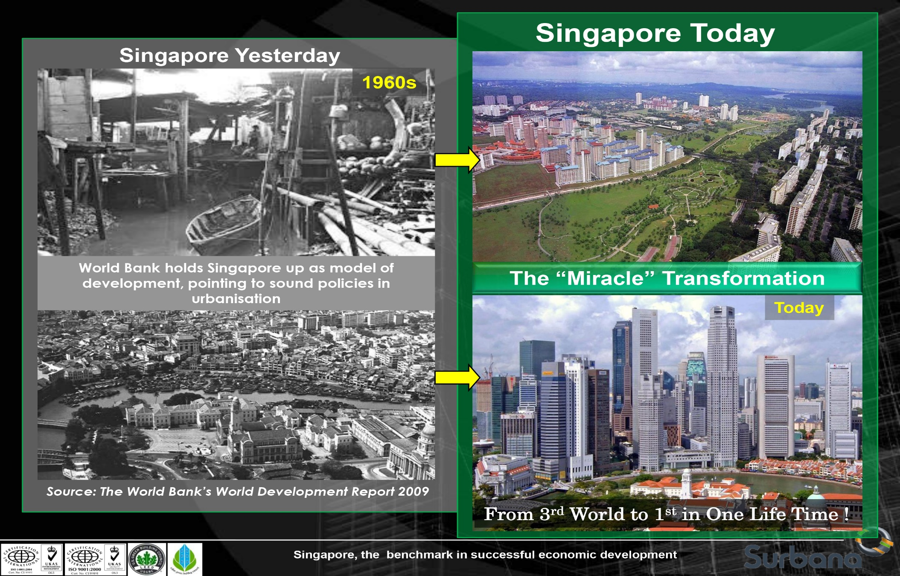
Singapore: Global best practice for Housing and Habitat
Courtesy: Er. Louis Tay Heng Hock, MD, Surbana International Consultants Pte Ltd

Slide 5
Affordable Housing Program
Case of Pakistan
Housing for all - is now beyond any Political Slogan
Fifty percent of population live in rural areas, while remaining 50% live in urban and peri-urban areas.
The previous governments program on housing did not address rural and peri-urban issues.
Though urban habitat are normally considered to be of “pakka” or permanent type, yet the hard fact is that all the big cities have slums, known as “katchi abadis”, and these are not less than 40-50 percent of the metropolitan cities population.
The slums are sprawling, and Even the villages and rural habitat are turning into worst slums over the years.
Pakistan is currently facing an overall housing backlog of around 11-12 million housing units.
The urban housing shortage is estimated to be around 4 million, while rural and peri-urban housing backlog is around 7-8 million.
Average Household Size in Pakistan is 6.5 persons, while India and Bangladesh are at around 5. With shrinking of current household size, say as in India and Bangladesh, the same population would need more housing, meaning that much larger housing backlog under the surface.
Year-on-year housing need of Pakistan: Based on Country’s population of over 230 million, with population growth rate of 2.0% and household size of 6.5 persons per household, the year-on-year incremental housing needs is 7 lacs units/year, which includes both urban and rural areas.
Pakistan needs to build at least 1 million (10 lacs) housing units/year just to cover up the existing backlog plus the incremental housing needs.
Not delivering on housing needs is no choice to carry any more. Stakeholders need to understand the challenge, learn from the “best practice cases” from the region and the globe, and work on deliverable and sustainable plans.

Slide 6
Housing backlog is increasing BUT housing delivery did not move beyond public announcements
Past:
Housing, as a political slogan, first appeared in Pakistan through Mr. Zulfiqar Ali Bhutto’s famous slogan of “Roti, Kapra aur Makaan”.
Then, three former Premiers, Mr. Junejo, Mr. Yusuf Raza Gilani and Nawaz Sharif announced some housing programs, like PM. Junejo to build One Million and PM NS to build 5 lacs units per year respectively.
Delivery on these promises was not seen since no institutional, administrative and legal platforms were made for execution.
The Govt. of PM Junejo did make a very humble start, but could not take off, then PM Gillani just announced intention, but without any activity on this announcement, the Govt. of PM Nawaz Sharif did do some table work through Housing Steering Committee, Chaired by Mr. Ishaq Dar, of which I was also a member. Nothing moved beyond drawing table.
Recent:
PTI Chairman Mr. Imran Khan asked Mr. Zaigham M. Rizvi to prepare PTI Housing Policy, made housing as part of PTI’s Election Manifesto and formally announced PTI Housing Policy at ABAD House, Karachi on July 04, 2018.
While in power, PM Imran Khan initiated by setting up a Housing Task Force, and made Zaigham as its Chairman.
While announcing the Housing Policy, he declared in front of Builders/Developers that the Govt. would play the role of ‘Enabler and Facilitator”, while the execution of the programme will be done by the private sector.
The program and the policy has a focus on Affordable Housing for wider coverage of low-income segments and with a wider geographical coverage around the country, and thus covered rural, peri-urban and urban housing.
In addition to Federal Housing Task Force, similar setups were also made in provinces.
For on ground delivery of the program, the execution authorities were set at Federal and Provincial levels.

Slide 7
Housing for all: Targets of PTI Naya Pakistan Housing Program (NPHP)
Target Numbers: The target of 10 lacs housing units per year (50 lacs over 5 years tenor) was aimed to be achieved in following market segments:
Rural Areas: 4 lacs units/year
Peri-Urban areas: 2 lacs units/year
Urban Areas: 4 lacs units/year
Target Segments: Addressing housing issue in wider geographical and income perspective:
Rural, Rural and Peri-Urban Housing: Address the rural and peri-urban housing issue, alongside the main issue of housing shortage in urban metropolitans.
Economically Weaker Segments: Focus on lower-middle, low-income and housing issues of Bottom-of-Pyramid
Slums and Katchi-Abadis: Address slums improvement, rehabilitation and resettlement of slums/squatters, and zero-tolerance for new squatter settlements.

Slide 8
We need to understand the stakeholders of affordable housing first
  Government at federal and provincial levels: Facilitator and Enabler Role. Land is a provincial subject (Constitution)
  Master Plan and Town Planners: Integrator of Housing and Habitat Development with Zoning and Town Planning.
  Fiscal Authorities : Providers of Fiscal Incentives to Construction Industry (MoF and FBR and such authorities in Provinces).
  Regulatory Agencies like central bank, building control authorities, RERA etc: Makers and implementers of Construction and Material Codes, Building Control Authorities etc.
  Academia: Academic Professional and students involved in research and development on Urban Planning, Habitat Designs, Construction Materials and Technologies.
  Developers/ Builders: Engaged in development of large scale housing including, LIH, users of innovative construction technologies for manufacturing scale production, development models under PPP modes, etc. (ABAD, Punjab Developers Association etc)
  Construction Materials Industry (CMIs): Providers of standardized Materials on large economies of scale volumes so as to go for Home Depot Concepts
  Housing Finance Companies and Commercial Banks (HFCs/CBs): Providers of Diversified Housing Finance Products, Expansion of Outreach and Financial Inclusion across geographical areas and income segments.
  Land Agencies/Land Banks (Land): Federal and Provincial Land, Land with state entities like ETBP, Railways etc.
  Arranger and manager of Raw Lands to Serviced Lands, enhancing supply of lands for habitat development.
  Agencies responsible for External Infrastructure: Physical Infrastructure (Roads, Communication, Transport,) and Social Infrastructure ( Health, Education, Social Integration).

Slide 9
Key Players of Affordable Housing-1
Finance-Side :
Specialized Housing Finance Institutions (SHFIs) like HBFC. Pakistan has only 4, while India has more than 100.
Commercial Banks active in housing finance. A recent phenomenon.
Central Bank as Regulator-State Bank of Pakistan (SBP) for HBFC under DFI Mode, SECP for SHFIs
Pakistan Mortgage Refinance Co. (PMRC): A long-term liquidity facility institution
Capital market for market based long term funding and liquidity instruments like REITs, Listed Property Instruments, Mortgage Backed Sukuks, and Bonds issued by Pakistan Mortgage Refinance Co. (PMRC) etc.
Supply-Side Agents:
Land supply, transformation of raw-land to serviced-land, Public Land and/or Private Land. Land Information Repository.
Land is a provincial subject under the constitution, so becomes the housing in practical sense.
Developer Industry: Real Estate (RE) developers under platform of ABAD, Punjab Developers Association etc. for large scale housing development both through horizontal and vertical habitat, under different PPP Modes.
Supply-Side Regulatory Agents like Building Control Authority, SECP, and Municipal Authorities like CDA, LDA, etc.
Real Estate Regulatory Authority (RERA) to ensure discipline in the developers industry and Real Estate Agents (Marketing)

Slide 10
Key Players of Affordable Housing-2
Policy and Execution Platforms
Naya Pakistan Housing Task Force (NPHTF):
Before moving for on ground execution of housing program, we needed housing policy, affordable housing projects, define and link role of stakeholders, facilitate fiscal and regulatory incentives, and continuing brainstorming to benefit from regional best practices.
The NPHTF initiated the process of translating PTI Housing Policy into various policy initiatives and programs, both at federal as well as provincial levels, covering Fiscal and Regulatory aspects.
Supply-Side: Fiscal Incentives Package for Construction Industry (Historical), Regulatory Incentives like FARs, FSI, et ,
Finance-Side: Housing Finance by Banks as Mandatory Credit, Interest Rate Subsidies, promote more Specialized Housing Finance Institutions etc.
Developer Finance Models acceptable to Banks/SHFIs
Real Estate Regulatory Authority (RERA): Draft for RERA was prepared by Mandwiwala & Zafar, cleared by MoH, vetted by Law Div. Things then on went very slow. Now things on Islamabad RERA are moving on ground. One federal RERA will be in place, it will be passed on to provinces.
Provincial Set ups: Since land is a provincial subject, Housing Task Forces and housing execution authorities were established in Provinces. Punjab Housing Task Force had initiated projects in around 40 locations. PHATA was assigned the role of provincial execution authority.
Execution Platform-NAPHDA:
State to play the role of enabler and facilitator between the operators, directly or through NAPHDA, except in Public-Public Partnership Projects.
Land as per constitution is a Provincial Matter, so is the housing. This should be binding factor while planning housing and habitat. Therefore, we can not establish a National Land Bank, but a Land Information Repository, both at Federal and Provincial levels.
In view of that NAPHDA may revisit its role.
Ministry of Housing (MoH), FGEHF, CDA, LDA, and similar entities to redefine and reactivate their role in housing, more so in affordable housing.

Slide 11
Housing development models
Housing and Habitat Projects are developed under following three PPP models:
Public-Public Partnership: Housing for Govt and Public Sector Employees, where land will be provided by the state and development will be done by state agencies like NESPAK, PHA, FWO and NAPHDA etc. It may be Ownership or Rental Housing.
Public-Private Partnership: Housing for Govt and Public Sector Employees, where land will be provided by the state and development will be done by market developers. Its Financial Model will be discussed later.
Private-Private Partnership: Where Private Developers will announce Affordable Housing Schemes on private land owned by them/the scheme and developer will seek regulatory and fiscal support available as per the Govt. Policy.
For Affordable Housing, in all these cases, more reliance on Smart-Subsidy and Cross-Subsidy Models, and less on Govt. Subsidy from Budget/Tax-Payers money is not dependable in the long term, and remains subject to public scrutiny.

Slide 12
Market Segmentation for Affordability
Market Housing: Works on market mechanism
Represents High and Middle Income Market Segments
Market Segment is addressed by market forces on its own without any need for state-intervention or support
Supply is there to meet the demand- Middle- and High-Income Segment
Social Housing: Needing affordability empowerment
Lower-middle and low-income market segment for Affordable Housing
Social Segment needs state intervention/support to facilitate affordable housing supply and an enabling environment –LIH Segment
Housing Microfinance:
Bottom of the Pyramid: The candidates for housing microfinance, needing delivery through direct/indirect state subsidies. EWS Segment
Almost half of the world lives on less than $ 2.50 a day, and four out of five under $ 10 a day.

Slide 13
Affordability:
Based on general definition used in Asia-Pacific region
Income Affordability :
When 35-40% of the disposable income match the equated mortgage payments (EMIs)
Loan to value (LTV) ratios are typically 70:30 or 90:10
Loan Tenors are long term of 15-20 years
Cost Affordability:
The cost of a housing unit needs to fall within to 50-70 times (4-6 years) of monthly income and EMI is determined long tenors.
For example, for Income Rs 50,000/month, Total Income over 5 Years is Rs 3 mn.
  So, affordability for this income segment is for a house of Rs 30 lacs.
  However, a single family member may not be earning that much, and we may need clubbing of facility income.
  And income may not be formal income, so we may include Informal Income Assessment Model.
Market Norms:
The above market norms are used for low and lower-middle income segments of population (LIH). These may not apply in case of housing microfinance (Bottom of the Pyramid –BoP or EWS), where an entirely different business like Akhuwat’s Mawakhat Model may be used.
Affordability definition can not have a universal or country level definition. Even within a country, Income and Cost Affordability vary among income segments and geographical segments.

Slide 14
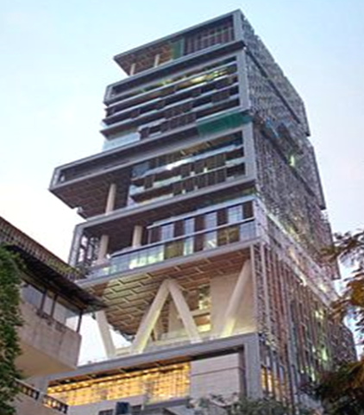
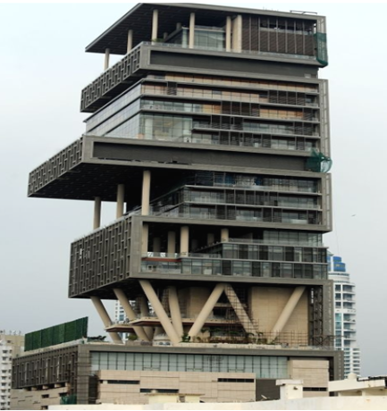
Affordability Defined….of haves
ANTILIA: Mukesh Ambani House Mumbai; Two Billion Dollar;
27 Story, 400,000 Sq. Ft Area;
600 Staff to maintain
Affordability is not what
you wish, its what you
desire and can have it

Slide 15
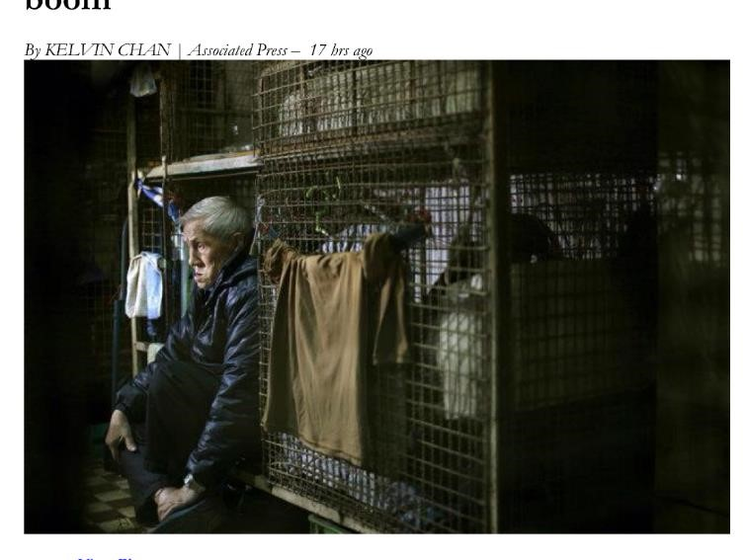
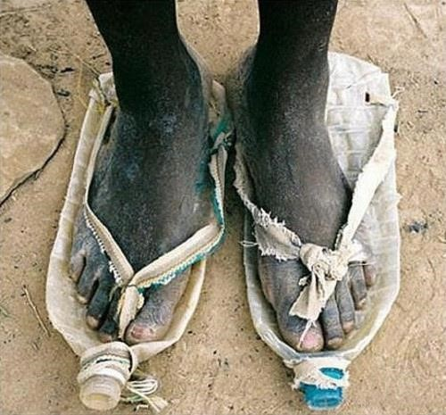
Affordability Defined….of have-nots
Cage Housing in Hong Kong
Shoes made of used Mineral Water Bottles
Affordability is what you essentially need for housing. If a state system fails to make it affordable through
economic empowerment, people get it through illegal means, like creating slums.
You do not give them, so they get those on their own.

Slide 16
Housing Affordability Models
Supply-Side:
  Market Driven Affordable Housing and Habitat
  New Satellite Towns on available state lands
  Essential Staff Colonies: Industries (Work Force), Hospitals (Nurses, Doctors), Law Enforcement (Police, Fire Brigade, Rangers etc
  Rental Housing: For renting only or Rent-to-Own Housing
  Use of different PPP Models
Demand/Finance Side:
  Housing Finance by Banks, SHFIs under “Mandatory Credit” Policy
  Sustainable Fiscal Incentives like Teaser Loans, Through Special Product Features, etc.
  Akhuwat Model of “Mawakhat Shelter Program”
Regulatory Incentives:
  FARs, FSI, On-line processing and approvals,
  Mixed Habitat and concessions of standards ratios of 55:45, Commercial Areas 5%

Slide 17
Affordable Housing
Supply-Side Issues and Answer

Slide 18
Affordability Measures: Supply Side-1
Cost of Land:
  Private Land vs State Land: Land Information Repository and Land Banking
  Land availability: Transformation from “Raw Land” to “Services Land”
  Internal Infrastructure by the Developer, and State supported External Infrastructure.
  State Land/Public Land to be at subsidized cost, while Private Land to be facilitated though provision of External Infrastructure (Physical, Transport, Utilities, Communication etc)
Construction Cost:
  Mass scale production of standardized Construction materials,
  Use of Construction Technology to benefit economies of scale.
  Fiscal incentives on Construction Materials and Fixed Tax Regime for Developers
  Regulatory Incentives like FAR, FSI etc
  E-Processing for project approval so as to save time, and adverse inflationary impact
  Research on Construction Materials and Construction Technologies: Role of Academia, Housing Research Centers, and Industry.
  Role of National Platform for Housing Research (NPHR)
  Role of Town Planners, Architects, and Academia in design of decent habitat and cost-effective resilient housing.

Slide 19
Affordability Measures: Supply Side-2
In-built mechanism for managing cost of development and construction
State-Backed Cash Subsidies are generally not viable, reliable and sustainable.
Plot (sized assumed): In terms of Area 3-5 marlas (80-120 sq.yds, Area: 650-850 sqft
Mixed Habitat with minimum defined Low Income Housing: To be viable and self-sustainable, a habitat needs to be designed “mixed” by the Town Planners. In all LIH Housing, it will be called “Ghariba-bad or Poor Man’s Habitat”, with not much value for commercial area, and attraction for social and physical infrastructure.
Best-Practice Examples suggest that Low-Income Affordable Housing, as per definition in the policy and the Program, may be around 25-35%.
Cross Subsidy: These Cross-Subsidies are generated from within the system:
  Commercial Area: Possible increase from 5 upto 10%, to be used/sold at going market price.
  Service Area: May be reduced say by 5% for more residential areas, say from 55:45 to 60:40 through intelligent layout design
  Mixed Land Use:
    Model: Horizontal,Ground+4 Walkable, High-rise G+8 and above.(G, G+4, G+8 and above)
    Allocation: Low-Income-35-40%, Middle Income,35-40%, and High Income-20-30%
Smart Subsidy: Use of Fiscal Incentives on Construction Materials, more so construction on low and lower-middle affordable housing. Global Practices lie in Mexico
You can not Tax the Poor and Help the Poor at the same time.

Slide 20
Affordability Measures: Supply Side-3
In-built mechanism for managing cost of development and construction
Research on Constriction Materials and Construction Technologies:
  Cost-efficient and qualitative construction materials and technologies are key to manage cost of construction. A lot has been done and is being done in this area in many of the countries of Asia-Pacific Region, including India, Malaysia, Singapore, Thailand, Indonesia, Vietnam, Australia etc.
  For this purpose, academia and PCSIR can play a vital role.
  A National Platform for Housing Research (NPHR) has been established which has more than 28 universities as its members. Housing Research Centers are also being set up to collaborate with each in specific research area.
  Standardization of construction materials and technologies for manufacturing scale production of construction materials and housing products in line with the concept of “Home Depot”.
Built-in Environment Friendly Green Housing:
  Reliance on Renewable Energy: Mini-Grids for solar powered system, roof top solar, solar streetlights, rooftop wind turbines, and hybrid alternate energy systems of solar+wind. (Architects)
  Mini-Grids for RE generation and distribution to be a part of habitat design and development level. (Town-Planners)
  Water-Conservation, water filtration and water recycling as built-in system in housing. (Architects)
  Rain-Water Harvesting: Habitat design and development to ensure community level system for rain-water harvesting, storage, filtration, and recycling (Singapore)

Slide 21
New Satellite Towns on State Land:
Affordability Measures: Supply Side-4
Federal Govt Land with Evacuee Trust Property Board (ETPB), Railways, PIA, and State Enterprises, lands and directly under Federal Govt, etc:
ETPB has a total of 110,000 acres of land in different cities which is effectively owned by Federal Govt and could be made available for developing new towns, Industrial Estates and Commercial areas for economic activates. Similar large land parcels are available with Govt. institutions like Railways, PIA, etc.
Some of these large land parcels are:
Nankana Sahib 16,000 acres: A large size city could be developed there by inviting an international developer.
Shiekhupura 4,000 acres, Sahiwal 9,600, Hyderabad 12,000 acres, Okara 12,000 acres, Layyah 5,800 acres.
Another 8-10 cities with land parcels of 1,000 to 4,000 acres.
Pakistan Railways has more than 100,000 acres
Provincial Govts have large parcels of land, which could be transformed into decent habitat, before it is grabbed by slums/mafia.

Slide 22
Fiscal and Regulatory Incentives to Construction Industry
Affordability Measures: Supply Side-5
Fiscal Incentives to Construction Industry under NPHP.
General Incentives to construction industry and specific incentives for Affordable Housing
Regulatory Incentives: FARs, FSI, Service Areas Relaxation, Commercial Area Relaxation etc.
While Internal Infrastructure is the responsibility of the Developer, State will provide assistance where applicable.
Provision of External Infrastructure in terms of Physical Infrastructure, Communication Infrastructure, Economic Infrastructure, Economic Zones, and Public Transport services etc.

Slide 23
Urban Housing: Progress on Ground
Affordability Measures: Supply Side-6
Private Sector:
A few developers in Punjab had initiated some projects under Private-Private Partnership Models or stand alone.
Punjab Developers Association is now more active in Punjab viz-a-viz ABAD
In other provinces like Baluchistan, KPK and Sindh, progress is not that visible in Affordable Housing Area.
One reason for slowdown was COVID, though erratic Govt. policies, both on fiscal and regulatory aspects have to bear the major part..
Routinely, private sector supplies and develops around one lac units a year on its own, as from the entities like ABAD .
Public Sector:
Delivery from institutions like LDA, CDA, PHA, FGEHF, etc.
Institutions like LDA (4,500), CDA, PHA and a few such other institutions had announced a few projects. Progress is either nil, or nominal.
Punjab Housing Task Force, under leadership of the then Minister for Housing had launched and inaugurated projects at 40 locations in Punjab. Progress was dormant due to bureaucratic hurdles.
NAPHDA’s own projects:
Not visible progress on ground even under Public-Public Partnership Model.
NAPHDA may revisit its business models, learn from experience gained so far.
Consult acknowledged housing professionals, entities like NESPAK, PCATP, NPHR, NESPAK etc
Visit best-practice cases from around the globe.

Slide 24
Affordability Measures for Peri-Urban Housing: Supply Side-7
Housing in Peri-Urban Areas has its own unique challenges:
Vey Low Income Segments
Land availability.
Largely Informal Income Sources.
Clubbing of income at times is essential
For very low-income and housing microfinance, the loan processing and recovery cost ids very high.
Model of Akhuwat Foundation (AF): A private sector social service institution
So far AF has done the maximum delivery of around 26.000 plus under the program.
Akhuwat has established its own housing finance company, Mawakhat Shelter Program,
Akhuwat Mawakhat Model has managed its in a very efficient cost-effective manner.
With its vast experience, presence all over Pakistan, having disbursed more than Rs 175 Bn,
Has served 5.1 mn clients, with nearly zero default.
LARGEST DELIVERY BY A SINGLE ENTITY UNDER PROGRAM

Slide 25
Finance-Side-1: Retail Housing Finance (Mortgage) – Pakistan’s Scenario
Residential Housing Finance: Role of Banks and SHFIs
Institutional housing finance in Pakistan, measured through Mortgage Debt to GDP Ratio has been lowest on Global scale,
Pakistan is at 0.3 India at 11% plus, Bangladesh at 5%plus, Malaysia at 27% etc
Outstanding Mortgage Debt in Pakistan stands at Rs 130 bn. This is our 70 years output.
HBFC is the only state-owned specialized housing finance institution (SHFI) in Pakistan.
The share of Conventional Banks in outstanding mortgage debt in Pakistan is insignificant while Islamic commercial banks are an exception, some of which like Meezan Bank, Bank-Islami, DIB are very active in housing.
It is hoped that after the recent SBP Directive, to make RE/ Housing Finance at a minimum of 5% (now raised to 7%) as “Mandated or Directed Credit”, the Banks are expected to proactively come forward.
SHFIs in Pakistan: In addition to HBFC, which is under DFI Mode, we have recently established 4 SHFIs,. Their performance is yet to be seen. However, unless these fall under SBP’s regulatory regime (currently under SECP), it will be difficult for them to raise market based funding.
PMRC has been established in Pakistan as a liquidity facility institution. However the size of outstanding mortgage portfolio is too small for an economical issue of Mortgage Binds/Sukuks.
India has around 100 plus SHFIs, whereas commercial banks are also very active in housing finance.
In India, just two commercial bank out of many CBs, i.e., ICIC, and SBI, do more than Irs.500 bn/year housing finance.
HBFC Pakistan, established in 1952, does on average 6 loans/day and around 6 bn/year housing finance.
HDFC India, established in 1978 provides more than 1,000 loans/day, and more than Rs 200 bn/year

Slide 26
Finance-Side-2: Challenges of Affordable LIH
Mismatch of Monthly Mortgage vs Income Affordability. At lower income levels, propensity to save is low and fragile (Stakeholders: HFIs)
Income assessment issues, informal income, issue of family vs. individual income etc. Income sustainability for long term remains an issue while longer tenors are needed to make mortgages affordable. (Stakeholders: HFIs, Regulatory Authorities (RAs))
Poor prefer FRMs (Fixed Rate), the Lenders prefer ARMs (Variable Rate) (Stakeholders: HFIs)
Long term liquidity/Funding challenges (Stakeholders: RAs, Long Tern Liquidity Facility Institutions like PMRC in Pakistan).
Issues of title verification, lien registration costs/fees, lengthy and complex foreclosure process. (Stakeholders: Land, Govt.., Municipalities)
Cost efficient loan delivery and servicing. (Stakeholders: HFIs)
Awareness on mortgage programs and fiscal/regulatory provisions. (Stakeholders: RAs, HFIs)

Slide 27
AKHUWAT
“Mawakhat Shelter Program (MSP)”
A Web-based platform of Akhuwat Foundation to provide financial support to low-income segments, under Islamic brotherhood spirit, for economic empowerment of poor, for a house beyond their means i.e., thus making housing affordable for them. A part Partial Financial assistance under the program will be for Purchase and/or Construction of house.
Program initiated by: Zaigham M. Rizvi, Voluntary Advisor Akhuwat

Slide 28
Fincnce-Side-3: Retail Housing Finance (Mortgage) – Pakistan’s Scenario
Housing Regulatory Regime in Pakistan:
While SBP is the regulator of housing sector, it only regulates housing finance by Banks and HBFC.
SBP does not have a dedicated housing regulatory function, and housing finance regulatory function is clubbed with three other functions like SME, Agriculture, Islamic Banking. So, no dedicated housing professional staff had been developed, who would have expertise in housing regulatory function
Housing Information System in SBP covers only limited areas of overall mortgage debt. There is a need to strengthen and broadened this function to include data/information gathering on housing with country level details on income segments, geographical areas, market penetration and financial inclusion, rural and per-urban etc
The Non-Bank Housing Finance companies, currently four in Pakistan, are regulated by SECP, where no dedicated housing expertise and function is available as could be expected.
Case of India:
In India Reserve Bank of India (RBI) is overall regulator of Mortgage Finance Sector.
It has a dedicated function to regulate housing sector, both by Banks and SHFIs.
In 1988, the housing finance regulator RBI was to regulate SHFIs to its newly established housing regulatory body and National Bank Of India. In the beginning had only 3 SHFIs to regulate. Today there are more than 100 entities, including a few with a focused market like Low-income segment and housing microfinance.
RBI has a very comprehensive housing information platform.
In Thailand, the Govt. Housing Bank of Thailand (GHB) has a remarkable Housing Information System, which covers both housing finance and housing supply. Similar are the stories for Malaysia and Singapore.

Slide 29
Fincnce-Side-4: Market Based Funding and
Role of Long-term Liquidity Facility Institutions
Real Estate Investment Trusts (REITs)
RE Projects could be financed under financing instruments like Development REITs or Rental REITs.
Pakistan RE Market has taken a humble start on REITs:
  Dolmen mall, as a Commercial Real Estate.
  Naya Nazimabad High Rise Residential Tower through Residential REIT supported by Meezan Bank.
  More are in the pipeline.
Mortgage Bonds and Sukuks:
Such MBS/Sukuks are globally the main source of long-term funding, essentially needed for housing finance. While much has been talked about it here, but nothing on ground
Liquidity Facility Institutions: PMRC is functional and is taking practical steps to facilitate banks/SHFIs on Long-Term Liquidity. So far, its main source is World Bank Credit Lines.

Slide 30
Affordable Housing Program:
Case of India, Pakistan, Indonesia, Turkey
India: Pradhan Mantri Awas Yojana (PMAY) or ‘Housing for all”:
  PMAY is the housing initiative by Government of India launched in 2016, in which affordable housing is to be provided to the urban poor with a target of building 20 million affordable houses by 31 March 2022.
  India’s PMAY Affordable Housing Program is moving close to targets in Rural Housing, while falling short of targets in Urban Housing
  India presents good models for regulatory and fiscal incentives for affordable housing. “Promise as made is Promise as delivered”
  Real Estate Regulatory Authority (RERA) is ensuring discipline on housing supply
Indonesia: A housing program to build one million Housing Units was launched in 2014. Figures from the Public Works and Housing Ministry show that in 2015 the country produced 0.7 mn homes, followed by 0.8 mn in 2016, and 0.9 mn in 2017 before exceeding the target with 1.1 million in 2018.
Turkey: TOKI produces mass housing projects in order to solve the housing problem of the low- and middle-income groups that cannot own housing under the current market conditions in line with the production area and activity targets defined by the Mass Housing Law and the Government Programs. With the housing projects of TOKI, the sales prices and re-payment conditions that are appropriate to the income and saving patterns of the target groups that cannot be reached by the applications of the private sector are presented.
Singapore: Role of HDB and Housing Provident Fund. See next slide on Singapore.
There are many other best practice cases like in Vietnam, Malaysia, Thailand, Mexico, Brazil and many African Countries like South Africa
There is an emerging need for sharing best practice models among the regional countries having such programs for large scale production of affordable housing.
Platforms like GHF, APUHF, IUHF, AUHF and multilateral agencies like UNHABITAT, The World Bank, IFC, ADB, IDB to play a pro-active role in facilitating such wisdom sharing.

Slide 31
Energy (Electricity) Poverty around Globe and in Asia: Solar for Social Housing
Issues: Nearly 1.3 billion people worldwide live without any access to electricity (living Off-Grid).
  Asia has the largest off-grid population in the world, where nearly 800 million live in near darkness.
  India alone has 400 million off-grid, which is 35% of their population.
  Pakistan’s 60 million is off-grid, that is 30% of the population.
  In Bangladesh 17 million out of total 29 million households are off-grid.
  In Indonesia 20 million households out of total 57 million are off-grid.
  Extending grid-electricity to these household is a remote possibility soon due to economic constraints and under-electrified grids.
Answer: Solar for Social Housing
  Solar Power, Wind Power, Biomass and Hybrid Solutions.
  Rooftop Solar and Roof-Top Solar+Wind Hybrid.
  Mini-Grids powered by renewable energy in new housing projects and in villages.
  Solar water Pumps.
  Alternate and renewable energy resources, mainly solar energy, is the doable and affordable option

Slide 32

Advisory Center for Affordable Settlements & Housing (ACASH)
A Web-Based Platform
for
HOUSING INFORMATION REPOSITORY & RESEARCH
http://acash.org.pk
http://center4affordablehousing.org/
Oct 24, 2022

Slide 33
Recommendation
Global Housing Foundation in association with UNHABITAT may facilitate wisdom sharing on “Best Practice Programs and Models for housing.
The presentations may be arranged by housing stakeholders from countries having launched affordable housing programs like India, Indonesia, Bangladesh, Pakistan, Thailand, Singapore, Malaysia, Vietnam and possibly 1-2 Speakers from Brazil, Mexico etc
The webinar may have a dedicated session to explore one-on-one collaboration between stakeholders/managers of affordable programs
Information on such programs will be placed on housing information web-Portal ACASH
GHF to facilitate execution of recommendations of the Webinar

Slide 34
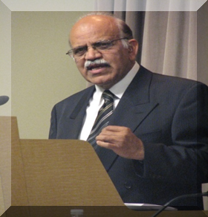
The information has been compiled by Mr. Rizvi from self study and from different sources. He is grateful to all those serving this noble cause in some form or the other.
Zaigham M. Rizvi
zaigham2r@yahoo.com
M.Sc. Engg., M.A. Economics, MBA, Fulbright Scholar
DIBP, ICSP, PICG.
Ambassador: Global Housing Foundation
World Bank: Sr. Advisor Housing for Asia
Secretary General: Asia-Pacific Union for Housing Finance-APUHF (www.apuhf.info)
Chairman: National Platform for Housing Research
Served/Serves as Housing Adviser/Consultant to:
ADB, UNHABITAT, CMHC-Canada
Affordable Housing Institute-USA (AHI)
Enclude-USA (ShoreBank Int’l )

