Slide 1
Launching event
Advisory Center for Affordable Settlements and Housing (ACASH)
ABAD House
June 26,2 018
Karachi
“ Asia-Pacific: Housing Scenario and need for ACASH”
By
Zaigham M. Rizvi
Founding Chairperson ACASH
Secretary General
ASIA PACIFIC UNION FOR HOUSING FINANCE (APUHF)

Slide 2
Contents
Housing Scenario and Challenges around Globe
Defining affordability for Low-Income Housing (LIH)
Housing Pyramid
Economic Impact of Real Sector
Electricity Poverty and Low-Income Housing
Housing: Story of Singapore
HDFC India: a model housing finance institution on global scene
Malaysia: a success story on the region backed by Cagamas
Thailand: Housing and Housing Finance
Self-Contained Communities for Housing: Case of CODI Thailand
Issues we know, Answers we need

Slide 3
World Population is 7.5 billion. By 2050 it will be 10 bn plus. (was One Bn in 1800, 4 Bn in 1974)
Current average net population growth about 130,000/day. (Interesting to see World Population Clock)
Every second person on the globe lives in urban areas, and by 2050 three out of four (70%)
By 2020, it is estimated that the world slum population will cross 1 bn
World needs 4,000 houses an hour to keep up with demand and backlog (UN-Habitat).
Since “Serviced land” availability is limited, population density (Persons/Sq. KM) is on the rise.
In Bangladesh, Population Density is 1,237 (was 381 in 1961), while it is 28,410 in city of Dhaka.
In India, Population Density is 441 (was 154 in 1961), while it is 28,500 in the metropolitan of Mumbai.
Almost half of the world lives on less than $ 2.50 a day, and four out of five under $ 10 a day
In view of this population and urbanization explosion:
The percentage of people without access to decent, stable housing is rising.
Adequate housing is vital to the health of the world’s economies, communities and populations.
If we are to succeed in the fight against poverty, we must support expansion of housing both as policy as well as practice.
Global Snapshot

Slide 4
Asian Snapshot
Asia-Pacific represents:
1/4th of the world’s population, and including China nearly half of the world population
Nearly ½ of the world’s poor
Region is faced with massive housing shortage. Nearly entire urban shortage is in low-income category
Awareness: Housing has become a popular political slogan.
  “Housing for all”;
  “Slum Free Cities”
  “Maang Raha hai har Insaan - Roti, Kapra, aur Makan” (Every human demands food, clothing and shelter); etc.
Delivery: In few countries it is SOME, but in most there is NONE
Each country in the region has its own geo-socio-economic parameters, while all face a common issue of “shelterless poor”

Slide 5

Housing is a ‘Numbers’ game – The OIC member countries are no exception
IDB member Countries need around 8.2 mn new housing units/year. To meet this yearly demand they will need US$ 15.5 Bn/year of investment in housing sector.*
Need for new housing for 8 mn plus due to population growth is based on 5-5.5/HH and population growth rate of 2.8%
The yearly requirement of housing in Muslim World is growing at 2.83% p.a.
Sharia-Compliant Housing Finance in Muslim Countries is around 20% only.
Muslim Population Share: Africa-53.0 %, Asia-32. 2%, Europe-7.6 %, N. America-1.8 %.**
Urban population of IDB member countries is growing at 2.8% per year (Worldwide growth 0.5%).
The total urban population of IDB member Countries is 731 Mn in 2010, representing nearly half of total population of IDB member countries.
MD to GDP ratio is highest in Malaysia (32%), lowest on Pakistan and Egypt (below 1%).

Slide 6
Market Segmentation for Affordability:
Market Housing:
Represents High and Middle Income Market Segments
Market Segment is addressed by market forces on its own without any need for state-intervention or support
Supply is there to meet the demand
Social Housing:
Represents lower-middle and low-income market
Social segment needs state intervention/support to facilitate affordable housing supply and an enabling environment –LIH Segment
Housing Microfinance
Bottom of the Pyramid: The candidates for housing microfinance, needing delivery through direct/indirect state subsidies. EWS Segment

Slide 7
Definition of Affordability:
Income Affordability: As percentage of Gross Household Income
Cost Affordability: 4-6 times of Gross Annual Income
Income Affordability:
India: 30-40 % of household income
Pakistan: 30-40 % of household income
Indonesia: 30 %
Malaysia: 30%
Thailand: If a household earn the amount 25% of which can be paid off for housing, then the housing is said to be affordable for that household.
Philippine: Housing is considered to be affordable if monthly amortization/ rental is PHP 264.78 (US$ 6.38) in the first decile, PHP 388.71 (US$ 9.36) in second decile and PHP 496.38 (US$ 11.96) in third decile.
Hong Kong: Like in the United States and the United Kingdom, Hong Kong uses the median rent-to-income ratio as an affordability yardstick for rent setting.
Cost Affordability:
Generally considered at 4-6 times of Annual Income

Slide 8
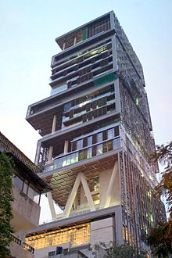
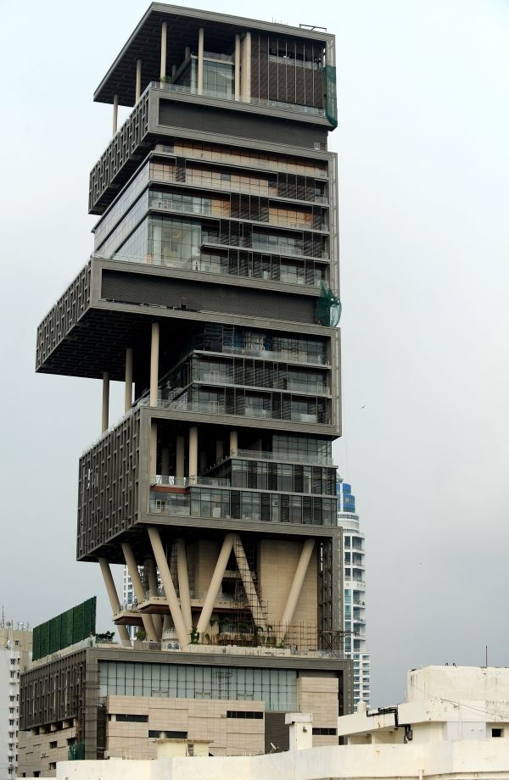
Affordability Defined….haves
ANTILIA: Mukesh Ambani House Mumbai One Billion Dollar, 27 Story, 400,000 Sq. Ft Area, 600 Staff to maintain
Mr. Ambani does not live in it
Affordability is not what you wish, its what you desire and can have it

Slide 9
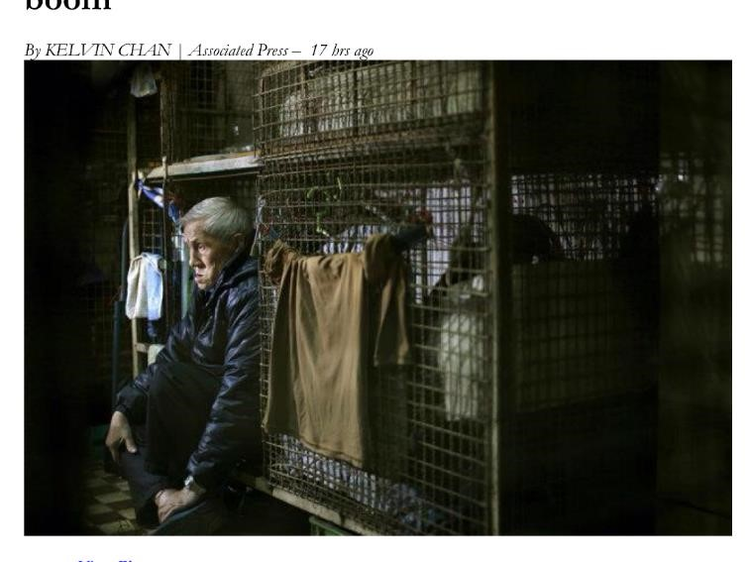
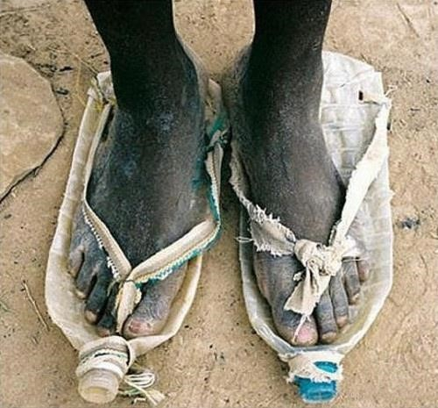
Affordability Defined….have-nots
Cage Housing in Hong Kong
Shoes made of used Mineral Water Bottles
Affordability is what you essentially need and need economic empowerment to have it.
This essential need, the poor are obliged to find their own ways and develop slums

Slide 10
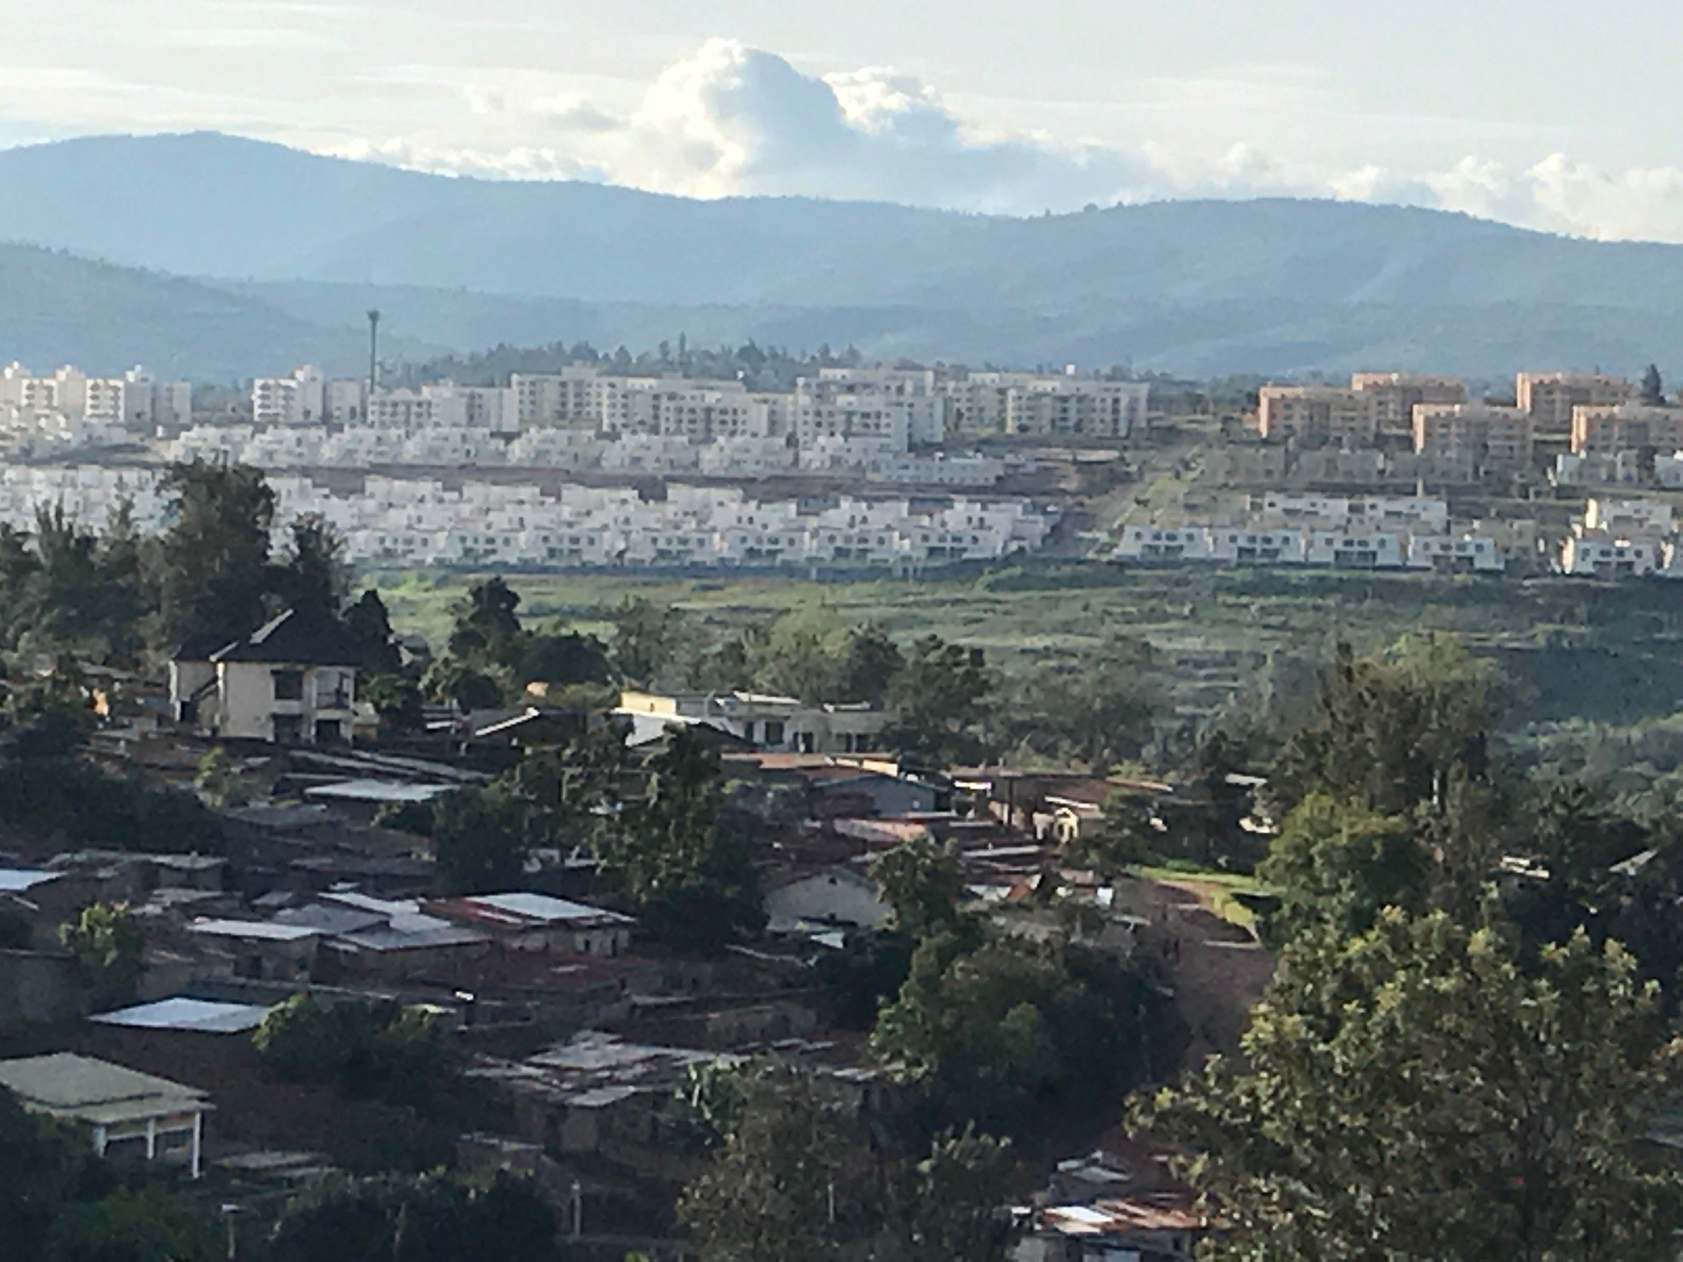
Rich-Man, Poor –Man Housing

Slide 11
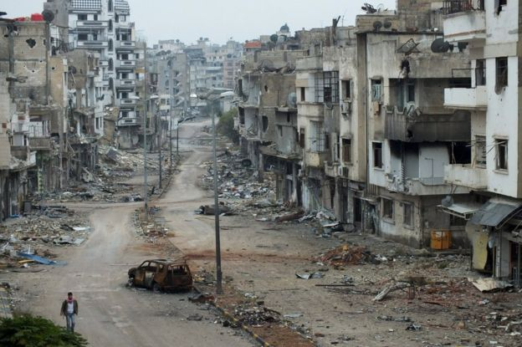
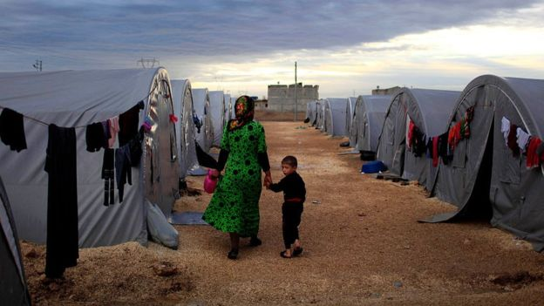
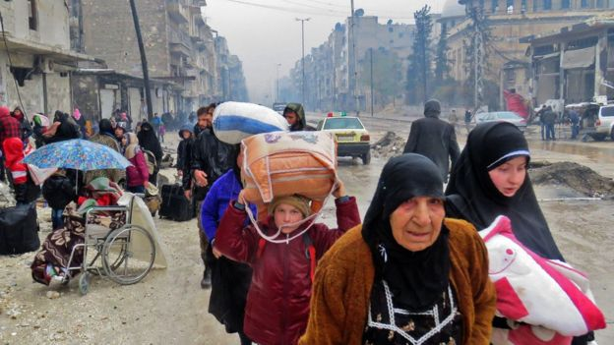
Housing Construction vs Destruction
Syria:
Destruction is mass scale,
Reconstruction may take decades, if at all it ever will

Slide 12
Stakeholders of Housing
  Government at federal and provincial levels: Facilitator and Enabler Role.
  Urban Planners : Integrator of Housing and Habitat Development with Urban Planning.
  Fiscal Authorities : Providers of Fiscal Incentives to LIH Developers and Material Suppliers.
  Regulatory Agencies like central bank, building control authorities etc: Makers and implementers of construction codes for Fiscal Authorities, Building Control Authorities etc.
  Academia: People involved in research and development on Urban Planning, Housing and Construction Materials.
  Developers: Engaged in development of large scale LIH, Innovative Construction Technologies for Manufacturing Scale Production, Development models under PPP Modes, etc
  Construction Materials Industry (CMIs): Provider of standardized CMIs
  Housing Finance Companies and Commercial Banks HFCs/CBs): Providers of Diversified Housing Products, Expansion of Outreach and Financial Inclusion
  Land Agencies/Land Banks (Land): Arranger and manager of Raw Lands and Serviced Lands, enhancing supply of lands under PPP modes.

Slide 13
India: The overall housing finance regulatory role and responsibility is with Reserve Bank of India (RBI). In 1988, RBI created National Housing Bank (NHB) as its wholly owned subsidiary and transferred the development and regulations of HFCs to it. RBI retained housing finance regulations of commercial banks and is maintaining active liaison with NHB on its regulatory role on housing for specialized companies.
Singapore: Central Bank of Malaysia (MAS)
Malaysia: Bank Negara Malaysia (BNM), The Central Bank of Malaysia.
Thailand: Bank of Thailand, The Central Bank
Philippine: BSP, The Central Bank
Pakistan: State Bank of Pakistan (SBP) for commercial banks and DFIs, while HFCs are regulated by the Securities and Exchange Commission (SECP).
Afghanistan: Da Afghanistan Bank, The Central Bank
Bangladesh: Bangladesh Bank, The Central bank along with Ministry of Finance.
Indonesia: Bank of Indonesia (BI) along with Ministry of Finance
Regulatory Framework in the region

Slide 14
Economic impact of Real Sector
Developed World: Real Sector contributes to the growth and development of 71 CMIs and contribution to GDP is 7-10%. In USA, it has direct and indirect linkage to 272 industries.
Developing World: Contribution spreads over about 42 CMIs and contribution to GDP is 3-6%
India: Real sector is playing a vital role in overall growth of the economy, growing at 20% pa in recent past and contribution to GDP is 7-8%.
China: 5-6% , UK: 7%, USA: 9%
Multiplier effect into economy:
  Philippine: Housing sector has a great economic impact. Citing example of Philippine, for every Peso spent on housing will create 2.3 jobs, has 3.3 pesos as Value Creation Multiplier, 0.47 as Household Income Multiplier and 3.9 Pesos as Indirect Tax Multiplier.
  India: IRs 1.0 invested in construction contributes IRs 0.8 to GDP (Agri-0.2, Manuf. 0.14)
  IRs 10 mn in construction generates employment of 22,000 unskilled man-days, 23,000 semi-skilled man-days, and 9,000 technical man-days.

Slide 15
Global Lighting Program of IFC
Nearly 1.3 billion people worldwide live without any access to electricity (being Off-Grid).
Nearly 800 million people in Asia live in a state of near darkness
International Finance Corporation (IFC) has launched a Global Lighting Program.
Lighting Asia is the Asian component of this program.
IFC has assessed some solar lights manufactures for “quality certification”.
In each country IFC has partner organizations, which include companies engaged in solar business, NGOs and Microfinance Institutions.
IFC promotes this program through consumer awareness and policy advocacy.
In Asia, IFC has conducted a few exhaustive studies on penetration and impact of this program in seven countries of Asia.
The reports concludes that program had positively impacted life of this electricity-poor population in terms of education, income generating activities, health and improved environment.
IFC’s Global lighting Program is being successfully used as affordable, viable and reliable option in meeting basic electricity needs of the low-income habitat.
Electricity Poverty and Low-Income Housing

Slide 16
Housing status in Singapore
Approximately 80% of Singapore’s housing stock is built by the HDB, with home ownership financed through CPF savings. As a result:
  The country’s home ownership rate is above 90% (at 50% in 60s)
  75% of the housing stock in 2015 classified as “public housing”; 82% of the resident population live in HDB estates, of which 79% lived in HDB-sold flats.
  The remaining private housing sector transactions are by higher-income Singapore citizens, SPRs, expatriates, and foreign investors.
The government developed its housing policies based on three pillars: the establishment of HDB in 1960; Land Acquisition Act 1966, and; the expansion of the role of the CPF to become a housing finance institution in 1968.
Establishment of HDB-1960
Land Acquisition Act-1967
CFP establishes Housing Finance Institution-1968

Slide 17
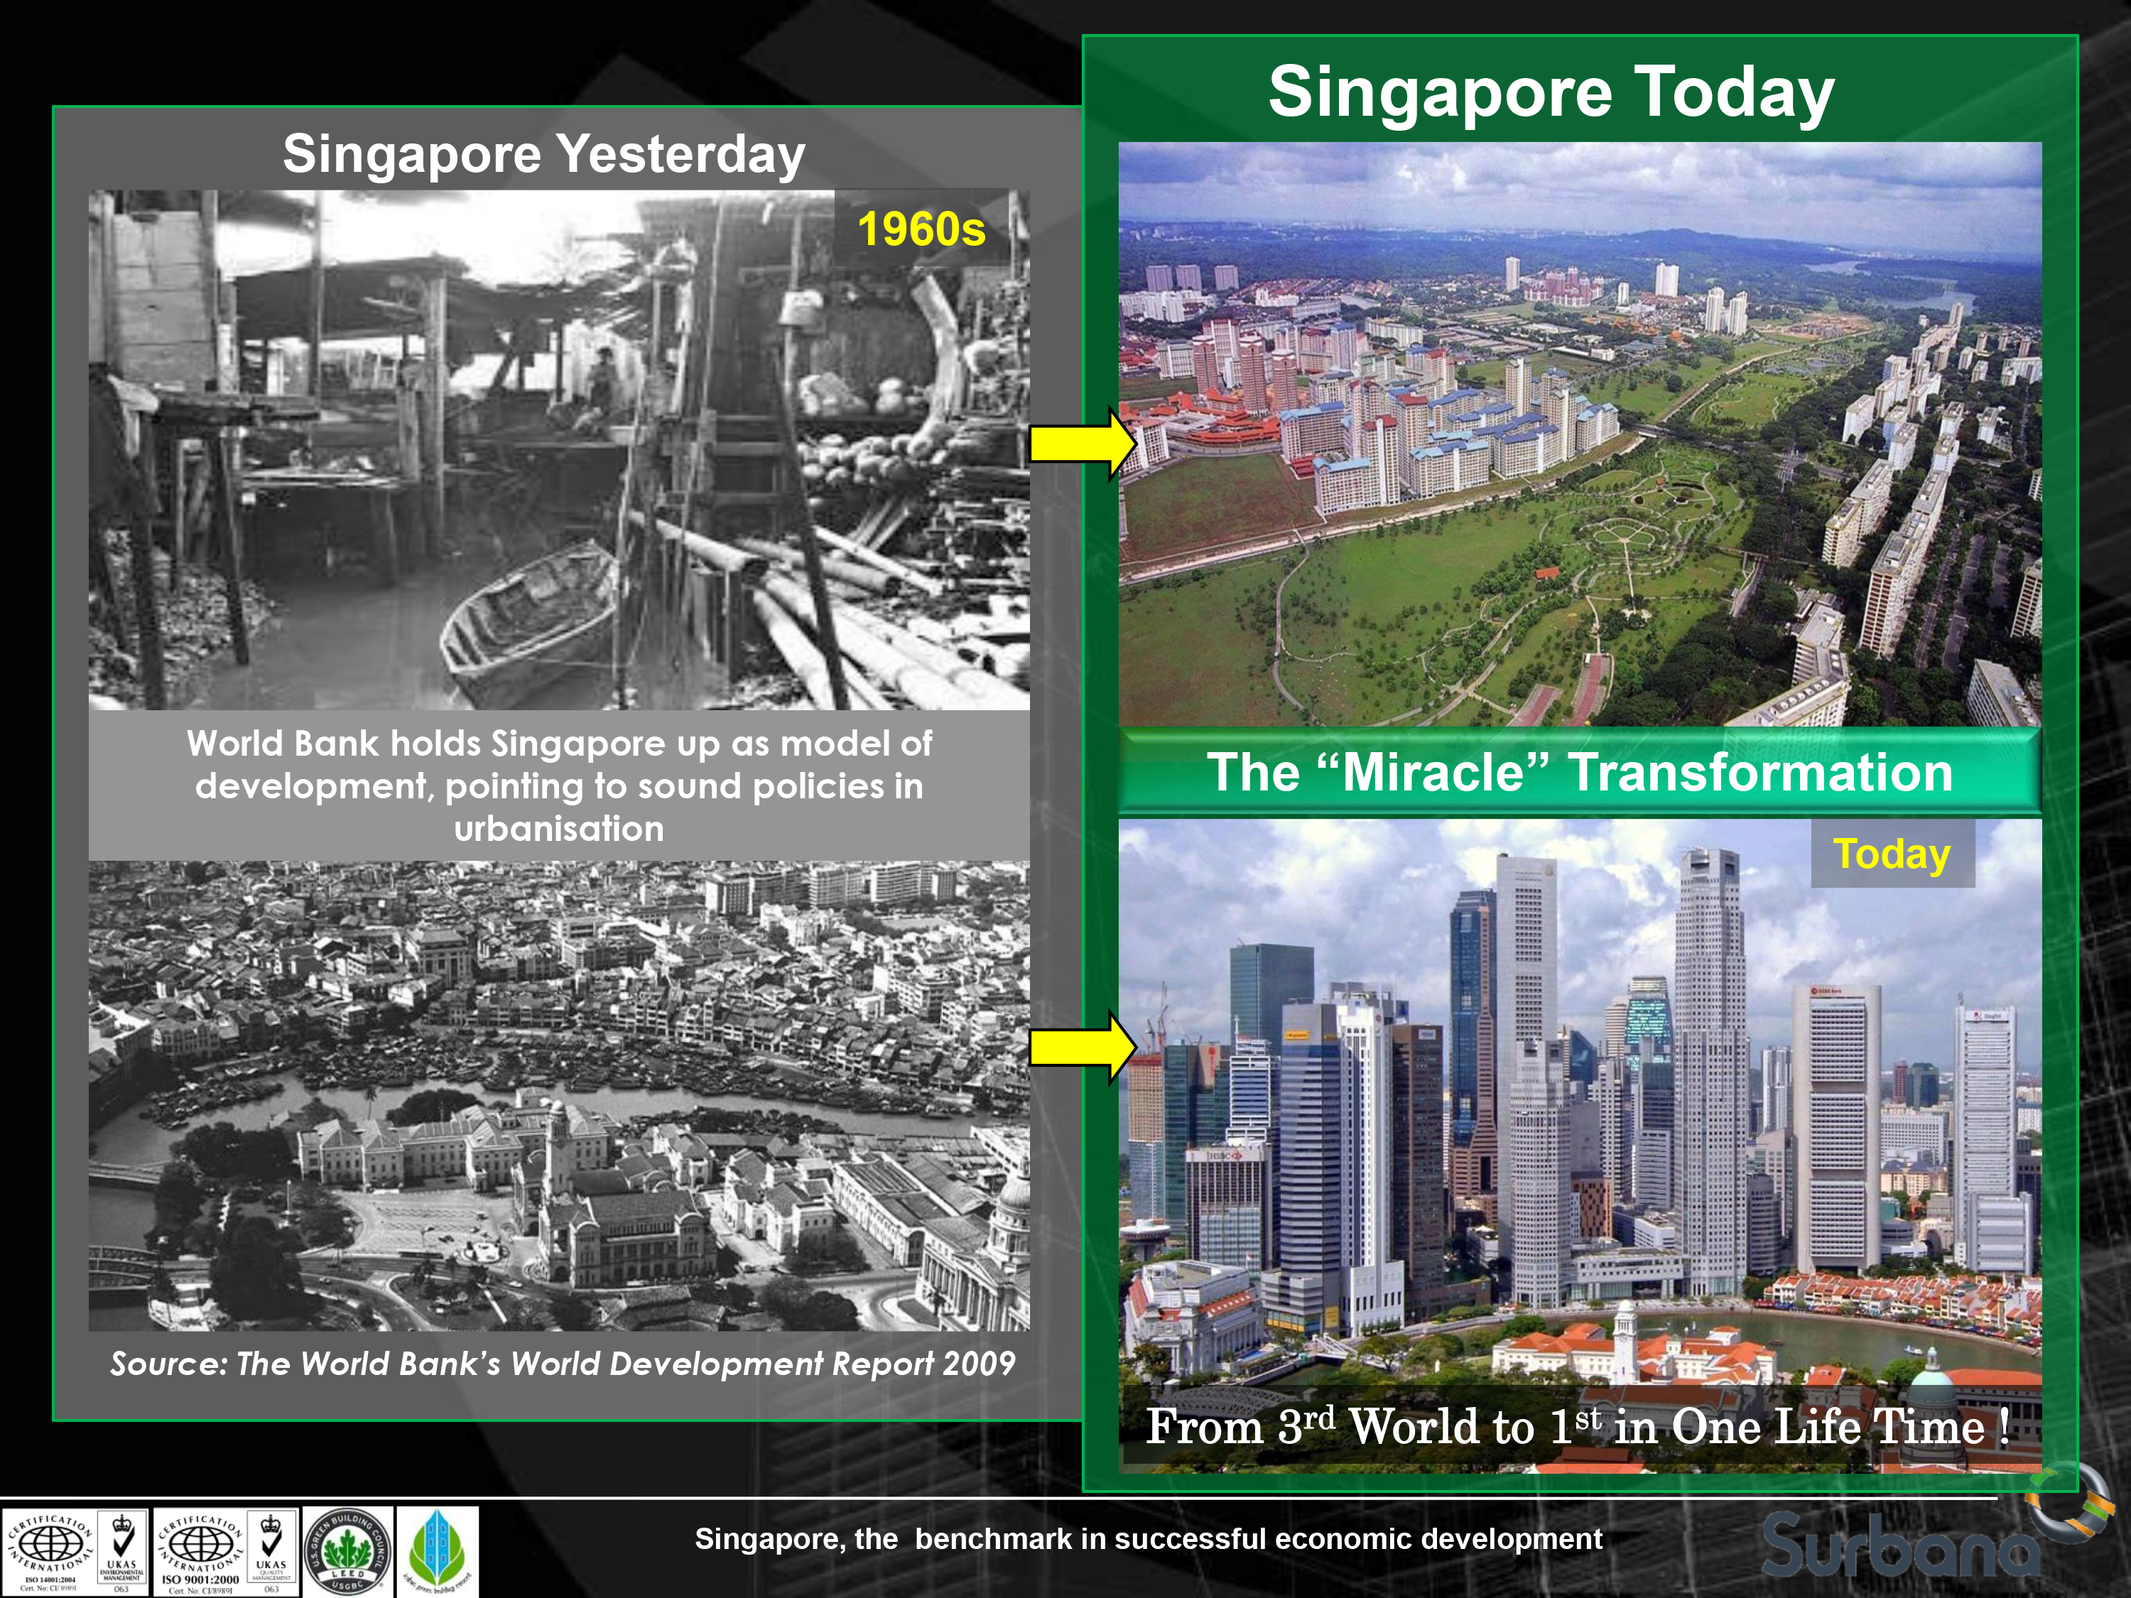
Courtesy: Er. Louis Tay Heng Hock, MD, Surbana International Consultants Pte Ltd

Slide 18
HDFC-India: a model housing finance institution on global scene
Housing Development Finance Corporation Ltd (HDFC) of India was incorporated in 1977 as a specialized housing finance intuition (SHFI) in the private sector.
Over the years it has grown into a financial conglomerate, having established eight subsidiaries of its own, which include a HDFC Commercial Bank, Life and General Insurance, Asset Management, Property Valuation, Venture Capital, Financial Services and an institution to serve low-Income housing segment (GRUH Finance).
HDFC’s outstanding Gross Loan Portfolio stands at US$ 43.8 billion as of March 2016.
Over the years it has served 5.4 million customers (March 2016),
HDFC is surving1,000 plus clients/day and its yearly average loaning is IRs 200-250 billion.
India has 80+ SHFIs regulated by NHB. Its overall outstanding mortgage debt is IRs 12.5 trillion
HDFC PAT CAGR is 18%; including subsidiary profits, 23%.
Cost to Income Ratio at HDFC is only 7.6%.
Total loans written off since inception are only 4 basis points of cumulative disbursements.
HDFC has a wide distribution network, based on physical and virtual offices. HDFC had 401 offices in 173 cities. In addition, it has 103 outlets of HDFC’s wholly owned Distribution Company.

Slide 19
Malaysia: Cagamas, a success story on the globe
The outstanding amount of housing loans, totaled RM 460 billion (USD 108 billion), granted by housing credit institutions (comprising of commercial banks, Islamic banks, the Treasury Housing Loans Division, the cooperative Bank Kerjasama Rakyat Malaysia Berhad, Malaysia Building Society Berhad, Borneo Housing Mortgage Finance Berhad and Sabah Credit Corporation).
The important factors that contribute to the establishment of the sustainable housing finance system in Malaysia are a calibration of government participation, active and efficient mortgage market and also the development of secondary mortgage market.
Mandated lending to priority sectors, including affordable housing, was introduced by BNM in 1976.
For development of Secondary Mortgage market, Cagamas Berhad was established in1987.
Cagamas aims at achieving widespread housing ownership and promoting the development of long-term capital market in Malaysia (i.e. to convert illiquid housing loans in the books of financial institutions into liquid and tradable securities).
Over the next 25 years after establishment, Cagamas cumulatively purchased housing loans and Islamic house financing in the secondary market equivalent to RM104 billion (US$ 24.4 billion) for the financing of 1.7 million houses. To fund said purchases, Cagamas issued bonds/Sukuk of varying tenures to match the underlying pools of housing loans/financing. These Cagamas bonds/Sukuk served as a catalyst for the development of the private debt securities market in Malaysia.

Slide 20
Roles of Cagamas
Promotion of home ownership/home accessibility and affordability in Malaysia
Source: Mr. Rupen CEO, Pakistan Mortgage Refinance Company (PMRC)

Slide 21
Thailand: HOUSING and HOUSING FINANCE
Population 66 million - Bangkok Metro. Region (BMR) 14 million (21%) •
Urbanization level 50% - Household size 2.7 – smaller in Bangkok 2.0
GDP growth +3.2% - GDP per capita US$ 5,662 - Unemployment 1.0% • Inflation 1.5% - Policy Rate 1.5% - Exchange rate US$1= Baht 35
Successful provision of affordable housing to all income levels • Home ownership rate 80%, Rental 16% • No serious housing shortfall
Slum housing has been decreasing, rather disappearing
Affordable subsidized housing is provided by NHA (264,000 units during 2004-12)
Private housing developers are efficient (800,000 units in BMR during 1993-97, 130,000 in 2016 )
Housing finance system has operated efficiently and is very robust. GHB is lead player.
Home Loans to GDP = 27%. Home loan outstanding Baht 3.3 trillion (US 97 billion )
Home loans are available, accessible and affordable to most income groups
Commercial banks altogether have the largest home loan market share 60%.
Government Housing Bank (GHB) is the largest individual holder of home loans 28%
GH Bank has played a key role in providing affordable home loans to LIG.
GHB’s 80% of all loan accounts are less than Bt 1 million baht ( US$33,000)
Lowest interest rates - highest LTV (up to 100%) and longest term 30 years
GHB supports housing market information, education and knowledge development (National Credit Bureau - Real Estate Information Center (REIC)- Journals & Websites - professional associations)

Slide 22
Pakistan: Low-Income Housing CHALLENGES
For a population of 200 mn, household size of 6.6 and population growth rate of 2.0%, the incremental demand for housing for new household is 0.6 mn ( 6lacs) plus units per year.
Urban population is nearly one-third of the total population and increasing. Likely to reach 50% by 2030-40.
With changing socio-economic norms, household size will shrink from 6.6 to lower levels, leading to more demand for housing units for the same population. (India 5.6).
If the household size shrinks to 5.6, the incremental housing need would be 0.7 mn (7 lacs) units/year
Overall housing backlog is around 11 mn Housing Units.
The Urban Housing Shortage is around 3.5-4.0 mn units, nearly all of which is in the Economically Weaker Segments (EWS) of population.
The yearly housing supply is around 0.30 mn or may be less. Therefore, short supply is adding another 0.3-0.4 mn every year to the existing backlog.
Depletion of old housing stock will further widen the shortage.
The Rural Housing Shortage is 5 mn units, being neglected so far.
Rural Housing calls for a different approach to address the issue of Housing Supply and Housing Finance. No Govt has ever addressed the issue of Rural Housing.
Notes:
22

Slide 23
Housing Continuum in Pakistan
Housing Finance Player
Market Segment
Income Distribution in %
Commercial
Banks
High - High
Rs
2 Lac
& above.
1 %
Rs 10.0
& above
0.075
Rs 5.0 to
Rs 10.0
High End
Rs.200,000
4 %
0.350
Market
Housing
Rs 2.50 ~ 5.00
HBFC
(SMH)
Upper Middle
Rs.50,001 to
Rs.100,000
15 %
1.250
Rs 1.0 ~ 2.50
Lower Middle
Rs.20,001 to
Rs.50,000
20 %
1.750
Rs 0.40~Rs. 1.0
HBFC &
Social
Housing
Bank
Small
Rs.8,001 to
Rs.20,000
40 %
Social
Housing
3.7500
Micro
Upto Rs.8,000
20 %
1.750
Rs 0.40
Mortgage Affordability
(Rupees in millions)
Housing Market
Income Segment
Housing Shortage *
(millions)
Per Capita Income: Rs.10,000 per month
Minimum Wage Rate Rs.12,000 per month
23
* The figures as above are just estimates current , based on in house research done at HBFC Pakistan in 2008.Total existing backlog is estimated at 9-10 mn units. The shortage in various income segments is assumed in the same proportion as per income distribution pattern. However, actual shortage is much higher in low income segments as opposed to higher income segments.

Slide 24
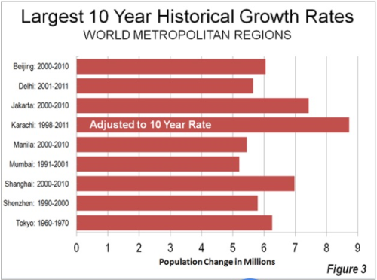
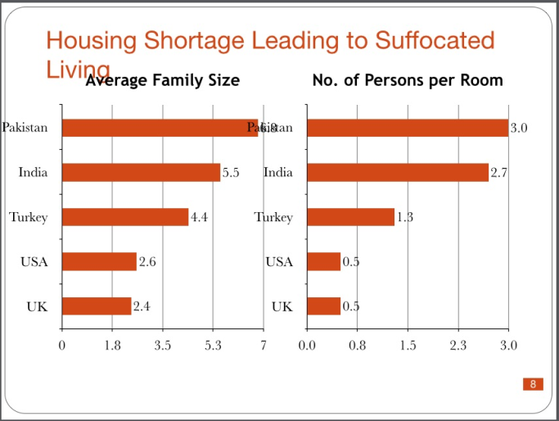
Pakistan: facing an abnormal housing challenge

Slide 25
Self-sustained Communities for Low-Income Housing
Social Infrastructure: Health, Education, Community participation
Physical Infrastructure:
Internal: Roads, Electricity, Sewerage, Water, Playground
External: Roads, Communication, Transport
Economic Infrastructure: Commercial opportunities within the community
Location: Maximum one hour commuting time to job
Energy/Electricity availability and efficiency:
Houses maximizing use of Wind and Solar
If Off-Grid, then communities be equipped with alternate energy sources
  Affordable housing should be more than just a roof over someone’s head — it should create solutions to provide residents with decent housing, and strengthen communities.

Slide 26
CODI: Community Organization Development Institute, Thailand
Self-sustained Communities
CODI was established in 2000
A public sector organization having flexibility in organizational management
Main objective is to strengthen poor community organizations and Community Welfare
Citywide slum upgrading ( “Baan Mankong”)
Poverty Alleviation (Supporting communities in savings, credits, loans and community development plan, etc.)
Assisting in setting up of Community Organization Councils throughout the country
Promoting natural resource management, sustainable agriculture, solving land and housing disputes
To make people as the owners and key actors of the process, not CODI
To coordinate with govt. agencies, NGOs and other civic groups
To promote community-based savings and make use finance as a tool for development

Slide 27
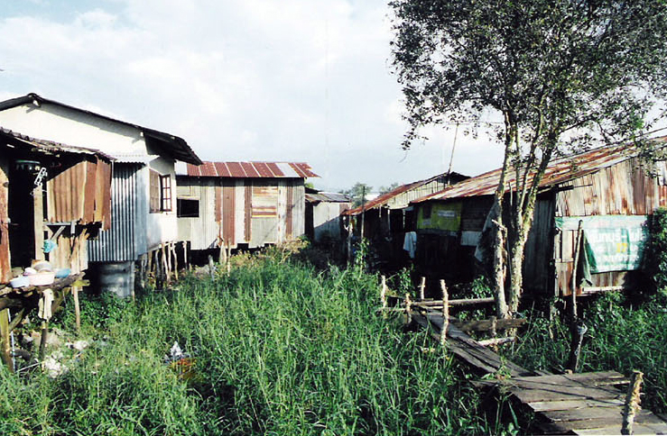
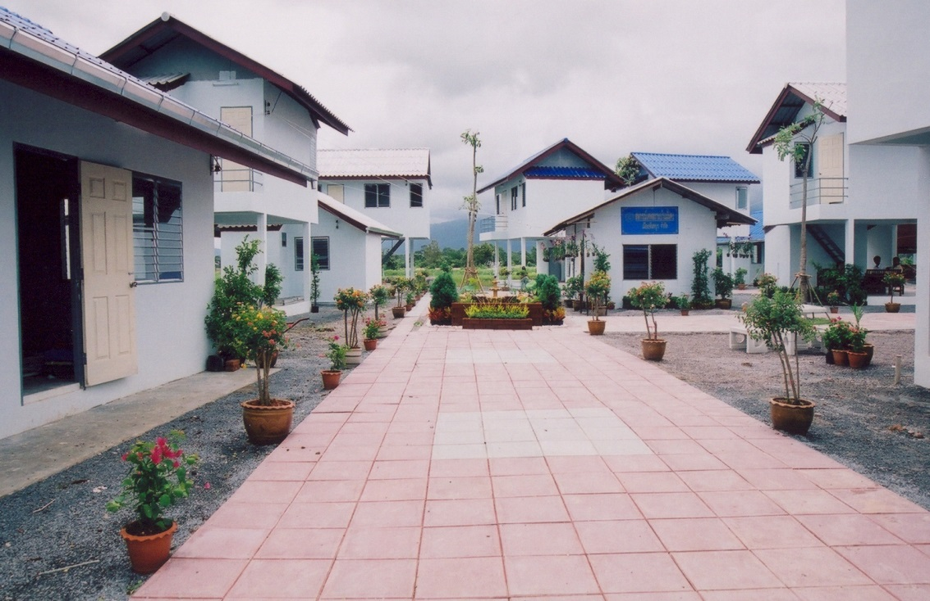
A CODI Project: Before and after
Baan Mankong Chantaburi -
Before and after

Slide 28
Massive urbanization, Poor Urban Planning and decaying Urban Infrastructure
“The infrastructure in our major cities cannot cope with current populations, never mind the predicted growth that continued urbanization will drive. People who live in decent homes are better workers and make the city a thriving place…the challenge is to make life more livable for people who are drawn to cities to find jobs and create that growth. Adequate housing and secure tenure are the basis for living. There are various ways to address long-term affordability of housing, but it has to start with the allocation of land.”
Jonathan Reckford
Chief Executive Officer, Habitat for Humanity International

Slide 29
Issues we know – Answers we need
Generally Political Sloganism
  “Housing for all”,
  “Slums Free Cities”,
  “Maang Raha hai har Insaan-Roti, Kapra, aur Makan” (every individual is demanding for bread, clothe and house), and so on……
In some countries delivery on these slogans is SOME, and in most it is NONE
Every country is facing a common issue of “shelter less poor” with an ever increasing backlog
Recent uprising in the ME has shown that even affluent economies are no exception
Regional successful models are to be shared and indigenized
Multilateral institutions like the World Bank, IFC, Islamic Development Bank, UN-HABITAT to play a pivotal role in promoting housing finance, more so in low-income affordable hosing supply and finance
Platforms like IUHF, AUHF and APUHF to play a pro-active role in serving the mission and be provided much needed support by multilateral agencies.

Slide 30
  ISSUE: Supply of Serviced land at affordable price: Availability of well-connected affordable land remains a main concern in major metropolitan cities of Asia. Affordable land is often not well connected to transportation and other public services.
    ANSWER: External Infrastructure support, in terms of physical and social infrastructure, should be a part of affordable supply of serviced land by the state. (Stakeholders: Govt.., UP, and Land)
  ISSUE: Rising Construction Costs: According to developers across cities in India, their construction cost has increased by 15-20% on yearly basis. LIH is a ‘low-margin’ business, making it less attractive, more so in case of delays.
    ANSWER: Fiscal support in terms of waiver of Sales Tax, Import duties, and other levies.
    (Stakeholders: FAs, CMIs. Dev)
  ISSUE: Lengthy and Complex Approval Process: This impacts construction timelines, project IRR and pricing. The approval fees/costs further adds to the unit price.
    ANSWER: Simplified approval procedures, on-line status, monitoring, waiver or discount of approval fees etc. (Stakeholders: Govt.. , RAs)
Challenges of Affordable Low Income Housing (LIH): Supply Side

Slide 31
Challenges of Affordable LIH: Supply Side- Cont’d
  ISSUE: Developer /Construction finance from financial institutions and capital markets is not easily accessible, due to absence of Developer Finance Regulations in most of the countries. Developers fund the projects through short term in-house funding or through customer finance.
    ANSWER: The Central Banks and Securities Commission to play a proactive role in facilitating market based supply of Long Term Funding for the developers.
    (Stakeholders: RAs, HFIs)
  ISSUE: Absence or insufficient Fiscal Support for LIH projects.
    ANSWER: Business Models of indirect Cross-Subsidies and direct Smart Subsidies to LIH/EWS projects will provide fiscal incentives to developers.
    (Stakeholders: FAs, Govt.., Dev)
  ISSUE: Absence of or insufficient Regulatory Support to LIH/BoP Segments.
    ANSWER: Regulatory incentives in terms of FARs, and wherever permissible, relaxation in Building Codes etc. without compromising on strength. (Stakeholders: RAs)

Slide 32
Challenges of Affordable LIH: Supply Side- Cont’d
  External Infrastructure: Government needs to ensure that Raw Land for LIH Projects is supported by way of external infrastructure in terms of roads, transport, communication, as well as provision of health and education.
  From Raw Land to Serviced Land. (Stakeholders: UP, Municipalities)
  Transport: At the initial stage of LIH Project, public transport be provided.
  (Stakeholders: Municipalities)
  Non-availability of Low-Cost Construction Technologies. The Developers need to be facilitated and supported to import and indigenize Low-Cost Construction Technologies for manufacturing large scale production. (Stakeholders: Dev, Academia)
  Lack of Low-Cost Construction Materials (CMIs): The Govt.. needs to promote local development of low-cost construction materials, and regulate standardization of CMIs for use in LIH projects.
  (Stakeholders: CMIs, Dev, Academia)
  Manufacturing Scale Production: The development projects and the developers are of small size, thus denying the benefits of economies of scales, and use of proven low-cost construction technologies. (Stakeholders: Dev, Academia)

Slide 33
Challenges of Affordable LIH: Demand Side
Mismatch of Monthly Mortgage vs Income Affordability. At lower income levels, propensity to save is low and fragile (Stakeholders: HFIs)
Income assessment issues, informal income, issue of family vs. individual income etc. Income sustainability for long term remains an issue while longer tenors are needed to make mortgages affordable. (Stakeholders: HFIs, RAa)
Poor prefer FRMs, the Lenders prefer ARMs (Stakeholders: HFIs)
Long term liquidity/Funding challenges (Stakeholders: RAs, Long Tern Liquidity Institutions).
Issues of title verification, lien registration costs/fees, lengthy and complex foreclosure process. (Stakeholders: Land, Govt.., Municipalities)
Cost efficient loan delivery and servicing. (Stakeholders: HFIs)
Awareness on mortgage programs and fiscal/regulatory provisions. (Stakeholders: RAs, HFIs)

Slide 34
Challenges of Affordable LIH: Demand Side- Cont’d
Specialized HFCs are needed to finance Low-Income Segment. (Stakeholders: RAs, HFIs)
Commercial banks (CBs) prefer middle and high-income market, low-income housing finance by CBs be placed under priority lending regulations. (Stakeholders: RAs, HFIs)
Housing Microfinance Institutions for BoP/EWSs. (Stakeholders: RAs)
Ensure outreach and financial inclusion to low-income segments, through innovative channels like physical branches, virtual branches, service agents, service on wheels etc. (Stakeholders: RAs, HFIs)
Customers’ lack of awareness on affordability, payment terms, registration & clearance of titles, and available fiscal/regulatory support. (Stakeholders: RAs, HFIs)
Delay in home delivery leads to simultaneous payment of rent and EMI. (Stakeholders: Dev, HFIs)
Provide interest rate subsidy to low-income customers (Stakeholders: Govt., RAs)
Waive or subsidize levies like VAT, stamp duty and registration fees for low-income customers (Stakeholders: FAs, Govt.., HFIs)

Slide 35
SBP to be directed to play a pro-active and effective role in promotion of housing and housing finance, with a target to improve MD:GDP Ratio from 0.5% to 5% within 5 years.
SBP to complete various regulatory initiatives in hand which are essentially needed for successful implementation of housing mission of the Government.
SBP and MoF to ensure that HBFC and Commercial Banks are fully geared to play their due role in providing housing finance to the beneficiaries/clients under APNA Ghar Program Housing specific Prudential Regulations
SBP to ensure fast-track launch of Mortgage Finance Guidelines, Housing Microfinance Regulations and Guidelines, Pakistan Mortgage Refinance Co., Long Term Liquidity Instruments like REITS, Mortgage Backed Securities and Developer Finance Regulations
Regulatory Role of SBP - the Finance-Side Regular

Slide 36
The SECP, as a regulator of the corporate sector, is to play a proactive role in promotion and regulation of housing supply agents like Developer Industry, Construction Materials Industry etc.
SECP to launch Real Estate regulatory initiatives under process like Real-Estate Regulatory Regime, Guidelines on Private-Public Partnership, Guidelines on Property Valuation etc.
Real Estate Regulatory Act (RERA): SECP to announce RERA to ensure discipline, confidence, and enforcement of rules, regulations and policies
Guidelines on Private-Public Partnership, Property Valuation
Role of Building Control Authorities: Relaxed regulations like FARs for Low-Income Housing, Fees etc.
Role of Architects and Civil Engineering Designers
Role of Urban Planners in Housing: Urban planning to cover development of new habitat, social and physical infrastructure etc.
Regulatory Role of SECP and other Stakeholders:
36

Slide 37
Developer Industry to play a key role in production of Low-Income Housing on manufacturing scale production to provide economies of scale.
Developers to maximizing use of role of construction technology and innovation and standardization of construction materials.
The Developer Industry may need to have technology transfer under joint ventures with large scale developers in the region
Developers may also develop and promote low-income housing schemes outside PM’s LIH Program
Academia: To enhance role of universities and academia in finding economical solutions for Low-Cost Housing, the Govt.. to set up Housing and Urban Development Departments of Universities.
The Govt.. to set up Housing Information System (Housing Observatory)
The National Policy on Slums to cover policies and programs on slums rehabilitation and resettlements.
Role of ABAD and Academia

Slide 38
Different stakeholders were under different administrative regimes.
An apex body was not in place to bring them on the table to collectively serve the mission.
In Pakistan, while land and housing is a provincial subject, the Federal Govt. attempted to be the champion of delivery.
Provinces would have accepted Federal Role as enabler and facilitator, but not as deliverer.
One key recommendation of steering committee was to “Set up a lean but strong function at Prime Minister’s Secretariat to execute, monitor and facilitate Apna Ghar Ltd”.
In view of the above factors, the Low-Income Housing Program could not effectively move beyond drawing table.
Defining role of Housing Stakeholders is one thing but getting them in unison on the table is critical for delivery.
Why LIH Program in Pakistan could not deliver its target

Slide 39
Immediate Term Initiatives
Define Low Income Housing in terms of Cost (say upto Rs 15 lac) and area (say 120 Sq.Yrds Plot or 1,000 Sq. Ft covered area) to be accepted by all fiscal and regulatory agencies.
Low-Income Housing(LIH) Policy: Announce the LIH Policy.
Develop Land Bank under Apna Ghar Ltd or under Provincial/Federal Entities.
Fiscal Incentives on Construction Materials: For low-income housing, all Govt. levies (federal or provincial), on three main construction materials i.e., Cement, Steel and Sanitary items should be waived. For example, if ex-factory price of cement is Rs 5,000/ton, it costs Rs 9-10,000/ton to the end user, due to impact of different levies. This will bring the construction cost of LIH from average of 16,00/Sq.Ft around Rs 1,000/Sq.Ft.. For a low-income House of 1,000 Sq.Ft area, the construction cost would be around Rs 10 lac. Even if we compare the import price of Cement, Steel etc. to local market price, the reduction in construction cost is similar.
YOU CAN NOT HELP THE POOR AND TAX THE POOR AT THE SAME TIME

Slide 40
Immediate Term Initiatives
Fiscal Incentives to Developers: Builders/Developers income from low-cost housing projects under low-income housing schemes should not be taxed.
Private-Public Partnership: Execute housing supply program under PPP mode, using Standardized Construction Contracts.
Housing Finance: Ensure that financial sector is geared up to play its role in housing finance. Country needs more Specialized Housing Finance Companies.
LIH to be declared by SBP as priority sector lending.
Long-Term Market Based Funding through instruments like REIRs, MBS, and Mortgage Re-Finance Institutions.
Institutionalized Microhousing Finance Instructions and provision of subsidized long term funding to HMFIs. Role of institutions like Akhuwat, Tameer etc could serve as a model.
Very Low-Cost Housing Supply and Incremental Houisng on models like KKB and Ansaar Management.
Promote Rental Housing under an institutionalized model

Slide 41
Medium Term Initiatives
Currently there is no Rural Housing Finance Program. The Banks and ZTBL to be geared to play a lead role for the purpose
For women empowerment, in houses where the property title is in women’s name or where she is a joint titleholder, the government should further subsidize interest rates.
APNA Ghar Housing schemes may be equipped with Solar and Alternate Energy Solutions, cost of which to be merged with monthly mortgage payments.
National Urban Renewal Program to focus on a strategies which may include smart land use planning, vertical housing/mixed development, development of commercial area, social infrastructure.
Housing Observatory: Pakistan does not have institutional arrangements to compile on on-going basis data/information on housing supply, housing demand, housing finance on the basis of geographical spread and for income segments

Slide 42
Medium Term Initiatives
Housing Finance: While SBP to frame policies for accelerating role of Commercial Banks and HBFC, we need to set up more specialized housing finance companies, at least a few more in the immediate future.
Sponsor a Shelter Foundation for Poor of the Poor under Zakat Foundation/
Banks income from low-income mortgages be taxed @ 10%.
SBP to provide regulatory relaxations to banks offering house financing to low-income segments.
SBP: Enhanced FSV Benefit for housing finance under PM’s low-income housing scheme

Slide 43
Medium Term Initiatives
SECP to launch Real-Estate Regulatory Authority/Regime: Guidelines on Private-Public Partnership, Guidelines on Property Valuation etc.
SECP: Guidelines on Private-Public Partnership Business Models, and development of Standardized PPP Contracts.
Slums Rehabilitation and Resettlement Program under a National Policy.
Relaxed Building Regulations and Codes e.g FARs for Low-Income Housing, Levies/Fees etc.
Labor Colonies and Student Hostels Schemes

Slide 44
Medium Term Initiatives
Role of Academia: Set up Housing and Urban Development Departments at Universities and arrange active coordination between Academia, Construction, Industry Developers, Housing Finance Institutions, Housing & Urban Planners
Fiscal Incentives from Provincial Governments: Exemption from CVT, Stamp Duty and Registration fee on Conveyance deed and mortgage deed, to make house more affordable under the PM’s low-income housing scheme. Sales Tax exemption on construction material used to construct houses, wherever applicable.
For Low-Income Housing Supply provide relaxation on FARs, FSI etc.
For Low-Income Housing, apply business models of Smart-Subsidies and Cross-Subsidies

Slide 45
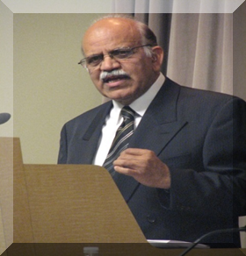
The information has been compiled by Mr. Rizvi from self study and from different sources. He is grateful to all those serving this noble cause in some form or the other.
Zaigham M. Rizvi
zaigham2r@yahoo.com
Secretary General: Asia-Pacific Union for Housing Finance-APUHF (www.apuhf.info)
Served/Serves as Housing Adviser/Consultant to:
World Bank/IFC, UNHABITAT, CMHC-Canada
Affordable Housing Institute-USA (AHI)
Encludes-USA (ShoreBank Int’l )
State Bank of Pakistan (The central bank)

