Slide 1
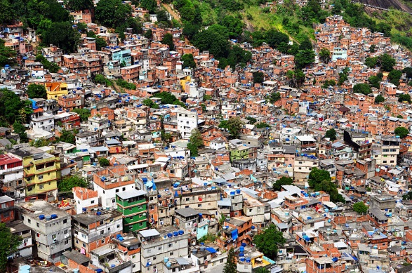
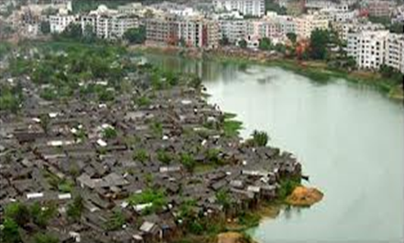
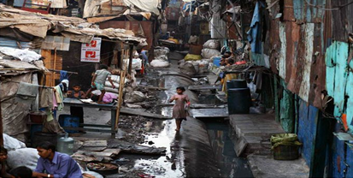
Challenges to Urban Planners: Slums & Urban Congestion
MENA Mortgage and Affordable
Housing Conference
Dubai Oct. 6, 2013
Zaigham M Rizvi

Slide 2
Housing is a ‘Numbers’ game – The Muslim World is no exception!
The Muslim world represents 1 of 4 humans on the planet
Nearly the same ratio in number of countries on globe
Represents 1 of 2 poor on the planet
A great challenge of widening demand/supply gap, adding to the already existing housing backlog
Most of the housing backlog and short supply is in low-income segment of the population
Population growth and urbanization are further compounding the existing urban housing backlog
Rising costs (land, construction, construction materials etc.) are making housing unaffordable for the poor

Slide 3
An Asian Snapshot
Asia-Pacific represents:
1/4th of the Worlds population, and
Nearly ½ of the Worlds Poor
Housing is an essential part of political sloganeering
“Housing for all”;
“Slums Free Cities”
“Maang Raha hai har Insaan-Roti, Kapra, aur Makan” (Every human demands food, clothing and shelter); etc.
In some countries there is SOME delivery but in most there is NONE
Each country in the region has its own geo-socio-economic parameters and all face a common issue of “shelter-less poor”
Regional successful models would be needed for sharing experience and knowledge

Slide 4
Housing Challenges : Asia-Pacific Region
Region represents more than 1/4th of Worlds population and ½ of the poor on the planet
Including China, Asia-Pacific represents ½ of the Worlds population
Region still among the lowest in terms of Mortgage Finance
Average Mortgage Debt to GDP Ratio is 3.3
Region is faced with massive housing shortage
India alone faces an Urban Housing shortage of 27 mn
Nearly entire urban shortage is in Low-Income Category
Persons per Room Density:
India/Pakistan 3.5
EU 1.1
USA 0.5

Slide 5
Factors contributing to Urban Housing Shortage leading to Slums
Massive Urbanization to major metropolitans
Population Growth rate
Depletion of existing stock
Changing size of persons per household (a cultural phenomenon)
Cities growing in circles around inner circles, rather than developing new satellite towns
Need to live close to place of work
Failure in redefining city limits with progressive Master Plans (urban/rural re-zoning)
Land prices force poor into suburbs with no civic amenities, transport, utilities, while Slums in cities provide that at indecent levels

Slide 6
Unplanned Urbanization leads to Slums
Urbanization:
World Urbanization in 2010 – 51%, and by 2030-61%
Cities in developing countries are expected to absorb 95 per cent of urban population growth in the next two decades, increasing the slum population by nearly 500 million between now and 2020.
Slums:
One billion people live in slums. That's one out of seven of us. Unless urgent action is taken, 1.4 billion people will live in slums by 2020
Cities account for some 70 per cent of global GDP and city slums are often economically vibrant; around 85 per cent of all new employment opportunities around the world occur in the informal economy
Slum dwellers grew from 777mn to 850mn during 2000-2010
Positive factor: 227 million moved from slums; doubling MDG goals
World needs 4,000 houses an hour to keep up with demand (UN-Habitat)
Source: Homeless International http://www.homeless-international.org/About-Slums

Slide 8
Urbanization and Slums

Slide 9
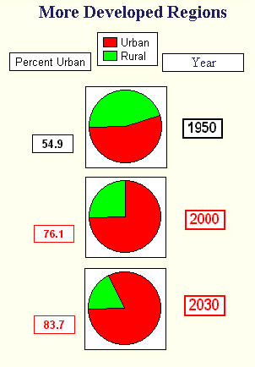
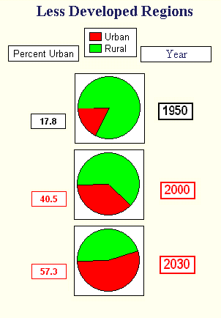
Urbanization of Third World Societies
Source: http://www.faculty.fairfield.edu/faculty/hodgson/Courses/so11/population/urbanization.htm

Slide 10
Slums Prevalence in Asia
Afghanistan: 80% of Kabul’s population (total 5 mn+) live in slums, hill housing or in houses damaged/destroyed during decades of wars
Bangladesh: 2,100 slums. In Dhaka, 2 mn people live either in slums or are without any proper shelter
India: 52,000 slums provide housing to 8 mn people (about 14% of the total urban population)
Pakistan: Karachi alone has between 600-800 slums sheltering 7.6 mn people (1 million households) out of the total city’s population of 15.1 mn people
Sri Lanka: A considerable share of the population of Sri Lanka lives in plantations, slums or shanties
Mongolia: 51% of the population residing in temporary ‘ger’ dwellings
Indonesia: 17.2 mn families live in approximately 10,000 slum areas

Slide 11
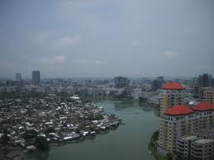
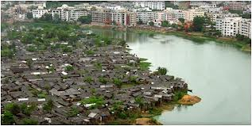
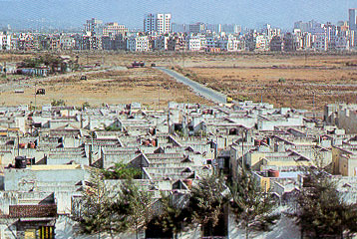
Urban Realities – A glimpse into reality

Slide 12
Characteristics of slums
Poor structural quality and non-durability of housing
Insufficient living areas and indecent living conditions
In Kibera-Nairobi, at times, on a 40 Sq.mt plot, three bedrooms accommodate three families, with an average persons/room density of 6+
Situation is similar in slums of Afghanistan, India, Pakistan, Bangladesh and many other countries of Asia-Pacific
Lack of secure tenure, thus no motivation to make improvement in the shelter
Poor access to water, sanitation, sewerage etc
Diseases like cholera, pneumonia, malaria, HIV and diarrhea are prevalent in many slums
A slum is more than an area of concentrated poverty; it is an area of physical and social deterioration
High crime rates. Slum dwellers are considered to be involved in serious crimes like drug and alcohol abuse, juvenile delinquency, gang violence etc.

Slide 13
Biggest slums around the world
Some of these slums are:
DHARAVI SLUM IN MUMBAI, INDIA
ORANGI TOWN, KARACHI, PAKISTAN
KIBERA SLUM, NAIROBI, AFRICA
Favela (Slums) of RIO DE JANEIRO, BRAZIL
KABUL, AFGHANISTAN
DZERZHINSK, RUSSIA
*Source: http://factspy.net/biggest-and-dirtiest-slums-from-around-the-world/

Slide 14
Dharavi Slum in Mumbai, India
Mumbai slum Dharavi in India is one of the biggest in the world. It used to be the largest slum in Mumbai at one time, but as of 2011, there are four other slums in Mumbai appearing to be larger than Dharavi.
Poverty, alongside increasing crime, unhygienic conditions, pollution, black spots, illegal business, drugs, prostitution, women crime, drug trafficking, child labor and abuse, diseases, AIDS*
Dharavi’s 600,000-1,000,000 persons inhabit 0.67 square miles.
Dharavi household industry exports goods around the world. The total (and largely informal) turnover is estimated to be between US$500-650 million per year. Actual may be more, since a large section of produce is sold to large scale exports.
As of November 2006 there was only one toilet per 1,440 residents in Dharavi
The main trade/handicrafts, and migrants who brought them here in Dharavi, are Pottery (Gujratis), Tannery (Tamils), Garments (UP)
*Source: http://factspy.net/biggest-and-dirtiest-slums-from-around-the-world/

Slide 15
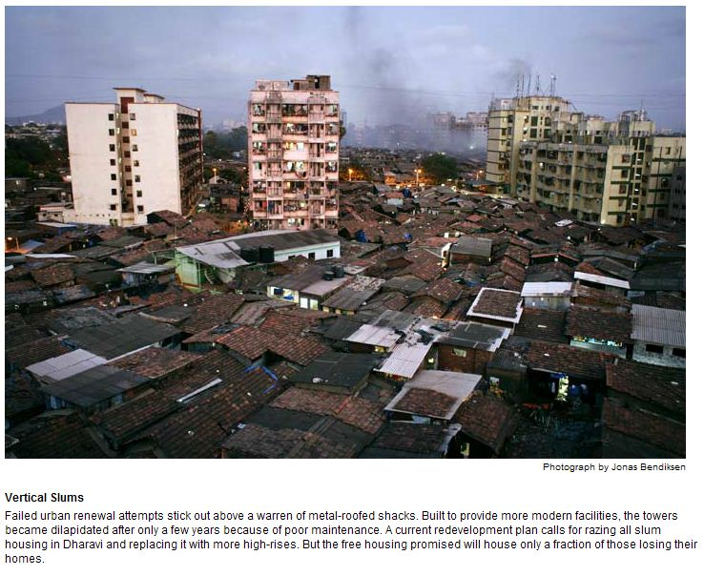
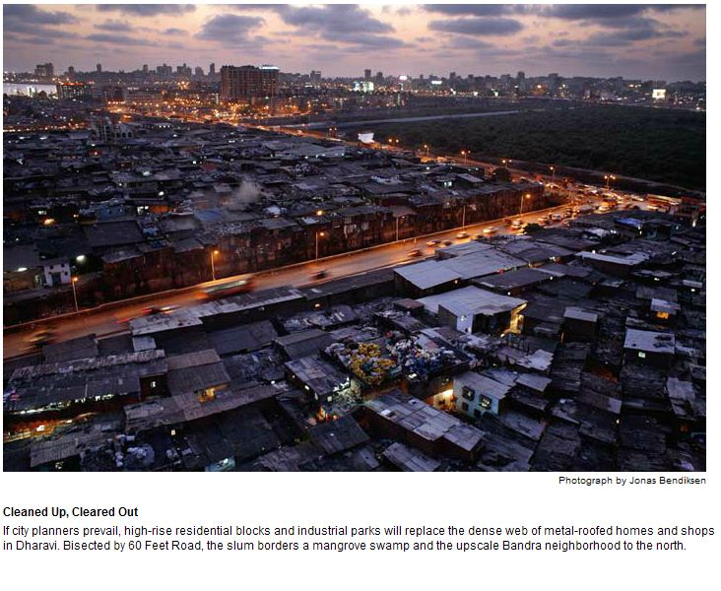
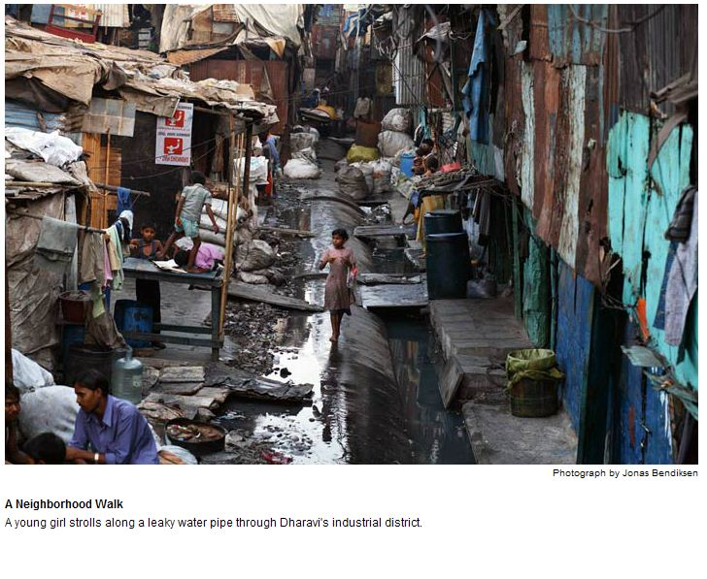
Dharavi-Mumbai

Slide 16
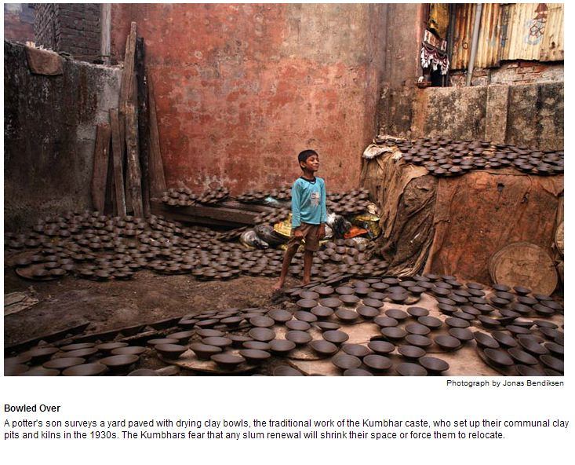
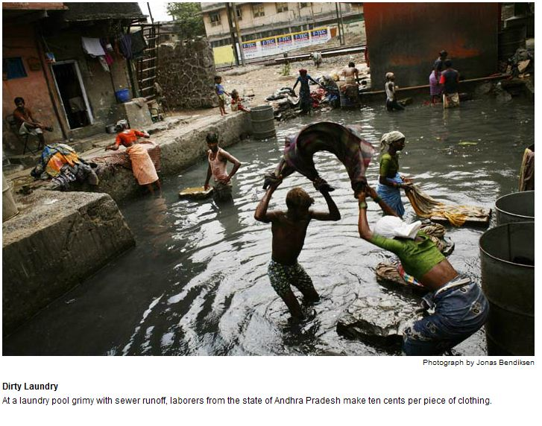
Dharavi - Mumbai

Slide 17
Orangi Town - Karachi Pakistan
Orangi Town is a town in the northwestern part of Karachi, Sindh, Pakistan, spreading over 22 square miles
Orangi town has a population of approximately 2.5 million although government records report 720,000 inhabitants (1998 census). It could be the largest slum in Asia, possibly surpassing Mumbai’s Dharavi in terms of population.
The population began to grow from 1965 onwards as a residential extension to the Sindh Industrial and Trading Estate (SITE)
Orangi also comprises of several new developed middle class areas and housing-societies that are still considered slums for statistical purposes, since they lack basic facilities that are provided to most homes.
Orangi received the world’s attention when local community financed, designed and built their own low-cost sewerage system, since the city municipality refused to allow the sewer system to be connected to the existing city sewers due to Orangi's unauthorized status
(Orangi Pilot Project was initiated by Akhtar Hameed Khan in 1980 )
Source: http://en.wikipedia.org/wiki/Orangi_Town

Slide 18
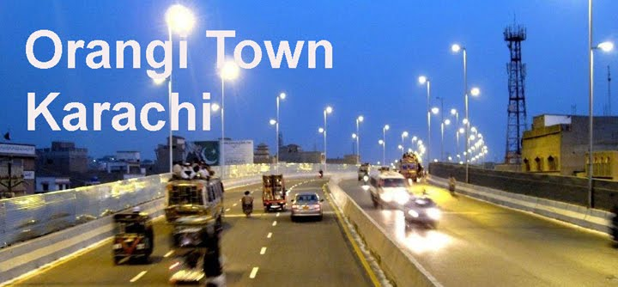
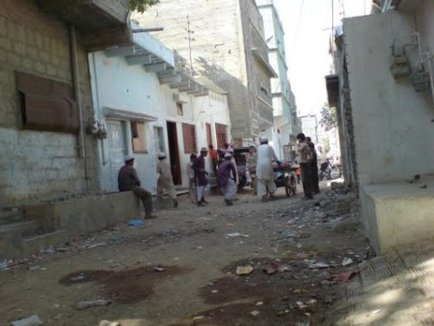
Orangi-Karachi Pakistan
Source:https://www.google.com/#q=sewerage%20system%20of%20Orangi%20Karachi

Slide 19
Kibera Slum - Nairobi, Africa
There are approx. 2.5 million slum dwellers in about 200 settlements representing 60% of Nairobi’s population, occupying just 6% of the land
Kibera houses almost 1 Million people. Kibera is the largest slum in Nairobi, and the second largest urban slum in Africa
Government owns all the land. 10% of “people” are shack owners and these “people” own many other shacks and sub-let them. The rest are tenants.
Until recently, Kibera had no water. Only about 20% of Kibera has electricity
In Kibera there are no government clinics or hospitals. The providers are the charitable organizations. People are dying from cholera even in the 21st century
In most of Kibera there are no toilet facilities. One latrine (pit in the ground) is shared by 50 shacks. At times 2,000 people share these community toilets
Alcohol (Changaa-50% alcohol), cheap drugs and glue sniffing is common.
Kibera is near the industrial area of Nairobi where up to 50% of the available workforce are employed (usually in unskilled jobs). However, there is still an unemployment rate of 50%. That is why the training and teaching of skills is very important.
Watch this video on YouTube “Famous and Rich- in the slums-2011”
Source: http://www.kibera.org.uk/Facts.html

Slide 20
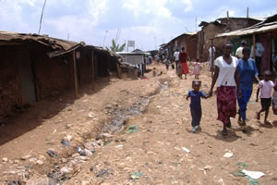
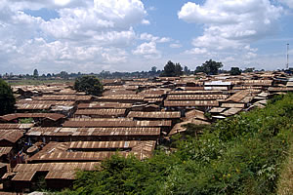
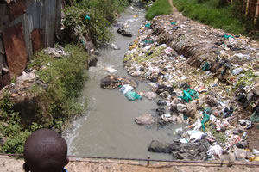
Kibera Slum, Nairobi, Africa

Slide 21
Rio de Janeiro, Brazil
A favela is the term for a shanty town in Brazil, most often within urban areas.
Unable to find a place to live, many rural/urban migrants end up in a favela.
Census data released in December 2011 by the IBGE (Brazilian Institute of Geography and Statistics) shows that in 2010, about 6 percent of the population lived in slums in Brazil.
Most of the current favelas began in the 70s, due to a construction boom in the more affluent districts of Rio de Janeiro. It initiated an exodus of workers from rural poorer states in Brazil
Favelas are built around the edge of the main city; thus expanding city in circles. The cocaine trade has affected Brazil and in turn its favelas, which tend to be ruled by drug lords.
It is said that until recently, there were parts of these favelas where police could not enter for more than 10 years, and now with the Olympics coming up in 2016, they are trying to clean these up.
Source: Wikipedia http://en.wikipedia.org/wiki/Favela

Slide 22
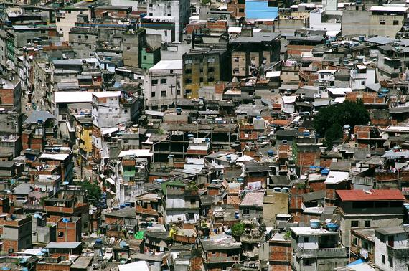
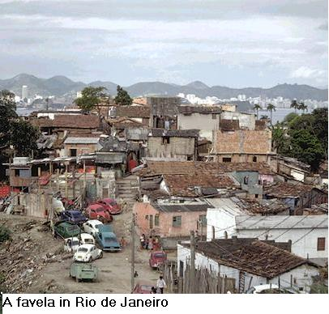
Rio de Janeiro, Brazil

Slide 23
Kabul - Afghanistan
Massive urbanization into 4 major cities, mostly to Kabul for economic and other reasons
51% of total urban population of Afghanistan is in Kabul with a large and growing young population, seeking housing
Of the total population of 31 mn in Afghanistan, Kabul has 5 mn
Challenge of Returnee Immigrants from Pakistan and Iran, mostly resettling in Kabul
Growing informal settlements including Informal Hill Housing on mountains surrounding Kabul
A large part of existing housing is in need of an upgrade
Kabul’s informal settlements shelter 80% of the population and cover 69% of the residential land in Kabul

Slide 24
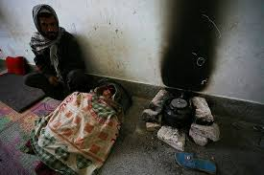
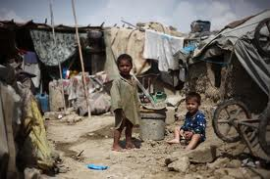
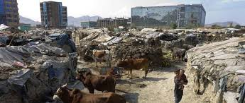
Afghanistan: Slums of Kabul

Slide 25
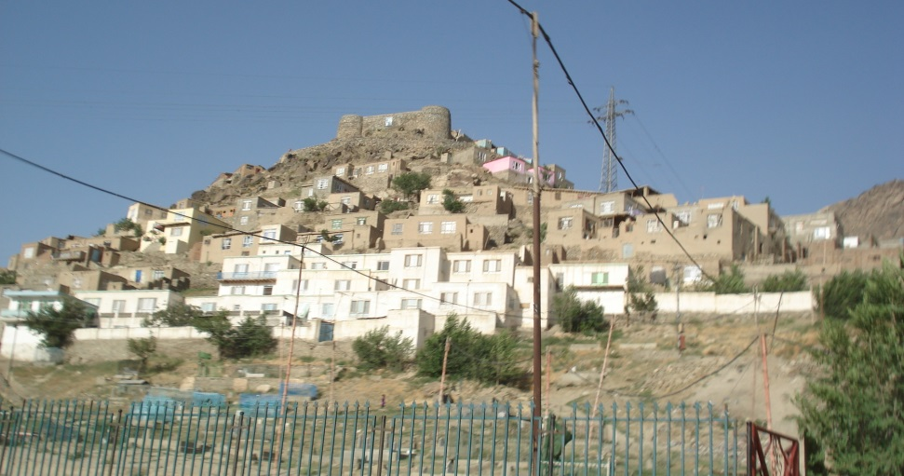
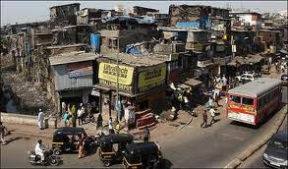
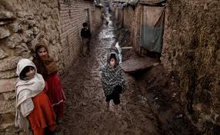
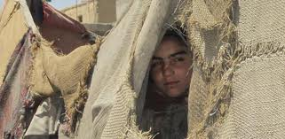
Afghanistan: Slums of Kabul

Slide 26
Challenges to Urban Planners on Slums Rehabilitation and Resettlement
Rapid Urbanization, prior backlog, and affordability challenges call for innovative approaches to urban planning
Current trend of cities expanding in circles results in further densification of cities, that has to be addressed
Urban planners to recognize that massive urbanization in major metropolitans adversely impacts Social, Physical and Economic Infrastructure, and thus needs to be accounted for in Urban Planning
Need for generating demographic data in finer details for use by Planners.
Urban Planners need to find alternative options for slums prevalence, expansion and inefficient use of land
Planners need to develop new neighborhood/satellite towns equipped with physical, social infrastructure, transport etc.
Wisdom sharing and on-going coordination between urban planners, housing, developers and academia is needed
Business models of pubic-private partnership for viable and sustainable plans and projects

Slide 27
Possible Answers
Urban Planners to work on:
Slums improvement and up-gradation Programs.
Slums Resettlement Programs.
Incremental Housing business model
Plan and develop new settlements in suburbs equipped with physical, social and economic infrastructure.
Linking urban periphery with urban centers of commerce and business with suitable mode of communications.
Business Models of Private-Public Partnership.
Compile and process data on urban-rural migration and measures to regulate/control urbanization (Model of China).

Slide 28
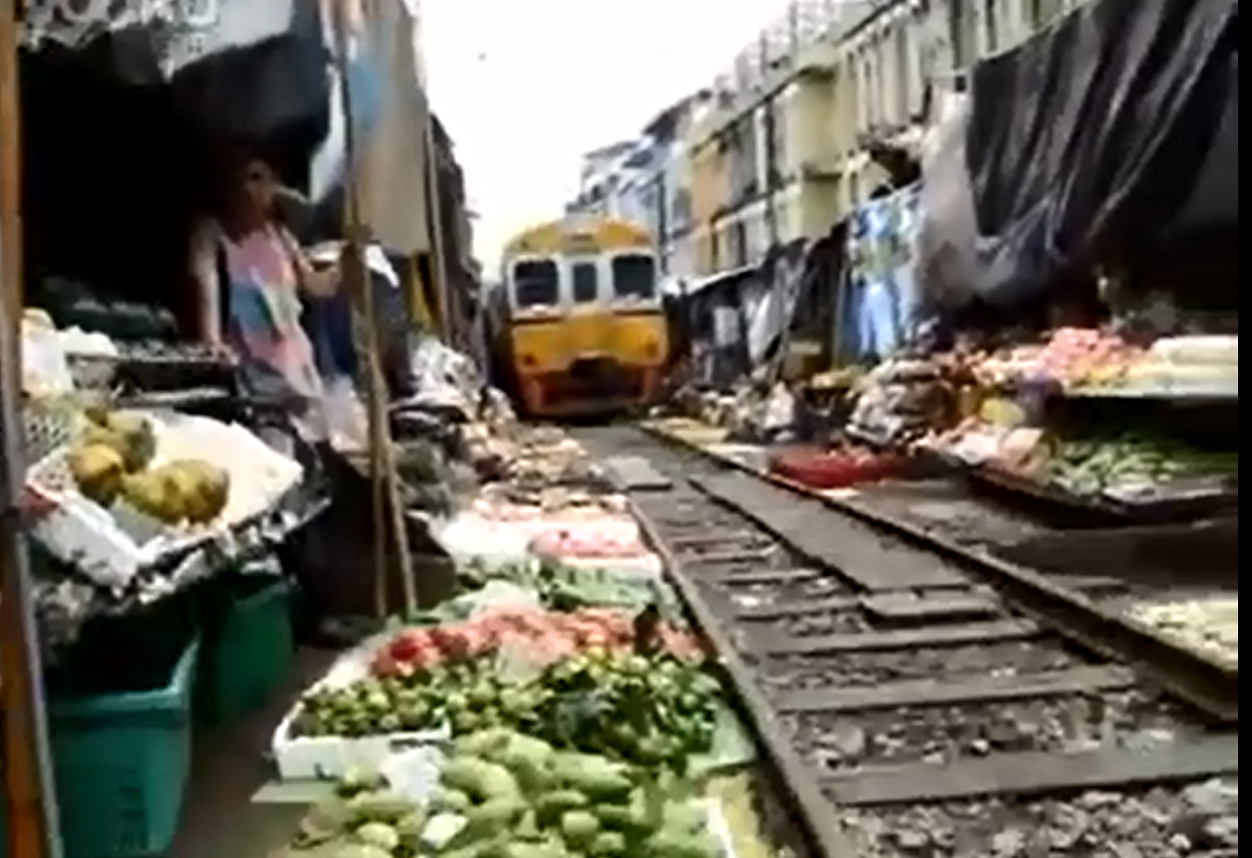
Urban congestion and courage of Urbans
Railway Train-track Veggie Market
http://www.youtube.com/watch?v=MENjFkEAj9g

Slide 29
Thank you
Zaigham M. Rizvi
zaigham2r@yahoo.com
Expert Consultant Housing: The World Bank
Senior Adviser Housing: ShoreBank Int’l USA
Secretary General: Asia-Pacific Union for Housing Finance-APUHF (www.apuhf.info)
This document is prepared by Mr. Zaigham Mahmood Rizvi for the sole purpose of providing a presentation to the MENA Mortgage and Affordable Housing Conference Dubai Oct. 6, 2013
The information contained in this document has been compiled by Mr. Rizvi from self study and from different sources. He is grateful to all those serving this noble cause in some form or the other.

