Slide 1
Data & Statistics and Consumer Related Issues

Slide 2
Importance of Data
Data and Information are the vital inputs in framing of fiscal, monetary, regulatory policies and business strategies. Data helps in evolving suitable system on sound and sustainable basis with transparency and protection of public interest at large.
“You can have data without information, but you cannot have information without data - Daniel Keys Moran”

Slide 3
Collection & Processing of Data
Data Collection process should be
In Structured Format
More Simplistic and informative
As current as possible
Faster
Safer
Reliable
Data Processing System designs should be
Able to deliver acceptable throughput to stake holders with minimum time lag
Reliable
Expandable without major redesign
Manageable
Well documented

Slide 4
Data & NHB
Different Types of Data Collected by NHB
Sources of collection of such data
Periodicity of data collected
Need for data collection by NHB
Use of data by NHB

Slide 5
Types of Data Collected
Individual Housing Loan – Sanctioned/Disbursed/Outstanding/GNPA/NNPA/Size-wise/Income-wise/State-wise
Builder Loan – Disbursement/Outstanding/GNPA/NNPA
Non-Housing Loan - Disbursement/Outstanding/GNPA/NNPA
Financial & Management profile of HFCs- NOF, Assets, Liabilities, Financial Ratios, Shareholding patterns, Promoter details etc.
On housing shortages
On Central/State sponsored schemes
On various subsidy scheme run by Government in association with NHB
On financial assistance extended by NHB under its various scheme to PLIs.

Slide 6
Sources of Data for NHB
Housing Finance Companies
Banks
Census of India
Reports published by concerned Ministries
Report of Research Agencies/Institutions
Report published by NAREDCO/CREDAI etc.
Report of surveys through reputed agencies like NCAER etc.

Slide 7
Periodicity
Monthly
Quarterly
Half yearly
Annual
As & when required

Slide 8
Need for Data Collection
To publish the Trend & Progress Report on housing.
To determine policy related to housing and give directions to HFCs.
To issue guidelines to HFIs to ensure their growth on sound lines.
To provide advisory services to the Central and State Governments, local authorities and other agencies connected with housing .
To extend financial assistance to HFCs and Banks and other financial institutions.
To publish Residential Property Price Index.

Slide 9
Use of Collected Data
Published Trend and Progress Report on Housing in India since 1989, annually
Issued directions to HFCs on- NOF requirement, LTV norms, Provisioning requirement, Risk weights, Investment, Credit exposure , disclosure norms etc.
Issued Policy Circular & Guidelines to HFCs on - ALM, Direct Selling Agent, KYC and FPC, Prepayment Penalty, Most Important Terms and Conditions, Caution Advice etc.
Assisted in the preparation of National and State level Housing and Habitat Policies
Contd.

Slide 10
Suggested changes in fiscal Policies to benefit home owners, housing loan providers, developers etc. with a view to encourage home ownership /rental housing.
Approached State Government/s for rationalization of stamp duties, registration charges etc.
Solicited budgetary support and allocations towards affordable Housing Solutions.
Contd.

Slide 11
Taking steps to promote Secondary Mortgage Market and its smooth operation for garnering resources for investment in housing
Steps for consumer Protection by bringing more and more transparency in the Housing Finance Market
Assisted in establishment of an enabling legal framework for strengthening the Housing Market - Introduction of SARFEASI for speedy recovery, Standardization and simplification of Housing loan documentation, Protection of Consumers and borrowers interest, Standardization of documentation etc.
Contd.

Slide 12
Creation of transparent and responsive decision making Housing and Housing Finance Market through Indexing of movement in Residential Properties – NHB Residex
Disseminating information on housing and housing related matters through housing information portal
Strengthening the housing finance system by promoting risk mitigation techniques

Slide 13
Trend in outstanding housing loans

Slide 14
Trend in registration of HFCs

Slide 15
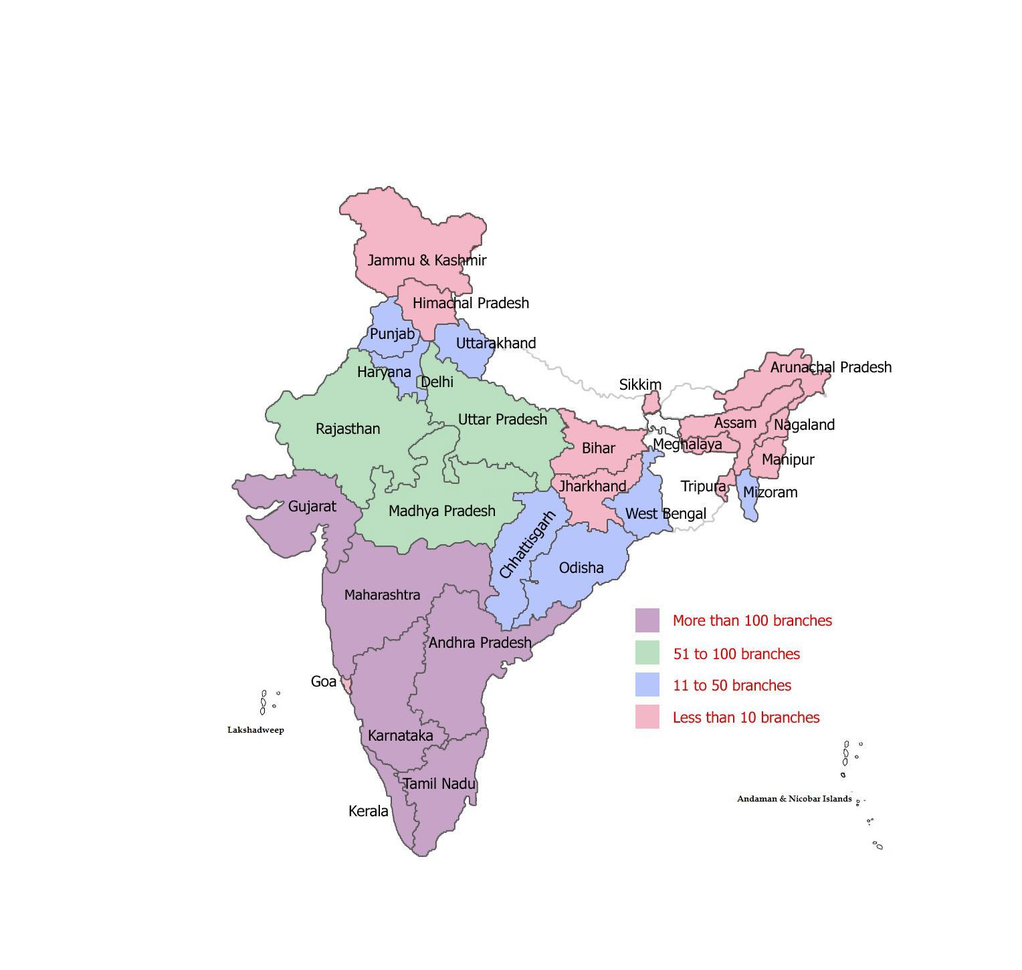
Trend in spread of branches of HFCs

Slide 16
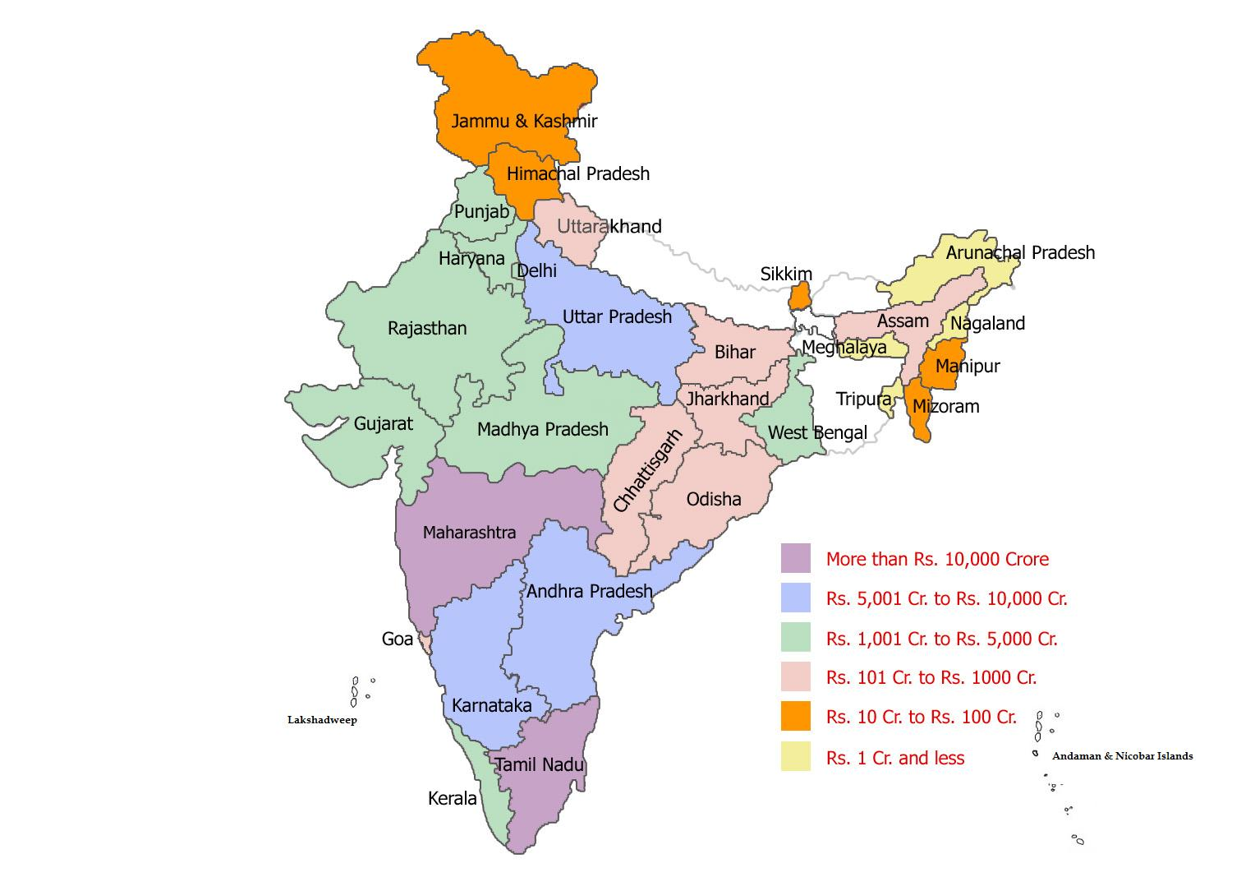
Housing Loan disbursements trend in HFCs

Slide 17
Customer Centric - Adoption of Codes
Major lenders of housing finance in India are banks and HFCs;
Banks and HFCs are regulated by RBI and NHB, respectively;
Banks have got
Voluntary Code (VC) set by the Banking Codes and Standards Board of India;
Fair Practices Code (FPC);
Citizens’ Charter (CC) for Public Sector Banks.
HFCs have got
Fair Practices Code (FPC);
Most Important Terms & Conditions (MITC)

Slide 18
Grievance Redressal Processes
Fair Practices Code set out the procedure for Grievance Redressal Mechanism;
Grievance Redressal Process have got prescribed time limit for redressal of Grievances
Every branch of a bank/HFC will have the Complaint registering process
Different Authorities have been specified by a Bank/HFC for escalation of grievance to higher authorities
Further, Customer can escalate the grievance to -
Banking Ombudsman for Banks; and
National Housing Bank for HFCs.

Slide 19
Thank You

