Slide 1
Housing Challenges and Role of Construction Industry: Asian Scenario
Presentation By:
Zaigham M. Rizvi
9th Build Asia Conference on
Construction Industry and Economy
November 19th, 2013 Expo Center Karachi

Slide 2
Issues we Know, Answers we Need
Pro-Poor Affordable Housing
is a
Global Issue with Country specific Challenges
and needs
Shared Wisdom and Indigenized Answers

Slide 3
Housing Challenges in Asia-Pacific region
Region represents more than 1/4th of Worlds population and ½ of the poor on the planet
Including China, Asia-Pacific represents ½ of the Worlds population
Region still among the lowest in terms of Mortgage Finance
  Average Mortgage Debt to GDP Ratio 3.3
Region is faced with massive housing shortage
  India alone faces an Urban Housing shortage of 27 mn
Nearly entire urban shortage is in Low-Income Category
Persons per Room Density:
  India/Pakistan is 3.5;
  EU is 1.1; and
  USA is 0.5

Slide 4
Housing is a ‘Numbers’ game –
Muslim World is no exception!
The Muslim world represents 1 of 4 humans on the planet
Nearly the same share in number of countries
Represents 1 of 2 poor on the planet
Facing acute challenge of widening demand/supply gap and rising housing backlog
Most of the housing backlog and short supply is in low-income segment of the population
Population growth and urbanization are further compounding the existing huge backlog
Rising costs (land, construction, construction materials) are making housing unaffordable for the poor

Slide 5
Housing Supply Challenge –
Muslim World is no exception!
IDB/IRTI recent study suggests housing needs of the Muslim World at 8 mn units/year, nearly all in Low-Income Segment
  The estimate needs further analysis and breakdown
    MENA 3.2 mn;
    Asia 2.7 mn; and
    Africa/others 2.3 mn.
Urban population likely to rise from 1/4th to 1/3rd of total
Rapid Urbanization a major issue in low income housing
Need for new housing of 8 mn due to population growth is based on 5-5.5/HH and population growth at 2.5%
Urbanization and bulging family size further increases the year-on-year housing needs in major metropolitans
Supply is 30-40% on new demand for housing

Slide 6
Slums Prevalence in Asia
Afghanistan: 80% of Kabul’s population (2.44 mn) live in slums or damaged/destroyed housing
Bangladesh: 2,100 slums. In Dhaka, 2 mn people live either in slums or are without any proper shelter
India: 52,000 slums providing housing to 8 mn people (about 14% of the total urban population)
Pakistan: Karachi alone has between 600-800 slums sheltering 7.6 mn people (1 million households) out of the total city’s population of 15.1 mn people
Sri Lanka: A considerable share of the population of Sri Lanka lives in plantations, slums or shanties
Mongolia: 51% of the population residing in temporary ‘ger’ dwellings
Indonesia: 17.2 mn families live in approximately 10,000 slum areas

Slide 7
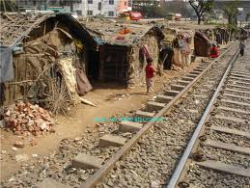
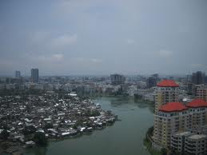
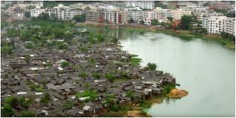
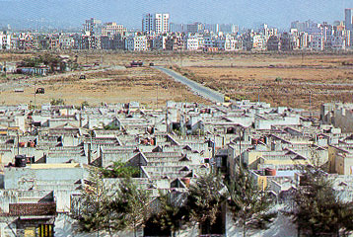
Urban Realities – A glimpse into reality

Slide 8
Linking Urban Planning with development of affordable and sustainable neighborhoods
Rapid Urbanization, prior backlog, and affordability challenges call for innovative approaches to urban planning.
Current trend of cities expanding in circles around circles , resulting in densification of cities is to be addressed,
Urban Planners need to find alternates options for slums prevalence, expansion and inefficient use of land.
Planners need to develop new neighborhood/satellite towns equipped with physical, social infrastructure, transport etc.
Wisdom sharing and on-going coordination between urban planners, housing, developers and academia.
Business Model of Pubic-Private partnership for viable and sustainable plans and projects

Slide 9
Affordability Defined
Housing units supplied in the “ Market Housing” are affordable, since that “Income Segment” can afford them. So supply matches demand, and at times exceeds.
So housing units in this segment are affordable. The One Billion $ house in Mumbai, was affordable, since Mr. Ambani could afford that.
Affordability is an issue of Low-Income Segment, where housing backlog and demand is massive, and market forces/developers do not come forward with supply.
Affordability issue arises where low-income does not have an affordability match with high-cost of housing.

Slide 10
Affordability Defined as per market practice
Income Affordability :
When 35-40% of the disposable income could match the equated mortgage payments (EMIs)
Loan to value (LTV) ratios used are 80:20
Loan Tenors are long term of 20-30 years
Cost Affordability:
The cost of the housing unit is equal to 60-70 times ( 5-6 years) of monthly income and EMI is determined for a long term loan
The above market norms are used for low and lower-middle income segments of population and do not apply in case of Housing Microfinance (Bottom of Pyramid), where an entirely different business model is used

Slide 11
Market Segmentation for Affordability
Housing Continuum covers:
Market Housing:
Represents High and Middle Income Market Segments
Market Segment which is addressed by market forces on its own, without any need for state-intervention or support
Supply is there to meet the demand
Social Housing:
Represents Lower-Middle and Low Income Market
Market Segment which needs State-Intervention and support to facilitate affordable housing supply, alongside an enabling role for the Stake-holders
Bottom of Pyramid: They are candidates for Housing Microfinance and needs special delivery models and direct/indirect subsidies from the state

Slide 12
Role of the Developer Industry and the Construction Industry

Slide 13
Players of Construction sectors
Developers/contractors
Designers
Construction material Industry (CMI)
Labor/employment
Financial Institutions/Banks
Capital Market (REITs, MBS, Sukuk etc.)
Regulatory agencies/Fiscal Authorities
Trade Associations
Above all, the Federal and Provincial Governments

Slide 14
Contribution to Construction Material Industries (CMIs)
In developed world the real estate sector contributes to the growth and development of 71 CMIs. Contribution to GDP is 7-10%.
In developing world, its contribution spreads over about 42 CMIs. Contribution to GDP is 3-6%.
The main industries are steel, cement, wood, electrical, ceramics etc.

Slide 15
Construction sectors covers the following
Real Sector: Residential and Commercial
Industrial and Infrastructure
In the developed world, the real estate sector contributes to the growth and development of 71 CMIs
  Contribution to GDP is 7-10%.
In the developing world, its contribution spreads over about 42 CMIs
  Contribution to GDP is 3-6%.
Low income housing:
  Is a challenge to the developer industry; and
  Needs to be addressed in a professional and commercially sustainable manner

Slide 16
Role of construction industries in select countries
India
Thailand ?
UK
China ?
Pakistan ?
Need to cove these countries as well

Slide 17
Construction Industry - INDIA
India is currently the second fastest growing economy in the world.
It is playing a vital role in overall economic growth, growing at 20% pa over past five years, and contribution 8% to GDP.
It is keeping pace with technological advancements and innovations in construction techniques and materials.
Emphasis on project design and management.

Slide 18
India continued
Emphasis on façade design in terms of Energy Efficiency, Sustainability, Strength, increased acoustics, alternate energy etc.
Developer Associations:
  CREDAI:
  (It is the apex body having membership of 200 associations and 6,000 developers)
  BAI: Builders Association of India
  (It is association of designers, architectures with of direct membership 13,000 contractors and indirect membership of 50,000 through various regional Associations affiliated to BAI)
  Construction Industry Development Council of India

Slide 19
India continued
Construction sector is second largest after agriculture.
Re.1 invested in construction causes Re. 0.8 contribution to GDP (Agriculture 0.2 and manufacturing 0.14).
Investment in construction sector causes 4.7 times increase in income and 7.8 times in employment as compared to agriculture and manufacturing.
Investment of Rs.10 million in construction generates employments of 22,000 unskilled man-days, 23,000 semi-skilled man-days and 9,000 technical man-days.
27 large scale developers are engaged in low cost housing projects all over India

Slide 20
Construction Industry - UK
Construction sector is 10% of country’s GDP, employs 1.5 million people.
Average new homes 150,000 per year at average price £100,000 (£1.5 billion market).
Share in construction sector-
  Housing 38%
  Infrastructure 9%
  Industrial 5%
  Commercial 18%
  CMI etc 30%

Slide 21
A need to share common wisdom and experience
Issues are common, answers are different and not shared
  Experiences are varied but rarely documented
Essential to promote Networking and Joint Ventures
An immediate need to share on regional and global basis :
  Low Cost Construction Technologies
  Low Cost Construction Material
  Builders with technical and financial muscle
  Long Term Funding, issues and answers
  Product innovation and experiences
  Policy Initiatives and Programs in different countries
  Provision of Affordable Serviced Land, and Land Banking
  Housing Micro-Finance Institutions
  Use and Abuse of Subsidies (Smart Subsidies vs. Charities)

Slide 22
Some Platforms for sharing wisdom
International Union for Housing Finance
Asia-Pacific Union for Housing Finance (www.apuhf.info)
African Union for Housing Finance www.auhf.co.za
Centre for Affordable Housing Africa
(Kecia@housingfinanceafrica.org)
HOFINET.org
Housing Finance International (www.housingfinance.org)
Center for Affordable Settlements and Housing (In Progress)
Affordable Housing Institute (www.affordablehousinginstitute.org)

Slide 23
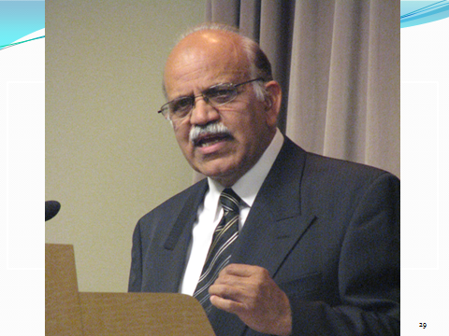
Mr. Zaigham Mahmood Rizvi
zaigham2r@yahoo.com
Expert Consultant Housing and Housing Finance
Ex Consultant World Bank and Adviser Housing: State Bank of Pakistan
Secretary General: Asia-Pacific Union for Housing Finance-APUHF www.apuhf.info

