Slide 1
Key Criteria for Viable, Sustainable, and Affordable Housing Programs and Projects
Presented by
Zaigham M. Rizvi
Presentation made to Housing Workshop of ABAD, Karachi
January 23, 2013

Slide 2
Issues to be addressed
Challenges of Pro-Poor Affordable Housing
Stakeholders in Pro-Poor Housing Supply
Linking Urban Planning with development of affordable and sustainable neighborhoods
Role of Developer/Construction Industry in Affordable Housing Supply
Definition of Affordability in Market Housing and Social Housing
How to address Homebuyers expectations for Affordable Housing

Slide 3
Issues we Know, Answers we Need
Pro-Poor Affordable Housing is a Global Issue …
with Country specific Challenges …
that needs Shared Wisdom
and Indigenized Answers!

Slide 4
Housing is a ‘Numbers’ game –
Muslim World is no exception!
The Muslim world represents 1 of 4 humans on the planet
Nearly the same share in number of countries
Represents 1 of 2 poor on the planet
An acute challenge of widening demand/supply gap and rising housing backlog
Most of the housing backlog and short supply is in low-income segment of the population
Population growth and urbanization are further compounding the existing huge backlog
Rising costs (land, construction, construction materials) are making housing unaffordable for the poor

Slide 5
Housing Supply Challenge –
Figures speak for themselves
IDB study suggests housing needs of the Muslim World at 8 mn units. This estimate needs further analysis and breakdown:
  MENA 3.2 mn;
  Asia 2.7 mn; and
  Africa/others 2.3 mn.
Urban population likely to rise from 1/4th to 1/3rd of the population
Rapid Urbanization a major issue in low income housing
Need for new housing due to generic population growth is estimated at 4 to 5 mn units/year
Urbanization and population growth further increases the year-on-year housing needs in major metropolitans
Supply is 30-40% on new demand for housing

Slide 6
Housing Finance Challenges
As most of housing shortage is in low income segment, poor need empowerment through housing finance
Institutional Housing Finance is either non-existent or in infancy stages in most of the Muslim World (Afghanistan and some African Countries)
Slightly advanced in some others (Malaysia, Turkey, Egypt, Morocco, Indonesia, Pakistan and Saudi Arabia)
Regulatory Framework needs strengthening
Additional challenges include:
  Role and responsibilities of Specialized Housing Finance Institutions (HFIs) and Commercial Banks (CBs)
  Long Term Liquidity Facility Institutions and Instruments
  Low-Cost Housing Supply Agents and Technologies

Slide 7
Sharia-Compatible Housing Finance
An issue of faith e.g. Afghanistan with nearly 100% Muslim Population
Also an issue of Financial Inclusion. Even if conventional finance is available, Faith-Based clients do not avail it
Standardization and Diversification of RE/Housing Products on Asset Side and Liability Side
Islamic REITS and MBS Products
Role of Islamic Banks and Islamic Windows of Conventional Banks
Need for Research and Development Centers

Slide 8
An Asian Snapshot
Asia-Pacific represents:
  1/4th of the Worlds population, and
  Nearly ½ of the Worlds Poor
Housing is an essential part of political sloganizm
  “Housing for all”;
  “Slum Free Cities”
  “Maang Raha hai har Insaan-Roti, Kapra, aur Makan” (Every human demands food, clothing and shelter); etc.
In some countries there is SOME delivery but in most there is NONE
Each country in the region has its own geo-socio- economic parameters and all face a common issue of “shelter less poor”
  Regional successful models would be needed for sharing experience and knowledge

Slide 9
Housing Challenges in Asia-Pacific region
Region represents more than 1/4th of Worlds population and ½ of the poor on the planet
Including China, Asia-Pacific represents ½ of the Worlds population
Region still among the lowest in terms of Mortgage Finance
  Average Mortgage Debt to GDP Ratio 3.3
Region is faced with massive housing shortage
  India alone faces an Urban Housing shortage of 27 mn
Nearly entire urban shortage is in Low-Income Category
Persons per Room Density:
  India/Pakistan is 3.5;
  EU is 1.1; and
  USA is 0.5

Slide 10
Slums Prevalence in Asia
Afghanistan: 80% of Kabul’s population (2.44 mn) live in slums or damaged/destroyed housing
Bangladesh: 2,100 slums. In Dhaka, 2 mn people live either in slums or are without any proper shelter
India: 52,000 slums provide housing to 8 mn people (about 14% of the total urban population)
Pakistan: Karachi alone has between 600-800 slums sheltering 7.6 mn people (1 million households) out of the total city’s population of 15.1 mn people
Sri Lanka: A considerable share of the population of Sri Lanka lives in plantations, slums or shanties
Mongolia: 51% of the population residing in temporary ‘ger’ dwellings
Indonesia: 17.2 mn families live in approximately 10,000 slum areas

Slide 11
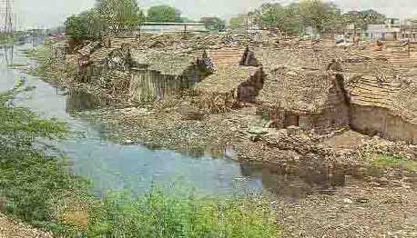
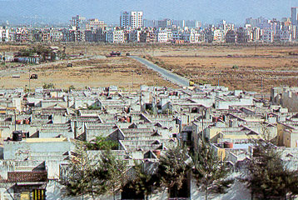
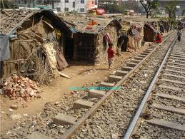
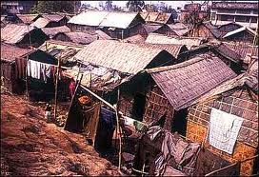
Urban Realities – A glimpse into reality

Slide 12
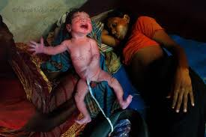
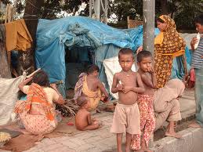
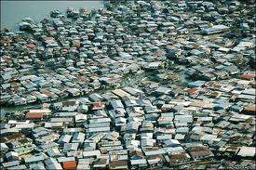
Urban Realities – A glimpse into reality Cont’d

Slide 13
Linking Urban Planning with development of affordable and sustainable neighborhoods
Rapid Urbanization, prior backlog, and affordability challenges call for innovative approaches to urban planning
Current trend of cities expanding in circles around circles results in further densification of cities that is not being addressed
Urban Planners need to find alternates options for slums prevalence, expansion and inefficient use of land
Planners need to develop new neighborhood/satellite towns equipped with physical, social infrastructure, transport etc.
Wisdom sharing and on-going coordination between urban planners, housing, developers and academia is needed
Business Model of Pubic-Private partnership for viable and sustainable plans and projects

Slide 14
Affordability Defined
Housing units currently being supplied in the residential “Housing Market” are considered ‘affordable’ since they are catered to the income segment that can afford them
  Hence, supply matches demand and at times may exceed it as well
  The One Billion $ house in Mumbai, was affordable, since Mr. Ambani could afford it
Affordability is an issue of Low-Income Segment, where housing backlog and demand is massive, and market forces/developers do not come forward with supply
Affordability issue arises where there is an acute mismatch between the low-income and the high-cost of housing

Slide 15
Affordability Defined as per market practice
Income Affordability :
When 35-40% of the disposable income can match the equated mortgage payments (EMIs)
Loan to value (LTV) ratios used are typically 80:20
Loan Tenors are long term of 20-30 years
Cost Affordability:
The cost of a housing unit is equal to 60-70 times (5-6 years) of monthly income and EMI is determined for long term loans
The above market norms are used for low and lower-middle income segments of population and do not apply in case of Housing Microfinance (the bottom of the pyramid), where an entirely different business model is used

Slide 16
Market Segmentation for Affordability
Housing Continuum covers:
Market Housing:
Represents High and Middle Income Market Segments
Market Segment is addressed by market forces on its own without any need for state-intervention or support
Supply is there to meet the demand
Social Housing:
Represents Lower-Middle and Low-Income Market
Market Segment needs State intervention/support to facilitate affordable housing supply and an enabling role for Stakeholders
Bottom of Pyramid: They are candidates for Housing Microfinance and need special delivery models and direct/indirect subsidies from the State

Slide 17
Affordability Issues
Financial Sector Issues
Project Finance
Individual Loans
Supply of Funds
Cost of Funds
Whether market based solution?
Real Sector Issues
Land Supply
Cost of Land
Land market functioning
Infrastructure provision
Construction & Delivery
Role of Public & Private Sectors
Subsidized Housing Credit
Subsidized House Prices

Slide 18
Definition of social housing
Lower-middle and lower income
Difficult to access finance due to low income levels, informal income sources, and inability to provide collateral
Bottom of the pyramid
No access to finance due to low income levels, informal income sources and inability to provide collateral
Supply: Market rate housing,
private sector
Finance: Mortgage
High income
Formal employment
and title
can obtain mortgages
Middle income
Less able to access finance due to informal income sources or inability to provide collateral (often due to inability to secure land title)
Supply: Limited market rate housing, non-profit and private sector involvement
Finance: Micro-mortgages
Supply: Social housing, self-built housing
Finance: Housing microfinance, home improvement lending
Slum redevelopment and upgrading
Notes:
ZR
-What is social housing? Introduction to SH – market rate vs. social housing/subsidized
-Who does it target? – market, refer to pyramid, gradual process for SHAF to go into slum upgrading
-How is it provided? Delivery channels – supply side
-Generic definition and country-specific definition

Slide 19
Housing Continuum in Pakistan
Housing Finance Player
Market Segment
Income Distribution in %
Commercial
Banks
High - High
Rs
1 Lac
& above.
1 %
Rs 5.0
& above
0.075
Rs 2.5 to
Rs 5.0
High End
Rs.100,000
4 %
0.300
Market
Housing
Rs 1.25 ~ 2.50
HBFC
(SMH)
Upper Middle
Rs.25,001 to
Rs.50,000
15 %
1.125
Rs 0.5 ~ 1.25
Lower Middle
Rs.10,001 to
Rs.25,000
20 %
1.500
Rs 0.20~Rs.0.50
HBFC &
Social
Housing
Bank
Small
Rs.4,001 to
Rs.10,000
40 %
Social
Housing
3.000
Micro
Upto Rs.4,000
20 %
1.500
Rs 0.20
Mortgage Affordability
(Rupees in millions)
Housing Market
Housing Shortage *
(millions)
Per Capita Income: Rs.5,000 per month
Minimum Wage Rate Rs.4,000 per month
* The figures as above are just estimates, based on in house research done at HBFC Pakistan in 2008.Total existing backlog is estimated at 7.5 mn units. The shortage in various income segments is assumed in the same proportion as per income distribution pattern. However, actual shortage is much higher in low income segments as opposed to higher income segments.

Slide 20
Cross-country level analysis
Social housing parameters by country
Country | Income ($) | Cost of housing ($) | EMI | Housing unit size
Kenya | Up to $240 | Up to $14,000 | $85 | Minimum 30 m²
Uganda | Up to $210 | Up to $12,000 | $65 | Minimum 30 m²
Zambia | Up to $318 | Up to $11,000 | $95 | Minimum 35 m²
Senegal | Up to $380 | Up to $22,000 | $112 | Minimum 40 m²
Botswana | Up to $770 | Up to $23,000 | $310 | Minimum 40 m²
Ghana | Up to $200 | Up to $14,000 | $65 | Minimum 35 m²
Malawi | Up to $150 | Up to $9,000 | $50 | Minimum 30 m²
Notes:
ZR
-How did we generate these parameters? Example of Kenya

Slide 21
Key Considerations for Social Housing Market
Supply of social housing
Cost of land
Land availability
Cost of construction
Construction technology
Land use management, land allocation
Land ownership
Government provision of serviced land
Fiscal and regulatory incentives
Self-built/incremental housing
Local construction materials
Expanding the supply of affordable housing is a critical factor in the development of a successful social housing programme. The greatest challenge in expanding the affordable housing supply is managing the cost of the housing that is developed.

Slide 22

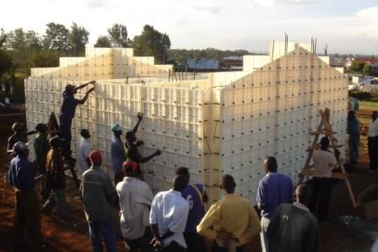
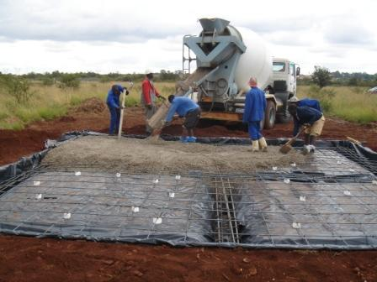
Key Considerations for Social Housing Market
Supply of social housing – construction technologies in Africa
Moladi: Established in 1986 in South Africa, developed construction technology to create durable, quality housing that is affordable and provides an alternative to traditional building methods
Formwork, fill: Modular plastic shutter concrete formwork system , filled with concrete or fly ash
Process: Lean assembly line, unskilled workers trained onsite to promote community participation and skills transfer
Timeline: Rate of production of one house per day with one mould
Notes:
ZR
-Moladi – South Africa
-Select Africa – Select Africa, a housing microfinance provider operating in Swaziland, Lesotho, Kenya and Malawi, has adapted the use of institute brick technology, which is a brick made of compressed soil and resin which is culturally accepted due to its face brick finish. Select Africa has also encouraged the use of housing-related projects to improve the sustainability of projects, including water and water harvesting tools and solar products.
-Kenya – pre-fab factories; on-site prefab vs. Off-site

Slide 23
Role of the
Developer Industry and the
Construction Industry

Slide 24
Players of Construction sectors
Developers/contractors;
Designers;
Construction material Industry (CMI);
Labor/employment;
Financial Institutions/Banks;
Capital Market (REITs, MBS, Sukuk etc.);
Regulatory agencies/Fiscal Authorities;
Trade Associations; and above all
The Central, Federal and Provincial Governments

Slide 25
Construction sectors covers the following
Real Sector:
Residential and Commercial
Industrial and Infrastructure
In the developed world, the real estate sector contributes to the growth and development of 71 CMIs
  Contribution to GDP is 7-10%.
In the developing world, its contribution spreads over about 42 CMIs
  Contribution to GDP is 3-6%.
Low income housing:
Is a challenge to the developer industry; and
Needs to be addressed in a professional and commercially sustainable manner

Slide 26
Construction Industry – INDIA, CHINA and USA
China and India - two most populous countries in the world
  Represent one out of every three persons on the planet
China has invested heavily in modernizing its physical infrastructure
India is way behind, but is in the race
Construction sector value in 2007:
  China: $ 161 bn (5.6% of GDP)
  India: $ 65 bn (6.9% of GDP)
  USA: $ 815 bn (9.0% of GDP)
Notes:
USA info source: http://www.plunkettresearch.com/real-estate-construction-market-research/industry-statistics :: Source of GDP ratio: http://www.fgould.com/media/files/ici_2008_janfeb.pdf

Slide 27
Construction Industry - UK
Construction sector is:
  10% of country’s GDP
  Employs 1.5 million people
Average new homes 150,000 per year at average price £100,000 (£1.5 billion market).
Share in construction sector-
  Housing 38%
  Infrastructure 9%
  Industrial 5%
  Commercial 18%
  CMI etc. 30%

Slide 28
A need to share common wisdom and experience
Issues are common; answers are different and not shared
Experiences are varied but rarely documented
Essential to promote Networking and Joint Ventures
An immediate need to share:
  Low Cost Construction Technologies;
  Low Cost Construction Material;
  Builders with technical and financial muscle;
  Long-Term Funding, issues and answers;
  Product innovation and experiences;
  Policy Initiatives and Programs of different countries;
  Provision of Affordable Serviced Land and Land Banking;
  Housing Micro-Finance Institutions; and
  Use and Abuse of Subsidies (Smart Subsidies vs. Charities)

Slide 29
Some Platforms for sharing wisdom
International Union for Housing Finance
Asia-Pacific Union for Housing Finance (www.apuhf.info)
African Union for Housing Finance (www.auhf.co.za)
Centre for Affordable Housing Africa (Kecia@housingfinanceafrica.org)
Housing Finance Information Network (www.HOFINET.org)
Housing Finance International (www.housingfinance.org)
Center for Affordable Settlements and Housing (In Progress)
Affordable Housing Institute (www.affordablehousinginstitute.org)

Slide 30
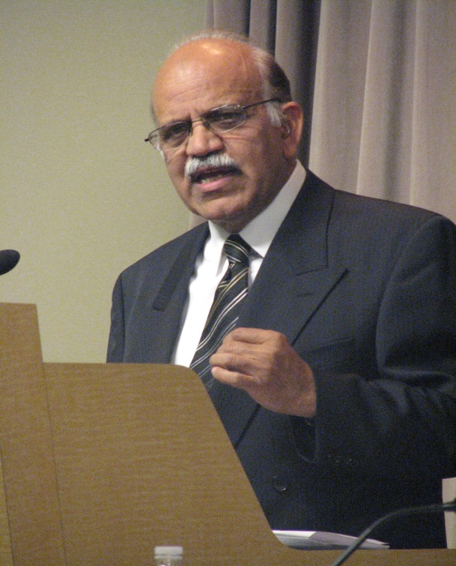
Thank you
Mr. Zaigham Mahmood Rizvi
zaigham2r@yahoo.com
Expert Consultant Housing: The World Bank
Adviser Housing: State Bank of Pakistan
Secretary General: Asia-Pacific Union for Housing Finance-APUHF www.apuhf.info
Notice:
This document has been prepared by Mr. Zaigham Mahmood Rizvi for the sole purpose of providing a presentation document to the Housing Workshop of ABAD to be held on January 15,, 2013.
30

