Slide 1
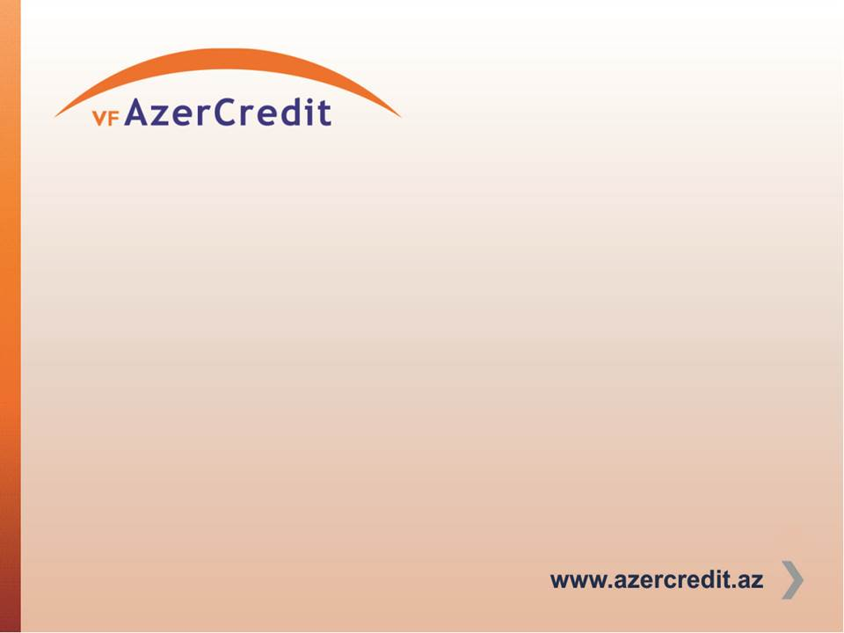
AZERBAIJAN HIGHLIGHTS
More than 9.5 million population (98% Muslims)
Secular state
Got independence after collapse of the Soviet Union
Some limited Islamic banking products offered by banks
Absolute absence of Islamic Microfinance despite of matured conventional microfinance sector
Islamic Finance Law is under development

Slide 2
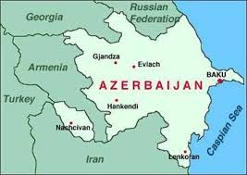

Slide 3
COMPANY HIGHLIGHTS
18 years of operations
More than 400 million USD disbursed since inception
46 branches
80 000 active clients
83 million USD of portfolio
720 staff
Regulated NBFI

Slide 4
COMPANY HIGHLIGHTS
BBB+ Financial and BB+ Social Ratings
Certified on Client Protection by Smart Campaign
Certified on Pricing Transparency
MIX S.T.A.R. MFI
MIX Platinum Reporter, 5 “diamonds”
Best Microfinance Company by International Finance Magazine

Slide 5
Stakeholders of Conventional Microfinance providing added values
Microfinance Investment Vehicles (MIVs)
Funding resources, Financial intermediary services
MIX Market
Access to quick and reliable reporting data/analysis
CGAP, Smart Campaign, SPTF
Financial Education, Awareness Raising, Resource Centers, Social Performance Tools

Slide 6
We strongly believe, that introduction of added value tools will better integrate synergy among Islamic Microfinance stakeholders and will leverage further boost of global development of Industry.

