Slide 1
Asia-Pacific Union for Housing Finance
Pro-Poor Affordable Housing Challenges
=Issues we Know, Answers we Seek=
www.apuhf.info

Slide 2
Evolution of APUHF
In May, 2008 the World Bank initiated a dialogue (GDLN) between countries of South Asia to address issues of housing and housing finance.
In May 2009 the World Bank organized a regional housing conference in Jakarta, Indonesia.
To better understand the issue and underlying challenges, the World Bank also initiated a study on housing in South Asia titled “ Expanding Housing Finance to the Underserved in South Asia”, published in 2010 published in 2010.
At the Jakarta Conference, based on its findings/recommendations, a proposal to set up a more permanent regional platform in the name of “South Asia Housing Forum-SAHF” was tabled.
The proposal was fully endorsed by the conference participants and multilateral agencies like the World Bank, IFC, and Asian Development Bank.

Slide 3
Evolution of APUHF Cont’d
Around the same time UNESCAP and UNHABITAT had launched an initiative on Pro-Poor Housing in Asia-Pacific region.
Under the initiative a study titled “ Regional Project on Pro-Poor Housing Finance in Asia-Pacific-A Compendium of Seven Countries” was launched In January 2010.
Findings and Recommendations of UNESCAP/UNHABITAT Study were in line with the objectives of SAHF.
In a joint meeting of the two initiatives held in Delhi in January, 2010 it was decided to merge the two initiatives, expand its scope to Asia-Pacific region and rename it as “ Asia-Pacific Union for Housing Finance-APUHF.”.
APUHF is functional since January 2010, with its Head Quarter in Delhi (Courtesy National Housing Bank, India)
Its affairs are run by its Advisory Board, and its General Assembly.

Slide 4
Objectives
To provide a basis and a platform for exchange of ideas, views, experiences, events, practices, products in different countries of South Asia
Help in policy design, strategic intervention, design of supply and finance instruments.
Exchange of learning and best practices on regional basis.
To provide an e-Platform for knowledge sharing and networking
To publish a periodic Journal on Housing and Housing Finance developments in the region

Slide 5
APUHF Advisory Board
India: Mr. R.V.Verma - Chairman Chairman & Managing Director, National Housing Bank
Thailand: Mr. Woravit Chailimpamontri - Alternate Chairman President, Government Housing Bank
Pakistan: Mr. Muhammad Ashraf Khan– Vice Chairman Executive Director, State Bank of Pakistan (Central Bank)
Srilanka: Mr.P.D.J.Fernando – Member Deputy Governor, Central Bank of Srilanka
Bangladesh: Mr. Mohammad Nazrul Huda – Member Ex - Deputy Governor, Bangladesh Bank
Mongolia: Ms. Enkhbayar Tsedendorj – Member CEO, Mongolia Mortgage Corporation
Indonesia: Mr. Raharjo Adisusanto – Member President Director, SMF, Indonesia
Afghanistan: Mr.Noorullah Delawari – Member Governor, Da Afghanistan Bank (Central Bank)
Japan: Mr. Masahiro Kobayashi – Member Chief Economist, Japan Housing Finance Agency
Mr. Zaigham Mahmood Rizvi – Member & Secretary General
Expert Consultant, Housing and Housing Finance

Slide 6
A Regional Snapshot
Asia-Pacific represents one-quarter of the World population,
Nearly half of the World Poor
Housing is an essential part of political sloganizm
“Housing for all”, “Slums Free Cities”, “Maang Raha hai har Insaan-Roti, Kapra, aur Makan and so on……”
In some countries delivery is SOME, and in most it is NONE
Each country in the region has its own geo-socio- economic parameters, from Afghanistan to Indonesia, all facing a common issue of “shelter less poor”, so regional successful models would needing sharing of experience and knowledge

Slide 7
Population Trends in Asia-Pacific
 | Total Populatio n (mn) 2007 1,125 162 20 64 26 225 158 | Populatio n Growth % 2007- 2015 1.3 2.1 0.3 0.5 1.0 1.0 1.6 | Urban Populatio n (mn) 2007 329 58 3 21 1.5 113 42 | Urban Populatio n % of Total 29 36 15 33 57 50 27 | Urbanizatio n Growth % 2.5 3.3 0.2 1.6 1.3 4.3 3.7 | GDP Growth Rate % 2000-07 7.8 5.6 5.3 5.3 7.5 5.1 5.7
Notes:
Source; World Development Indicators 200p

Slide 8
Housing Challenges in Asia-Pacific region
The Region represents more than one out of four persons and one out of two poor on the planet.
Including China, Asia-Pacific represents one out every two persons on the planet
It is among the lowest in terms of Mortgage Finance
(Average Mortgage Debt to GDP Ratio 3.3)
Region is faced with massive housing shortage, Indian
Urban Housing shortage 27 million plus,
Nearly the entire urban shortage is in Low-Income Category
Persons per Room Density in India/Pakistan is 3.5. EU is 1.1, USA is 0.5

Slide 9
Population explosion in Asian Cities
In 1950, about 232 million people lived in urban areas, which represented about 17% of Asia’s total population. Today it is more than one-third and by 2025 nearly half of Asian Population will be Urban
This means that by 2030, one out of every two urban residents in the world will be in Asia
In India, as per census 2001, the total housing stock was 249 million units out of which 29% (72 million) were in urban areas. India today faces an Urban housing shortage of 25 million units. Pakistan around 3 million.
Nearly entire Urban Housing Shortage is in Economically Weaker Sections of society
India, Thailand, Indonesia, Malaysia and more from the region have unique success stories in different areas and regional countries could benefit from knowledge and experience sharing.

Slide 10
Slums Prevalence in the Region
Afghanistan: 80 percent of the Kabul population (2.44 million) live in slums, damaged or destroyed housing
Bangladesh: 2,100 slums; more than 2 million people in Dhaka live either in slums or are without any proper shelter
India: 52,000 slums holding 8 million urban households, representing about 14 percent of the total urban population.
Pakistan: Karachi alone has between 600-800 slums, sheltering about 7.6 million (or 1 million households) out of the total city population of 15.1 million people
Sri Lanka: A considerable share of the population of Sri Lanka lives in plantations, slums and shanties.
Mongolia: 51% of the population is residing in temporary ger dwellings
Indonesia: 17.2 million families live in approximately 10,000 slum areas

Slide 11
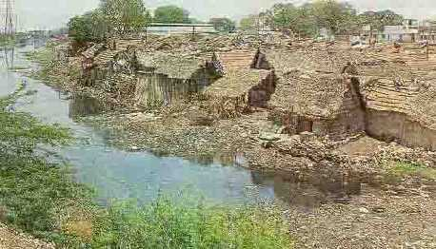
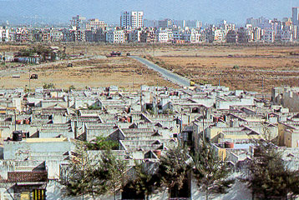
URBAN REALITIES

Slide 12
Where the Urban Poor Live
Hiding behind higher persons/room density, and living in slums. In some cases homeless poor live on footpaths, and even in abandoned sewerage pipes,
Slums, Shanty Towns, Jhopar Patti, Jhuggi, Basti, Katchi Abadi, Squatter Settlements, legal/illegal habitat, and you name it
Nearly 50% of major metropolitans in the regions are slums
Two prong approach would be needed
Slums improvement programs and
Slums rehabilitation programs

Slide 13
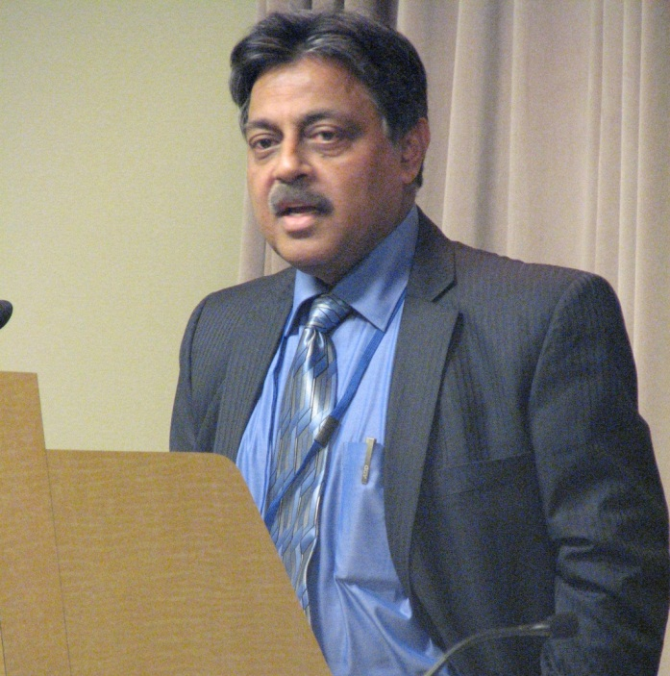
Message from Mr. R.V. Verma, Chairman APUHF
APUHF aims at exploring viable and sustainable answers to the challenge of Pro-Poor Affordable Housing Supply and Finance for Economically Low-Income Population of Asia-Pacific Region.
It welcomes endorsement and support of international agencies, housing experts and stakeholders of housing and housing finance.

Slide 14
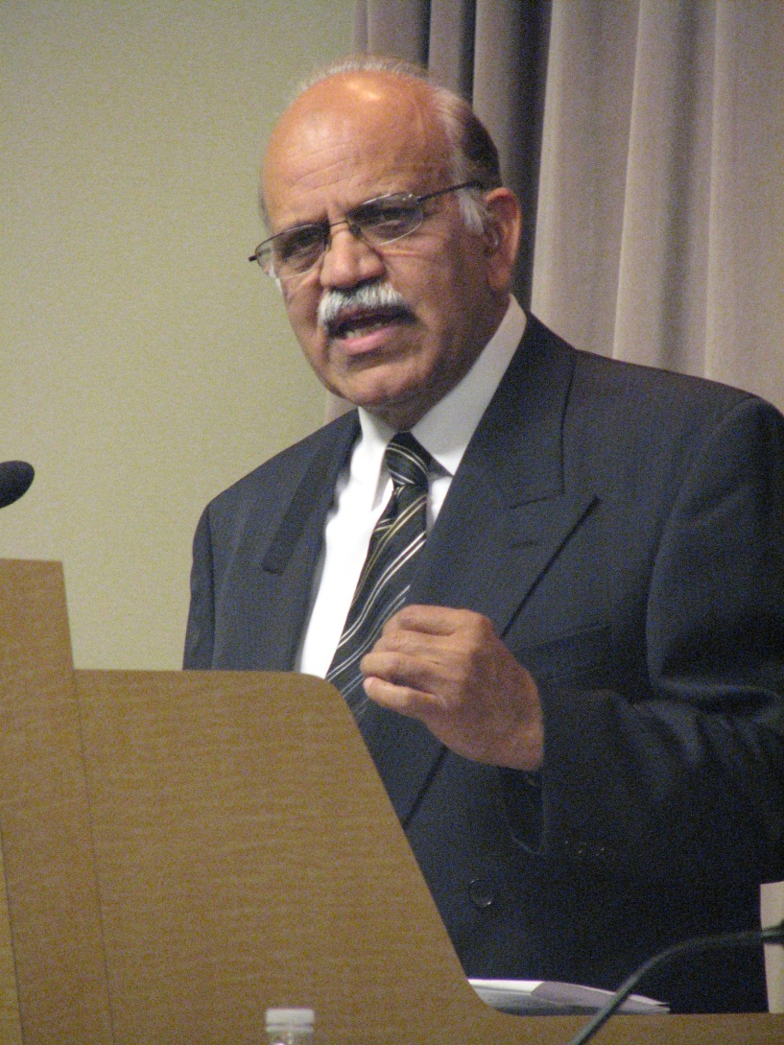
Thank You
Presented by:
Zaigham Mahmood Rizvi
Secretary General, APUHF
At 5th Global Housing
Finance Conference
Housing Finance in Emerging Markets
May 30 – 31, 2012, Washington,
D.C.
World Bank Washington

