Slide 1

4th Global Micro-Finance Forum
Organized by:
Al-Huda c.i.b.e.
Dubai 1st – 2nd November, 2014.
Technical session V: Micro-Takaful
By: Capt. M. Jamil Akhtar Khan
ACII, MCIT, Master Mariner
Takaful & Insurance Professional

Slide 2
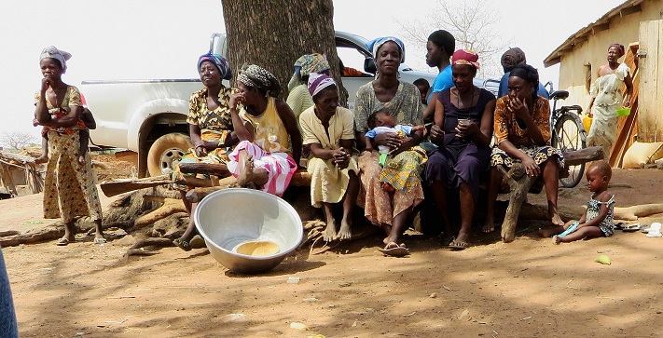
Islamic Insurance (Micro-Takaful) – An effective tool for Sustainable Development.

Slide 3

Outline of Presentation
Micro-Takaful defined
Global Landscape of Takaful
Case for Micro-Takaful
Vulnerabilities at micro-level
The Takaful Advantage
Micro-Takaful & sustainable development
Why Micro-Takaful?
Micro-Takaful Products
Case Study Pakistan – Takaful & Micro-Takaful initiatives
The Way Forward

Slide 4
_{Definition}
Micro-insurance defined:
“Risk-pooling arrangements that are tailored to suit the low-income market in terms of cost, scope, coverage, and delivery mechanisms”.
Micro-Takaful refined:
“A mechanism to provide Shariah-based protection to the blue collared, under-privileged individuals at an affordable cost”.

Slide 5
Global Landscape of Takaful
There are now 200+ Takaful companies in over 35 countries.
Global Gross Takaful Contributions crossed US$ 11bn in 2012
Y-O-Y growth has slowed from the 2007-11 CGAR of 22% to a more sustainable growth rate of 16%
Forecasts estimate US$ 18bn Global Takaful Contributions by 2015.
New opportunities in rapid growth markets such as Turkey and Indonesia.
Rapid growth envisaged in the African continent.
Poor Insurance penetration in the 3rd world countries (<1% of GDP).
Non–Muslims increasingly opting for Takaful products for commercial benefits.

Slide 6
Takaful Over The Years

Slide 7
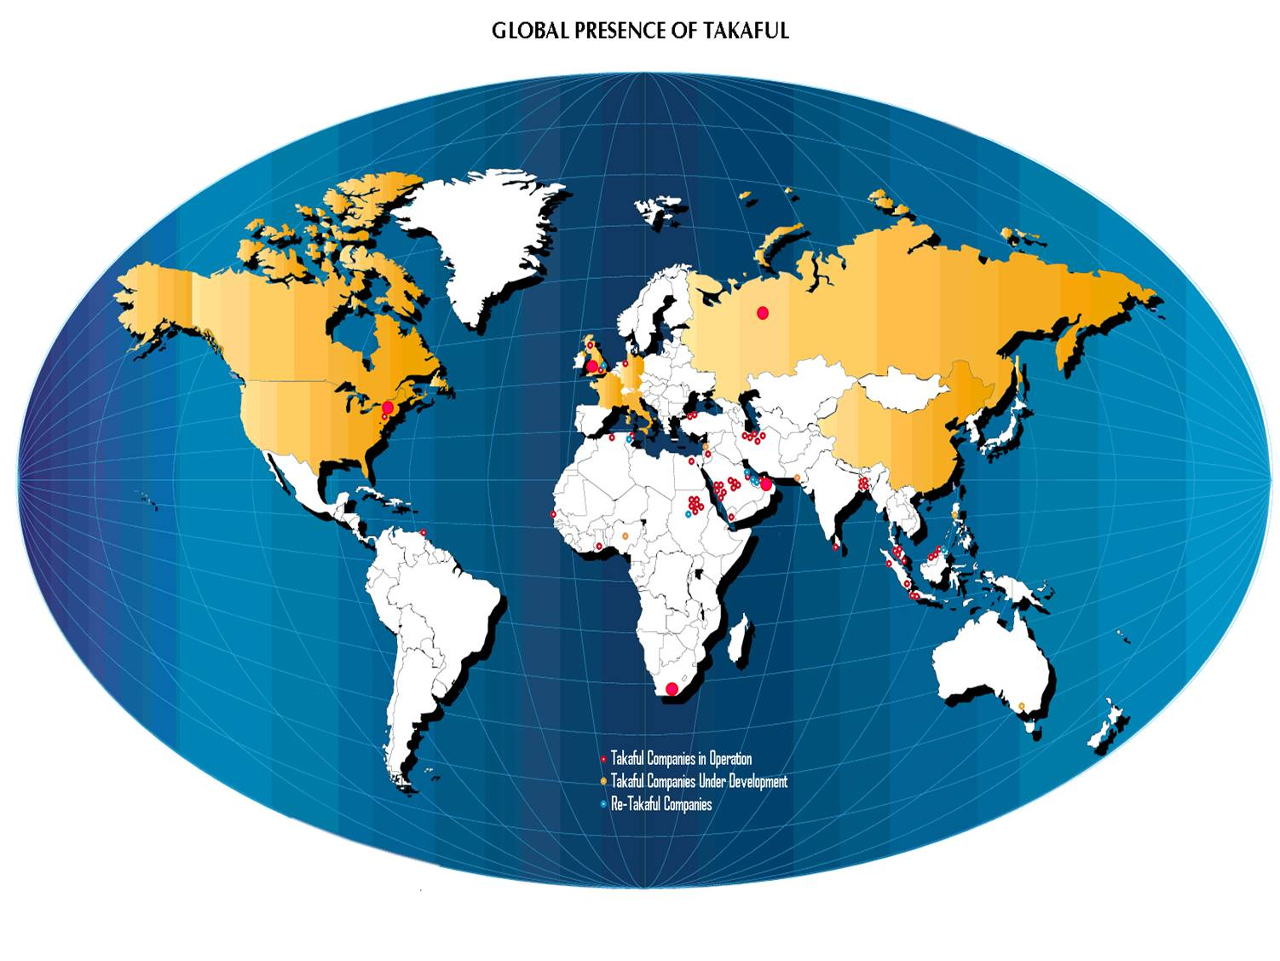
Global Presence of Takaful

Slide 8
Case for Micro-Takaful
Individuals want convenience of access
Life-cycle events impact differently at different times
Poor people are more prone to uncertainty
Young individuals are more vulnerable to financial pressures
General lack of awareness about microTakaful and its availability
Covers against illness and maternity are prime motive for females

Slide 9
Micro-Takaful
Basic Takaful Principles
Simple & Understandable products
Low Cost coverage
Core Ingredients of Micro-Takaful
Flexibility
Ease of access

Slide 10
Micro-insurance/Micro-Takaful -- Vulnerabilities & Rationale
Health Risks -- can result in unbudgeted, high expenses on medical treatment PLUS indirect costs due to loss of job/loss of income
Life Cycle Risks – un-usual expense or hardship faced due to sudden death of the family’s main bread-earner, retirement, children marriage, children education, etc.
Financial Risks – due to death of livestock, crop destruction, loss of business assets & properties, sudden fall in prices due to reduced demand or buying power, etc. These factors can adversely impact the income-flow of low-income households.
Disaster Risks – Natural disasters like Floods, typhoons, tsunamis, earthquakes, etc. can result in large-scale loss & severe impact on the low-income families.
Market Segments:
Population living above the international poverty line of USD 1.25/day but below USD 4/day, who need commercially viable micro-insurance;
Those living below the US$ 1.25/day poverty line, who cannot afford MI products on their own, can be covered through government subsidies or even sponsorships.

Slide 11
Key Life-cycle & Risk Events
Accidents
Burglaries
Natural Catastrophes
Serious Illness
Business Losses
Crop destruction
Death
Maternity
Literacy
Business Setup
Marriage
Travel
Vicissitudes of Life

Slide 12
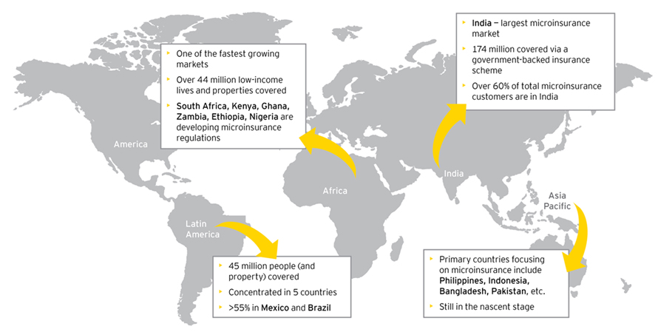
Global Micro-insurance/MicroTakaful market

Slide 13
The Takaful Advantage
“ … they seemed satisfied with the convenience and affordability of the policy, but some thought that the premium should be reimbursed if they do not file a claim”.
Excerpt from
The Demand for Micro insurance in Pakistan
by
ELIZABETH MCGUINNESS & VOLODYMYR TOUNYTSKY
MARCH 2006

Slide 14
The Takaful Advantage
Micro-insurance
↓
Payment of Premium
↓
Coverage & benefits
↓
(Balance to Shareholders)
Micro-Takaful
↓
Contribution
↓
Coverage & benefits
↓
(Wakala fee to Shareholders)
↓
Investment income to participants
↓
Surplus to participants

Slide 15
The Takaful Advantage
Share Holder
S H A R E H O L D E R S’ F U N D (S.H.F.)
Wakalah Fee
Investment
Income
Mudarib’s Share of PTF’s Investment Income
Management Expense of
the Company
Profit/Loss
Takaful Operator
Investment by
the Company
WAQF
Operational Cost of Takaful / ReTakaful
Investment
Income
Claims &
Reserves
Surplus (Balance)
Participant
P A R T I C I P A N T S’ T A K A F U L F U N D
(P.T.F.)

Slide 16
Micro Takaful – An Effective Tool for Sustainable Development
In Micro-Takaful, the relationship between the Participant and the Takaful operator is based on the Islamic concepts of ta’awum (mutuality) and tabarru (donation).
‘Best Practice microinsurance services’ can be translated in a Shariah-compliant way.
An international commercial insurer can successfully tailor and offer Micro-Takaful schemes compatible with the socio-cultural Islamic principles.
Doing so, such an international insurer can penetrate in this untapped market segment.
Micro-Takaful is well suited to serve the low-income segments of the society in most of the developing countries.

Slide 17
Micro-Takaful & Best Practices
SIX factors that can make micro-Takaful compatible with the international ‘Best Practices’ set for microinsurance:
Market needs
Demand-driven products are a prerequisite to be successful since the financial resources of the target group are limited.
Product design
To keep premium affordable, only major insurable risks should be covered by a relatively small benefits package. Group policies should be offered rather than individual covers, to avoid ‘anti-selection’.
Premiums/contributions
Premium amounts should be commensurate with the cash-flows of the Participants; ideally, premiums should be linked to an existing financial service (like micro-finance facility).
Processes
Policy application and claims documentation are reduced to the minimum. Claims are settled quickly.
Distribution
Market awareness
Existing distribution network of the partners should be used since they know the target market well and have an established relationship with the potential clientele.
Market education is essential in order to create awareness and availability of micro-Takaful.

Slide 18
Why Micro-Takaful?
The insurer’s objective to provide micro-Takaful is to empower micro-entrepreneurs.
Micro-Takaful is an inherent part of the Company’s social obligation of supporting the needy.
“Micro-Dua” (in Indonesia) is an adaptation of a conventional Credit-Life microinsurance product. It is a response to the Islamic micro-finance institutions that still lacked access to insurance cover in accordance with Shariah. Hence the product is distributed by Islamic micro-finance institutions.
THREE prime motivations for an insurance company to enter the low-income market:
  The insurer would like to test a new market segment that can greatly enhance its base.
  The move supplements the Government’s drive to provide access to insurance to a much wider range of people.
  Micro-Takaful combines corporate social responsibility with a business opportunity.

Slide 19
Why Micro-Takaful (Cont’d. …)?
Profit-orientation does not violate Shariah as long as the insurer serves its policyholders by the creation and operation of a Participants’ pool based on the principles of solidarity and mutual assistance.
Microinsurance ‘Best Practices’ are already ingrained in the socio-cultural Islamic principles. Thus it facilitates the international or multinational insurance corporations to enter an untapped micro-Takaful insurance market.
The emerging market for micro-Takaful insurance products offers strategic growth opportunities to underserved insurance markets.
Emerging markets of the developing nations can facilitate economic growth by offering incentives to international insurers to offer Micro-Takaful insurance schemes in their countries.
The two concepts of Takaful and microinsurance complement each other.
Micro-Takaful provides a promising perspective for the future development of Islamic emerging markets, thereby accelerating their economic growth.

Slide 20
Types of Micro-Takaful Products
Property
Fire
Rainfall
Theft
Floods
Health
Agriculture
Prices
Disability
Surgical
Out-patient
Hospitalisation
Permanent
Partial
Total
Temporary
Optical
Dread Disease
Dismemberment
Credit Disability
Life Insurance
Dental
“Transition funds”
Pensions
Credit Life
Funeral
Endowments
Education Life

Slide 21
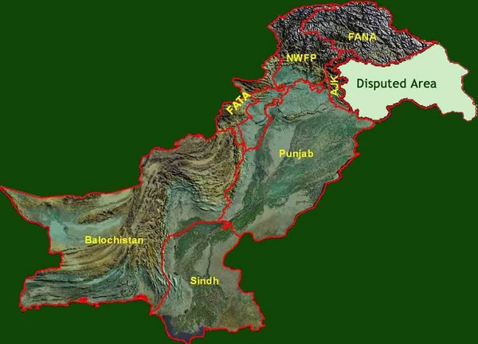
_{Case Study: Pakistan}
Serious efforts at national level
Advent of Microfinance banks
Large Rural/Urban divides (65% : 35%)
13% urban Vs 27% rural population below poverty level
Scope for extensive work
Mushroom growth of NGOs

Slide 22
_{Why Micro-Takaful in Pakistan?}
At micro-level, we interact with individuals.
Peace of mind, along with peace of conscience.
There is a niche market for micro-Takaful in this predominantly Muslim nation.
Islamic banking has already created awareness.
Commercial advantage over the conventional form of micro-insurance .

Slide 23

Micro-Takaful Initiatives in Pakistan
Coverage to over 100,000 low-cost houses.
Synergy with NGOs for providing family
Health/Hospitalization cover.
Students’ Healthcare/‘Campus Care Cover’.
Factory workers’ & Daily wagers.
Crop & Livestock Takaful.
Credit coverage for Islamic Microfinance.
Covers tailored for SMEs’ financing.
All above at incredibly low, affordable costs.

Slide 24
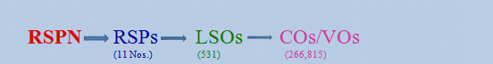
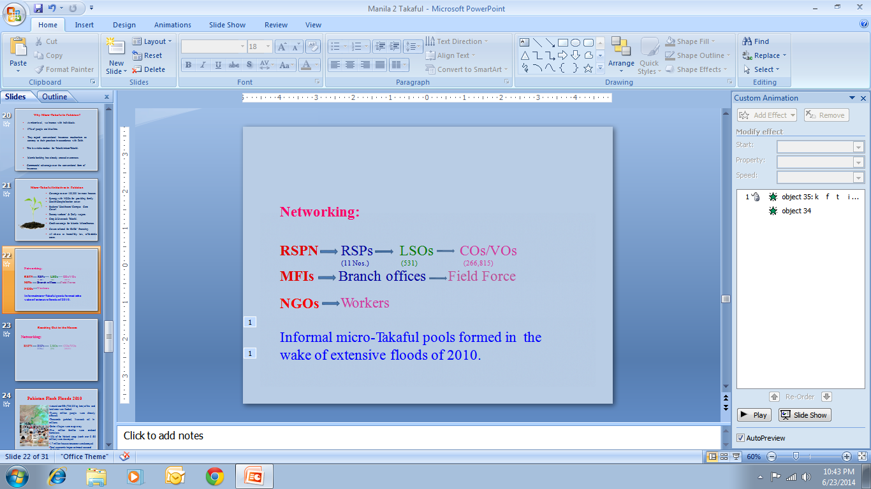
_{Reaching Out to the Masses}
Networking:
Informal micro-Takaful pools formed in the wake of extensive floods of 2010.

Slide 25

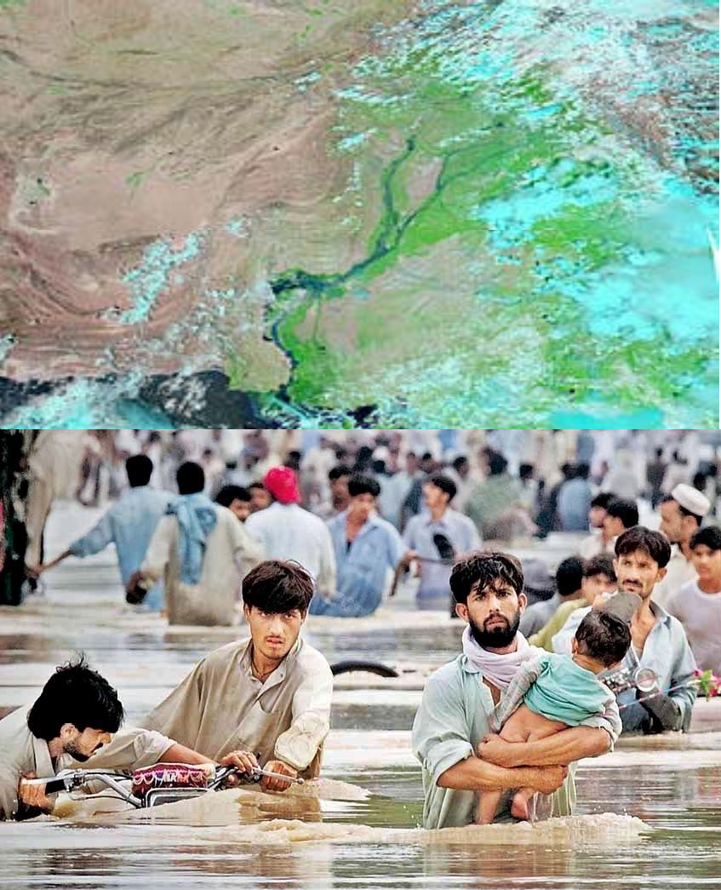
_{Pakistan Flash Floods 2010}
Around one-fifth (796,095 sq. kms) of the total land area was flooded.
Twenty million people were directly effected.
Thousands perished, livestock toll in millions.
Entire villages were swept away.
Five million families were rendered homeless.
10% of the Nation’s crops (worth over $ 500 million) were destroyed.
1.7 million houses/structures were destroyed.
Total economic impact estimated to exceed
$ 43 billion.

Slide 26
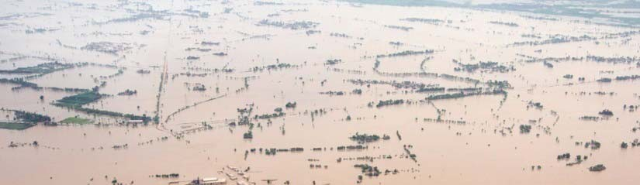
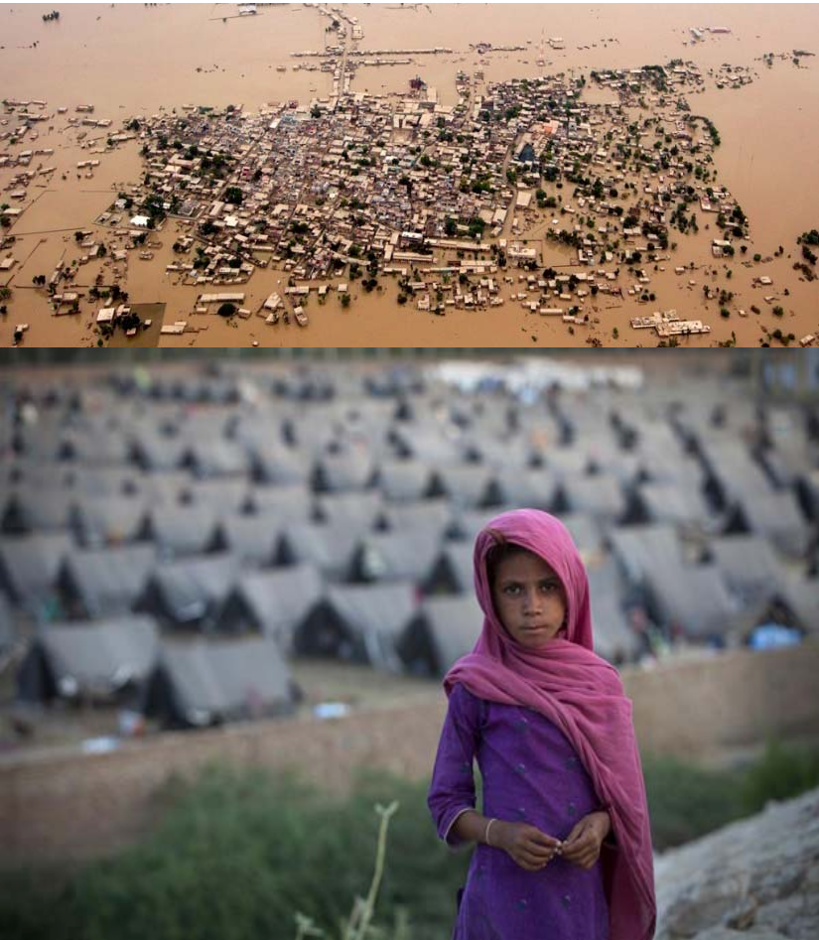
_{Pakistan Flash Floods 2010}
MFIs’ response
RSPN members set up relief camps in 64 districts.
Food and drinking water was supplied to over 1.2 million families.
Medical aid rendered to 1.85 million individuals through field hospital camps.
Resources for relief & early rehabilitation projects were mobilized worth around $ 24.75 million.
Several other NGOs also rendered remarkable assistance.
People at large, realized the need for mutual assistance and formed & self-support camps & funds – informal micro-Takaful pools!

Slide 27
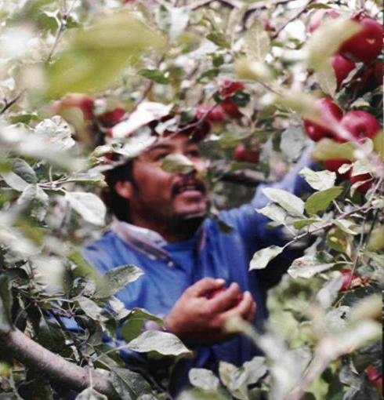
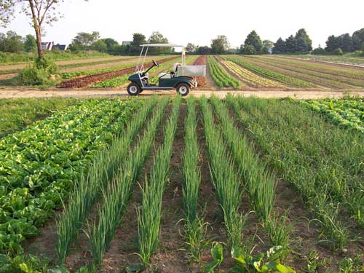

The way forward
Tax incentives
Goodwill
Awareness
Distribution channels
Strategic alliances
Incentives & Awards

Slide 28
Urban – Subsidy – Rural
Surplus
Subsidy for Takaful Contribution
Surplus

Slide 29
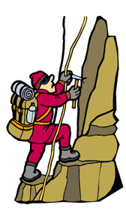
What is required?
When there is will, there is a way!

Slide 30

End of Presentation
Thankyou for your attention
captain.jamil@gmail.com

