Slide 1
4th Global Micro-Finance Forum
DUBAI
Organized by:
Al-Huda C.I.B.E.
Workshop on Micro-Takaful
November 4, 2014.
By: Capt. M. Jamil Akhtar Khan
ACII, MCIT, Master Mariner
Takaful & Insurance Professional

Slide 2
Contents’ Outline
Micro-Takaful defined
Global landscape
Case for Micro-Takaful
Life-cycle events & risks
Target Market
Best Practices
Products & schemes
Lessons to be learnt

Slide 3
_{Definition}
Micro-insurance defined:
“Risk-pooling arrangements that are tailored to suit the low-income market in terms of cost, scope, coverage, and delivery mechanisms”.
Micro-Takaful refined:
“A mechanism to provide Shariah-based protection to the blue collared, under-privileged individuals at an affordable cost”.

Slide 4















_{Global Landscape}
Only around 80 million out of the world's 2.75 billion poor were
covered by some form of micro insurance in 2006. By end 2012, the
number has reached close to 700 million!
•
•
Only 3% of poor lives were insured in India and China in 2006;
compared to the latest figure of around 17% by 2012.
Only 0.5% of the poor were insured in Africa in 2006. This
•
O l 5 f i d Af i 2006
percentage has now increased to around 2.7% by 2012.
In 23 of the poorest 100 countries in the world, there is currently no
identified micro insurance activity.
•
micro acti it

Slide 5
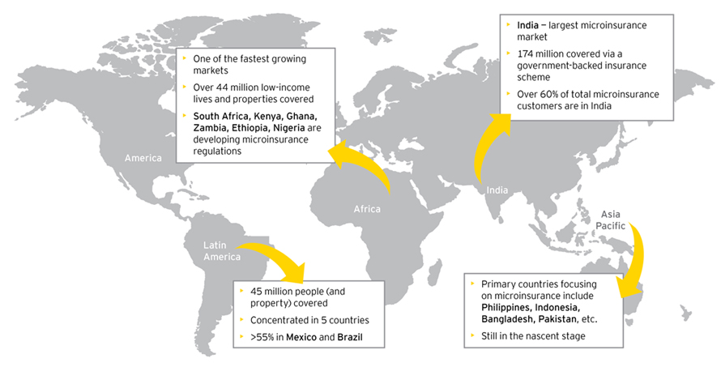
Global Micro-insurance/MicroTakaful market

Slide 6
Case for Micro-Takaful
Individuals want convenience of access
Life-cycle events impact differently at different times
Poor people are more prone to uncertainty
Young individuals are more vulnerable to financial pressures
General lack of awareness about microTakaful and its availability
Covers against illness and maternity are prime motive for females

Slide 7
Micro-Takaful
Basic Takaful Principles
Simple & Understandable products
Low Cost coverage
Core Ingredients of Micro-Takaful
Flexibility
Ease of access

Slide 8
Micro-insurance/Micro-Takaful -- Vulnerabilities & Rationale
Health Risks -- can result in unbudgeted, high expenses on medical treatment PLUS indirect costs due to loss of job/loss of income
Life Cycle Risks – un-usual expense or hardship faced due to sudden death of the family’s main bread-earner, retirement, children marriage, children education, etc.
Financial Risks – due to death of livestock, crop destruction, loss of business assets & properties, sudden fall in prices due to reduced demand or buying power, etc. These factors can adversely impact the income-flow of low-income households.
Disaster Risks – Natural disasters like Floods, typhoons, tsunamis, earthquakes, etc. can result in large-scale loss & severe impact on the low-income families.
Market Segments:
Population living above the international poverty line of USD 1.25/day but below USD 4/day, who need commercially viable micro-insurance;
Those living below the US$ 1.25/day poverty line, who cannot afford MI products on their own, can be covered through government subsidies or even sponsorships.

Slide 9
Key Life-cycle & Risk Events
Accidents
Burglaries
Natural Catastrophes
Serious Illness
Business Losses
Crop destruction
Death
Maternity
Literacy
Business Setup
Marriage
Travel
Vicissitudes of Life

Slide 10
Micro-Takaful
Ideally suited for achieving phenomenal spread in the African continent due to a significant poor & rural-based population.
Apart from focusing on providing affordable coverage to the poor, this may provide employment opportunities to a large number of educated, yet unemployed youth.
Main products will be Health, Education, Family, SMEs, Crops & Livestock.
Significant social uplift can be achieved by this means.

Slide 11
Micro-Takaful - Target Market
People who do not insure due to religious reasons.
People who insure and are insensitive to religious reasons.
People who currently do not insure at all.

Slide 12
The Takaful Advantage
Micro-insurance
↓
Payment of Premium
↓
Coverage & benefits
↓
(Balance to Shareholders)
Micro-Takaful
↓
Contribution
↓
Coverage & benefits
↓
(Wakala fee to Shareholders)
↓
Investment income to participants
↓
Surplus to participants

Slide 13
The Takaful Advantage
Share Holder
S H A R E H O L D E R S’ F U N D (S.H.F.)
Wakalah Fee
Investment
Income
Mudarib’s Share of PTF’s Investment Income
Management Expense of
the Company
Profit/Loss
Takaful Operator
Investment by
the Company
WAQF
Operational Cost of Takaful / ReTakaful
Investment
Income
Claims &
Reserves
Surplus (Balance)
Participant
P A R T I C I P A N T S’ T A K A F U L F U N D
(P.T.F.)

Slide 14
Micro Takaful – An Effective Tool for Sustainable Development
In Micro-Takaful, the relationship between the Participant and the Takaful operator is based on the Islamic concepts of ta’awum (mutuality) and tabarru (donation).
‘Best Practice microinsurance services’ can be translated in a Shariah-compliant way.
An international commercial insurer can successfully tailor and offer Micro-Takaful schemes compatible with the socio-cultural Islamic principles.
Doing so, such an international insurer can penetrate in this untapped market segment.
Micro-Takaful is well suited to serve the low-income segments of the society in most of the developing countries.

Slide 15
Micro-Takaful & Best Practices
SIX factors that can make micro-Takaful compatible with the international ‘Best Practices’ set for microinsurance:
Market needs
Demand-driven products are a prerequisite to be successful since the financial resources of the target group are limited.
Product design
To keep premium affordable, only major insurable risks should be covered by a relatively small benefits package. Group policies should be offered rather than individual covers, to avoid ‘anti-selection’.
Premiums/contributions
Premium amounts should be commensurate with the cash-flows of the Participants; ideally, premiums should be linked to an existing financial service (like micro-finance facility).
Processes
Policy application and claims documentation are reduced to the minimum. Claims are settled quickly.
Distribution
Market awareness
Existing distribution network of the partners should be used since they know the target market well and have an established relationship with the potential clientele.
Market education is essential in order to create awareness and availability of micro-Takaful.

Slide 16
Why Micro-Takaful?
The insurer’s objective to provide micro-Takaful is to empower micro-entrepreneurs.
Micro-Takaful is an inherent part of the Company’s social obligation of supporting the needy.
“Micro-Dua” (in Indonesia) is an adaptation of a conventional Credit-Life microinsurance product. It is a response to the Islamic micro-finance institutions that still lacked access to insurance cover in accordance with Shariah. Hence the product is distributed by Islamic micro-finance institutions.
THREE prime motivations for an insurance company to enter the low-income market:
  The insurer would like to test a new market segment that can greatly enhance its base.
  The move supplements the Government’s drive to provide access to insurance to a much wider range of people.
  Micro-Takaful combines corporate social responsibility with a business opportunity.

Slide 17
Why Micro-Takaful (Cont’d. …)?
Profit-orientation does not violate Shariah as long as the insurer serves its policyholders by the creation and operation of a Participants’ pool based on the principles of solidarity and mutual assistance.
Microinsurance ‘Best Practices’ are already ingrained in the socio-cultural Islamic principles. Thus it facilitates the international or multinational insurance corporations to enter an untapped micro-Takaful insurance market.
The emerging market for micro-Takaful insurance products offers strategic growth opportunities to underserved insurance markets.
Emerging markets of the developing nations can facilitate economic growth by offering incentives to international insurers to offer Micro-Takaful insurance schemes in their countries.
The two concepts of Takaful and microinsurance complement each other.
Micro-Takaful provides a promising perspective for the future development of Islamic emerging markets, thereby accelerating their economic growth.

Slide 18
Types of Micro-Takaful Products
Property
Fire
Rainfall
Theft
Floods
Health
Agriculture
Prices
Disability
Surgical
Out-patient
Hospitalisation
Permanent
Partial
Total
Temporary
Optical
Dread Disease
Dismemberment
Credit Disability
Life Insurance
Dental
“Transition funds”
Pensions
Credit Life
Funeral
Endowments
Education Life

Slide 19




_{Major Products}
Most Complex
Crop Takaful
Integrated Takaful Packages
Health Takaful
Relative Complexities
Annuities/Endowment
Property/Livestock Takaful
P l A id /U l
Personal Accident/Unemployment
Life Takaful
Least Complex

Slide 20

Envisaged operation of
Pool
the
micro-Takaful
Scheme Supervisory Committee
Government
Fund manager/
Svc. provider
Insurance/Takaful
Service provider
POOLED FUNDING
Management
Fee/premium
Basic
benefits
Add-on benefits
Health/
Hospitalization
Accidental death
Funeral & Burial
Livestock losses
Crop
HealthCare Clinics
losses
Calamity affectees & their
Families
(card holders)

Slide 21


Package offered to Microfinance
institutions
Clients / Borrowers
• Health / Hospitalization
• Education
• Crop / Livestock
• Accidental coverage
• Property
• Credit Advance coverage
Employees
• Health / Hospitalization for the entire family
• Accidental Death coverage
• Children Education Plan
• Kidnap / Ransom
• Asset, Property and Vehicle Coverage
Surplus as
reduce the
defined above shall be used to further subsidize /
rates for the coming years

Slide 22

Micro-Takaful Initiatives ―
Lessons to be learnt
• Pre-launch ― Local needs & priorities to be carefully considered.
• Affordability & accessibility of facilities.
• Sustainability!
• Loss Ratios will tend to increase over time.
L R i ill d i i
• Bureaucr
much!
hurdles (PPP) ― Do not expect
Bureaucratic hurdles (PPP) Do not expect

Slide 23
A Typical example: Micro-HealthCare
Takaful
This product was tailored for borrowers of SUNGI Rural Development Program (in late 2008).
Around 7,000 families were covered.
Individual Cover Limit Rs. 25,000.
Annual Contribution (Premium) per family: Rs. 1,250/- only;
•
•
Loss Ratio: 28% only, for the first 18 months.
Win-win-win for all: SUNGI-Borrowers-Company.
A yet another, separate initiative to set up ‘Takaful
Clinics’ in city slums & rural areas failed!

Slide 24

End of the presentation
Thankyou for your attention
captain.jamil@gmail.com

