Slide 1
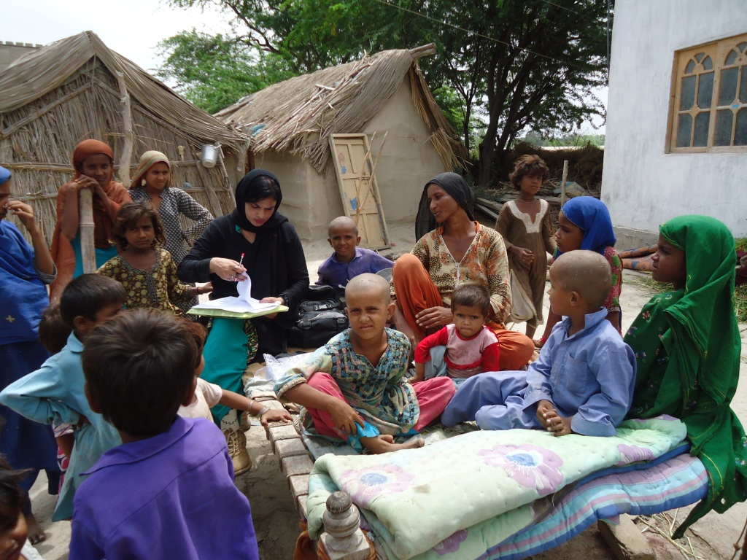
4th Global Islamic Microfinance Forum, Dubai 1-2 Nov. 2014
Rural Micro financing
An Experience from Sindh, Pakistan
By: Aijaz Ali Khuwaja

Slide 2
Sindh Society of Social Scientists- Introduction
The Sindh Society of Social Scientists (SSSS) is a Social Think Tank, established in 2010
SSSS is a consortium of Social Development Organisations working for the integrated development of rural downtrodden masses in Sindh, Pakistan
SSSS is guiding CBNGOs, CSOs, NGOs, Local Networks, RSPs & Govt. Initiatives in Sindh, Pakistan

Slide 3
Microfinance Initiatives in Pakistan
Started from The Aga Khan Rural Support Program (AKRSP) in 1980’s & then after the success of AKRSP, National Rural Support Program was established in 1990’s.
Dr Akhtar Hameed Khan was the pioneer of Rural Support Programs in Pakistan.
Now in Pakistan we have ten Provincial and National level Rural Support Programs, which are running under the leadership of Mr. Sohaib Sultan Khan, Chairman RSPN Pakistan.

Slide 4
Village Organisation Banking & Community Investment Fund
Village Organisation Banking system was first introduced by AKRSP in Pakistan
VO Banking System was based on Land Development, Agriculture Development, Credit & Banking & Marketing
After success of VO Banking system, Rural Micro-financing was started all over rural areas in Pakistan through different initiatives

Slide 5
Village Organisation Banking & Community Investment Fund
The Community Investment Fund (CIF) is a community managed model in which micro-finance provided to poor women.
CIF was started from Andra Pardesh, India and piloted in Pakistan by RSPN/RSPs at Provincial level.
The fund has lower operational costs due to community managed model. CIF is successfully running all over Pakistan through RSPs.

Slide 6
Sindh Rural Support Microfinance Initiatives
Sindh Rural Support Program/Organisation (SRSO) was established in 2002
AKRSP, NRSP microfinance initiatives remained successful so provincial RSPs were established all over Pakistan.
Government of Sindh (GoS) supported this idea of rural micro-financing & integrated rural development through establishment of SRSO.
GoS supported SRSO through endowment funding for this noble cause.

Slide 7
Rural Micro-financing
SRSO is now major micro-financing organisation in not for profit social development sector beside NRSP, TRDP, OPP & other locally based NGOs in Sindh.
Micro-finance portfolio of SRSO is now around 10 billion Pakistani rupees.
Government of Sindh has supported SRSO for different rural microfinance initiatives in Not for Profit Sector.
Islamic way of micro-financing in Not for Profit sector is new in rural setup of Sindh, Pakistan.

Slide 8
Rural Micro-financing in Sindh
Rural micro-financing is still at nascent age in rural setup of Sindh.
The involvement of Banking sector in rural micro-financing is yet to establish.
The First Micro-Finance Bank, Tameer Bank, Khushali Bank & other regular banking sector is now gradually establishing their local branches in Sindh.

Slide 9
Rural Micro-financing-Case Study
Around 300,000 families have got support through rural micro-finance initiatives of SRSO in 360 union councils of 05 Districts of upper Sindh.
The poverty ratio of these targeted families was around 60%-65% (according to BBSYDP poverty score card).
Though this Not for Profit Micro-finance initiative was taken in 2011, after devastating floods, positive results are now pouring in from different UCs.
Families which faced powerful floods in 2010-2011 are now recovering after this micro-finance initiative.

Slide 10
Rural Micro-financing-Case Study
The most important feature of this Community Based Micro-finance initiative is that community is itself monitoring their own development and reporting to organisation on regular basis.
300 more families are waiting for funding from SRSO due to success of this initiative.
Mostly female CSOs have identified female members for lending of micro-finance. They are giving their own guarantee for return of money on regular basis.
The return rate is around 93%, which is very much encouraging in first two years of this Not-for-Profit microfinance initiative

Slide 11
Micro-finance Challenges
Not for Profit Organisations & Government/Private Financial Institutions are working in isolation in rural areas of Sindh.
Public/Private Financial Institutions are giving less or no priority to rural downtrodden communities due to their chronic poverty and vulnerability.
RSPs are giving priority but they have not sufficient funding to reach all poor areas in 24 rural districts of Sindh.

Slide 12
Micro-finance Challenges
Products such as micro-insurance may be more necessary than microcredit to alleviate poverty in areas prone to natural disasters.
It is important that banks understand that consumer protection and financial literacy are part of the investment, not an expense.
Aspirations of the Poor are growing, and as a result, they require loan and savings products to invest in education, healthcare and other safety nets.

Slide 13
Micro-finance Challenges
The microfinance sector serves as a model and, in many ways, has created the foundation for future financial inclusion regulations.
There must be a paradigm shift – even though demand exists, financial institutions have fallen behind in innovating products to meet demand.
Sharing knowledge and experience is important. There must be communication among all the institutions involved, and out ‐ sourcing should be encouraged when a particular institution cannot provide a needed product.

Slide 14
Micro-Finance Challenges
Strengthening the role of government, in terms of policy guidance and incentives, would accelerate the building of social credit schemes and innovation in financial inclusion.
Making micro-finance more Islamic & demand driven as per market rules & regulations.
Lower administrative/financial cost & work on roll over basis micro-finance initiatives.
Introduction of Islamic Micro-finance public and private Banking sector in rural areas of Sindh?

Slide 15
Recommendations
Islamic Micro-financing is a new paradigm for rural masses in Sindh.
Private & Public extensive Banking advocacy is required to achieve Islamic ways of micro-financing.
Not for Profit Organisations are now using term of “Financial Rolling” in micro-finance sector, which is a positive indicator towards “No profit No loss’’ philosophy.

Slide 16
Recommendations
A joint venture of Public/Private & Not for Profit Organisations in Islamic Micro-financing is required.
Strong Community Mobilisation is required for each and every micro-finance initiatives in rural setup.
Social Mobilisation of Client is key of RSPs & Banking Sector is relying on financial rules & regulations, so joint venture of social mobilisation and relaxed financial rules will support to rural masses.

Slide 17
Recommendations
Agricultural microfinance must take into consideration the special circumstances affecting agribusiness, such as seasonal fluctuations in production, changes in food prices and problems specific to a given rural area.
How to close the gap between specialized demand and products supplied? More Knowledge sharing, as well as additional innovation, are needed blending approaches across business model archetypes.
Effective financial service for small agribusiness requires specialized workable products, as well as client and risk assessment techniques that take into account the variegations of farming.

Slide 18
Recommendations
Banks with Islamic micro-finance portfolio should take full advantage of their vast urban and rural network in order to reach the largest number of clients.
It may be useful to create a platform for the exchange of financial inclusion experiences, so as to diminish inconsistencies among financial inclusion best practices in different countries.
Strengthening the role of government, in terms of policy guidance and incentives, would accelerate the building of social credit schemes and innovation in financial inclusion.

Slide 19
Recommendations
Governments and donors that aim to extend the outreach of financial services, particularly to remote and poor areas targeting the poorest women, should invest in the role out of CIF across the organized communities in Pakistan.
Ensure sustainability of all micro-financial initiatives to get poor out of poverty and to achieve UN declared MDGs.

Slide 20
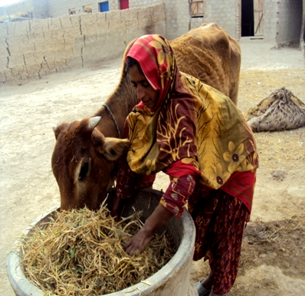
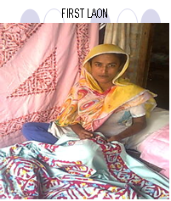
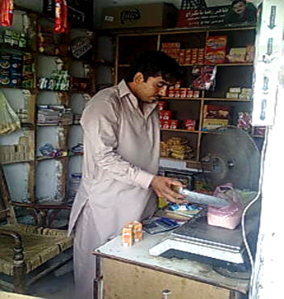
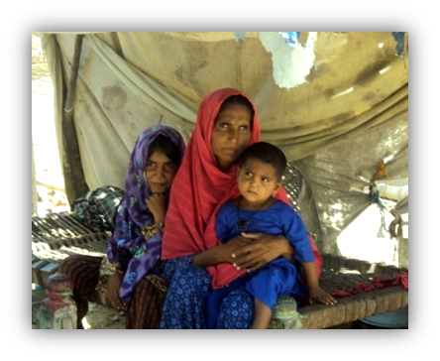
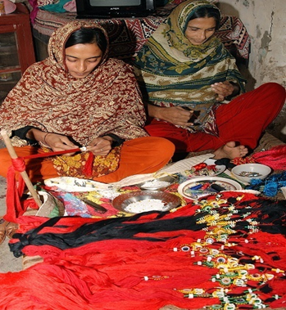
Pictorial View of Micro-Finance Initiatives in Sindh

Slide 21
Thanks for Patience

