Slide 1



NAYMET TRUST
www.naymet.org

Slide 2

Introduction
Registered in 2005
Head Office: Lahore, Pakistan
Program office: Lahore, Pakistan
Branches: 6 (Punjab & Gilgit Baltistan)

Slide 3
Vision:
Mission:
Micro Actions-Macro effects
Sustainable socio-economic development with focus on poverty alleviation and gender equality.

Slide 4
Programs
Islamic Microfinance
Health care Centres
Skill Development Centres
Water Wells
Disaster Management
Seasonal projects

Slide 5
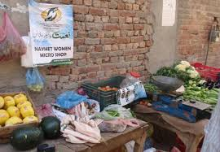
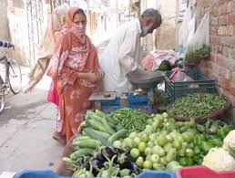
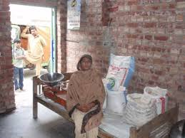
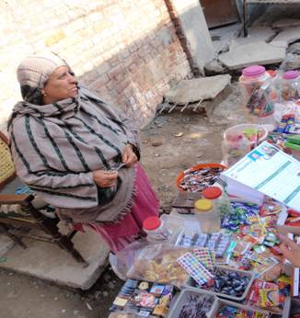
Naymet Micro Shops

Slide 6
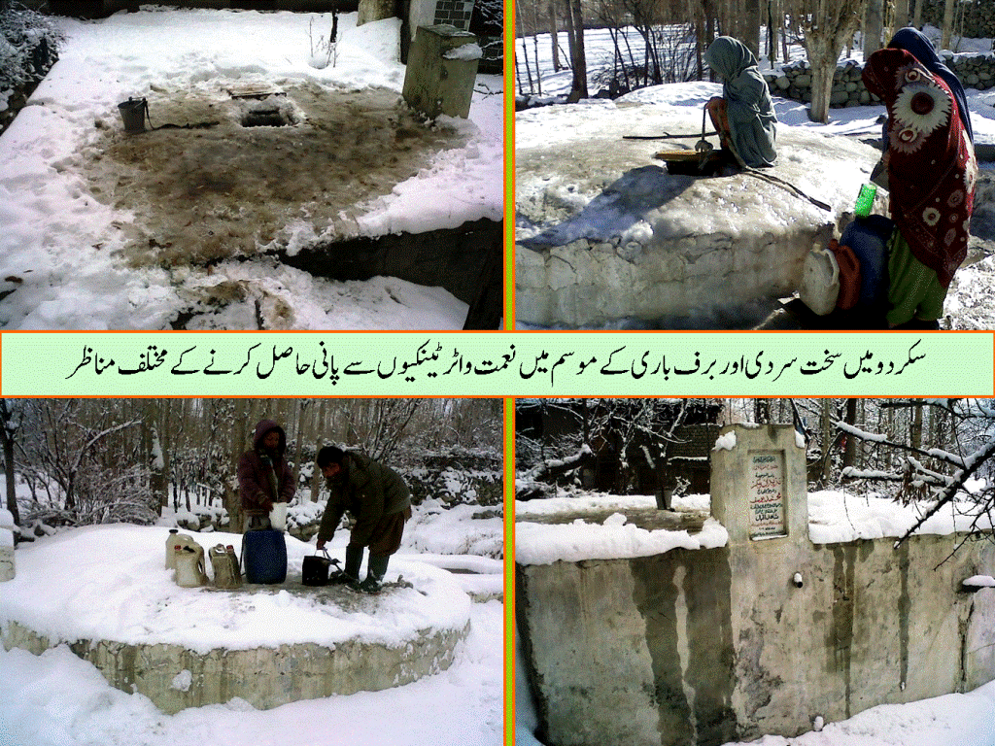
Water Wells

Slide 7
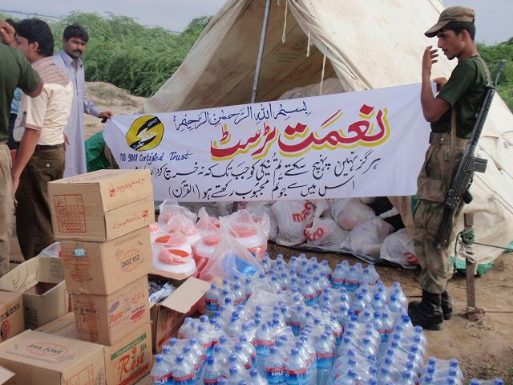
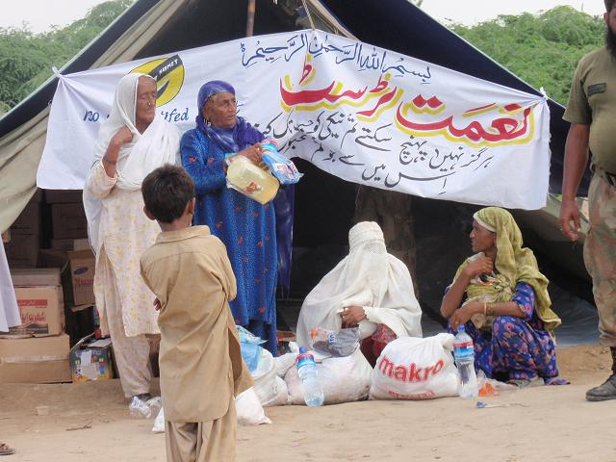
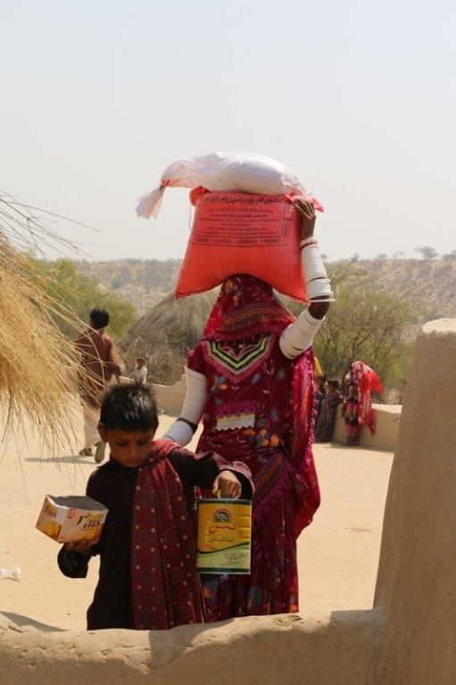
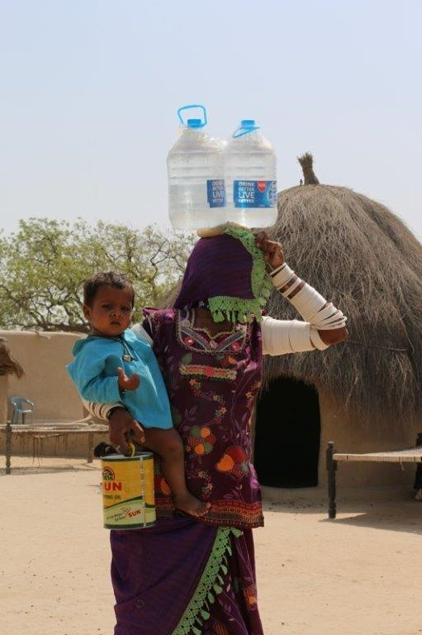
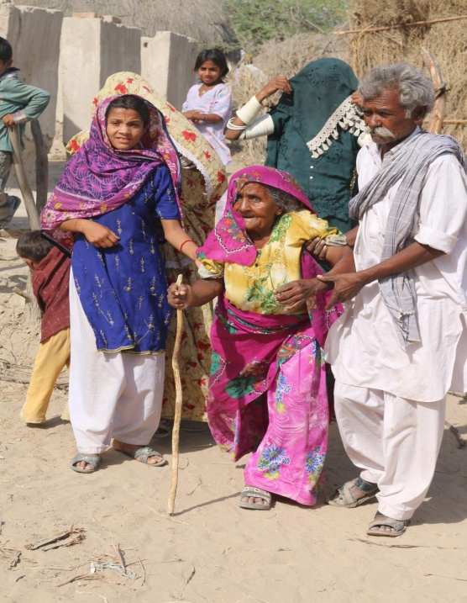
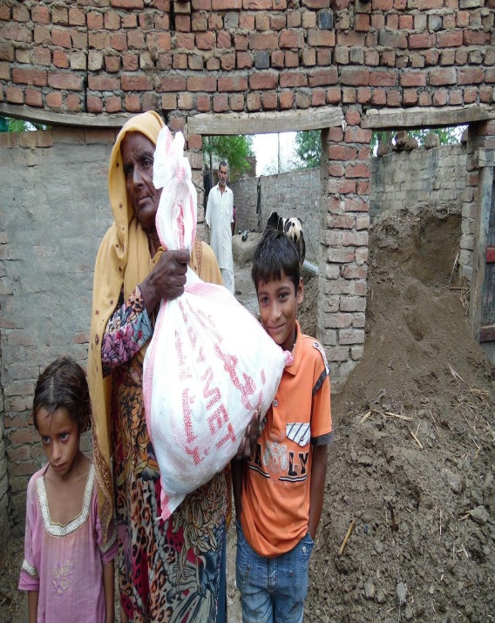
Disaster management Flood,
Earthquake & drought

Slide 8
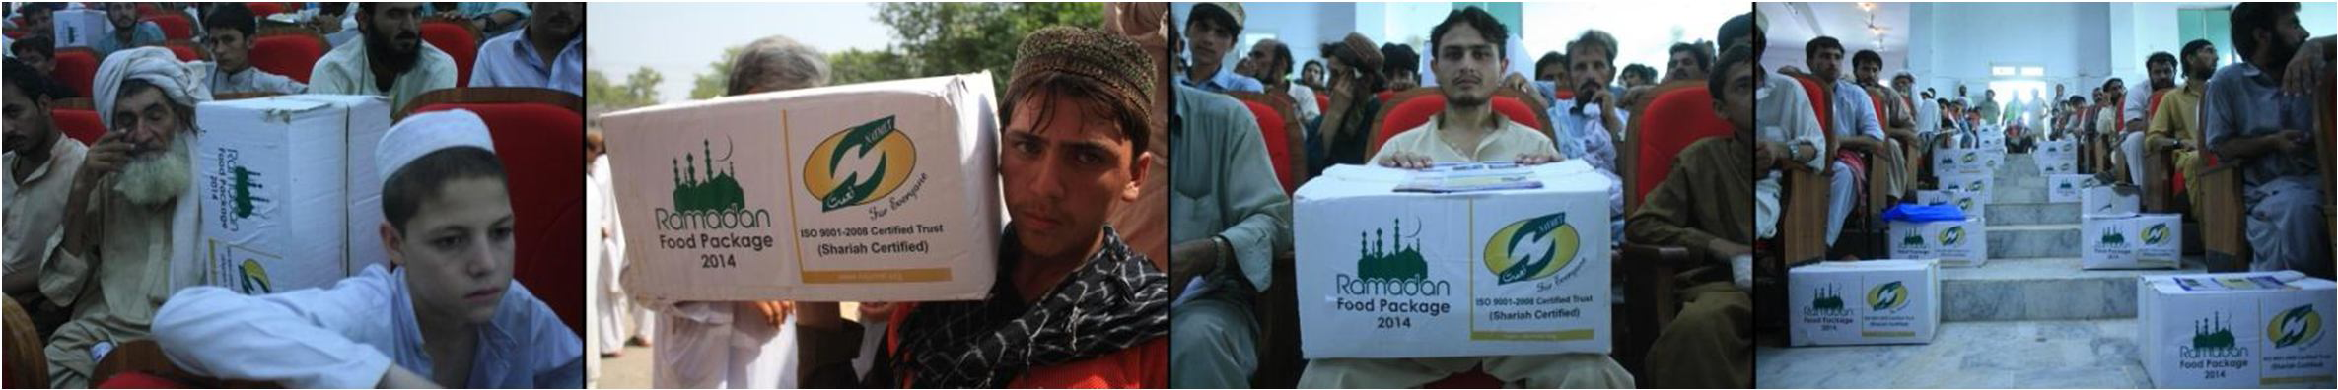
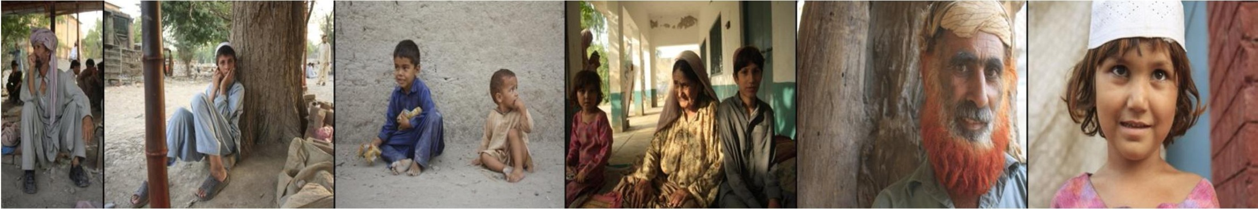
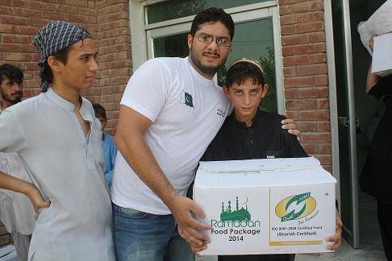
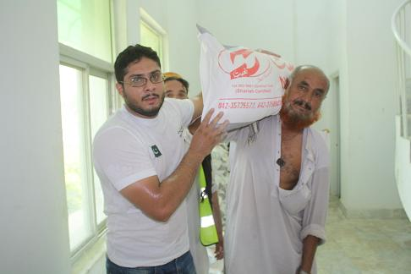
IDPs (North Waziristan)
Relief work at Bannu (KPK)

Slide 9
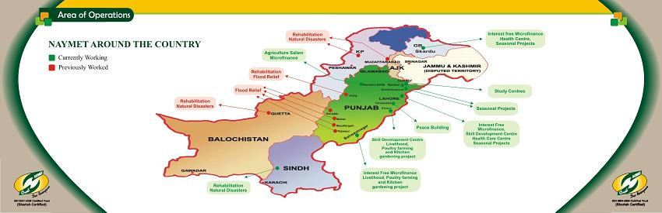
Area of operations

Slide 10
Naymet Microfinance
(3 Models)
Qarz-e- Hasna
Provides cash to borrowers who may use for consumption purposes. The capital is riba-free.
Murabaha
Implies a sale on cost-plus basis.
Mudarbah
Implies providing microfinance on partnership basis for scaling up small enterprises.

Slide 11
Performance Highlights
Qarz-e-Hasna, Murabaha & livelihood (Sep 2009-OCT 2014)
Total clients served | 7500
Total disbursement | PKR 75 Millions
Male and female ratio | 52% female & 48 % Male
PAR | o
Overdue | o

Slide 12
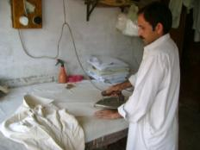
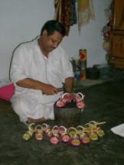
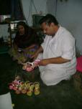
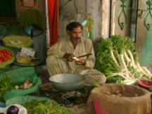
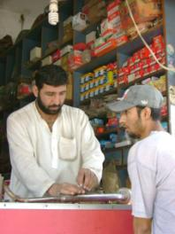
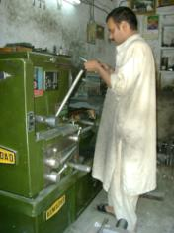
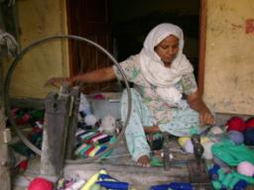
BUSINESS SECTORS SERVED
Trading - 30%
Tailoring – 24%
Manufacturing Light Engineering Works-15%
Services Sector – 9%
Food & Agriculture – 9%
Handicraft & Embroidery – 8%
Live Stock – 5%

Slide 13
Vision 2015
100 Millions
04 New Branch Offices
In Punjab & KPK
OCT 2014
75million
06 Branch Office Punjab & GB
TIME LINE
Oct 2009
Rs.674,000
01 office

Slide 14
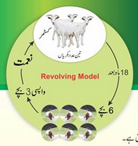
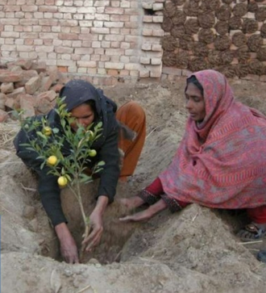
Sustainable Livelihood Project
Bahawalnager & Pattoki

Slide 15
Three female goats; one male goat
Ten hens, one roaster
Three plants of Chinese lemon, one Karronda( Carissa carandas) plant
Hybrid seeds and plants for seasonal vegetables enough for 10” x 20” land cultivation
Sustainable Livelihood Project
Period of 18 months
Selected Clients gets the following:
3-5 females are selected from Progress out of Poverty Progress(PPI)

Slide 16
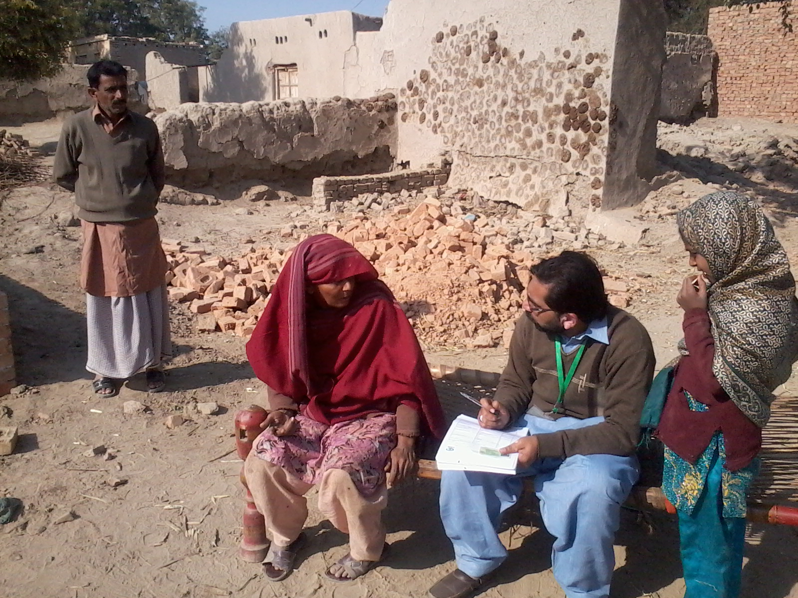
Client Identification through
Progress Out of Poverty Index (PPI)

Slide 17
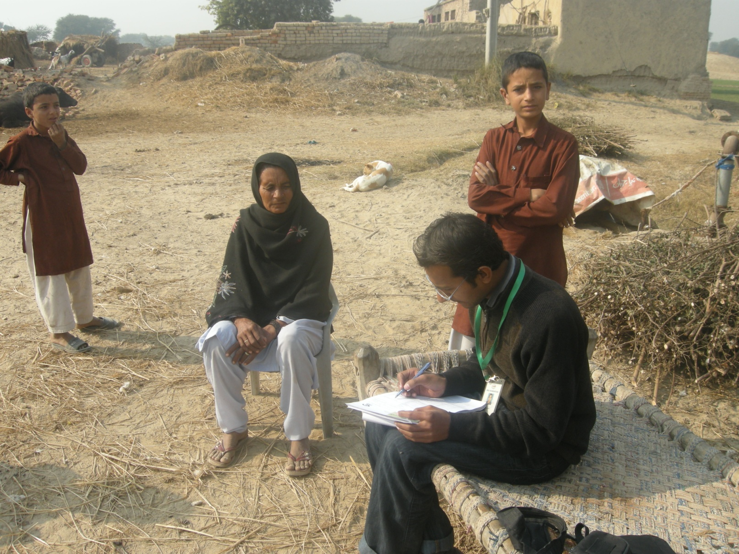
Application Form Filling of
Ultra Poor Community

Slide 18
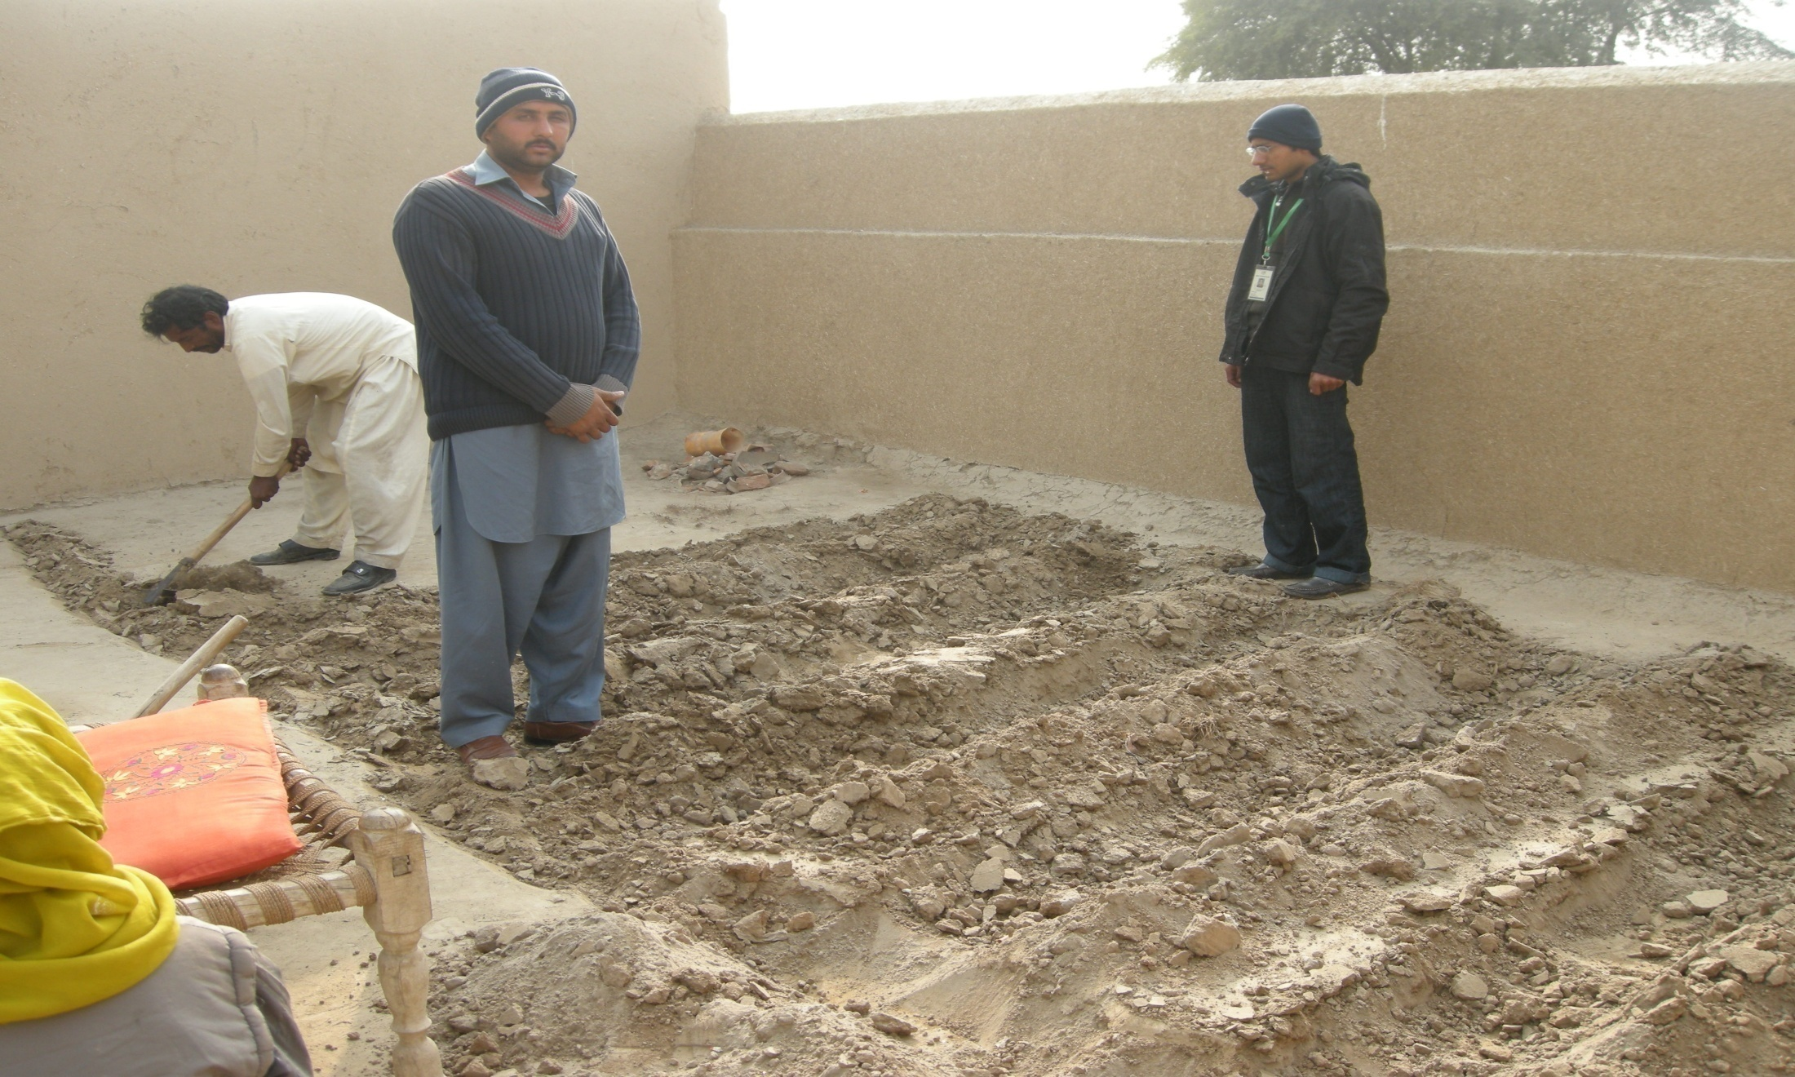
Preparation
Of
Kitchen Gardening Plots

Slide 19
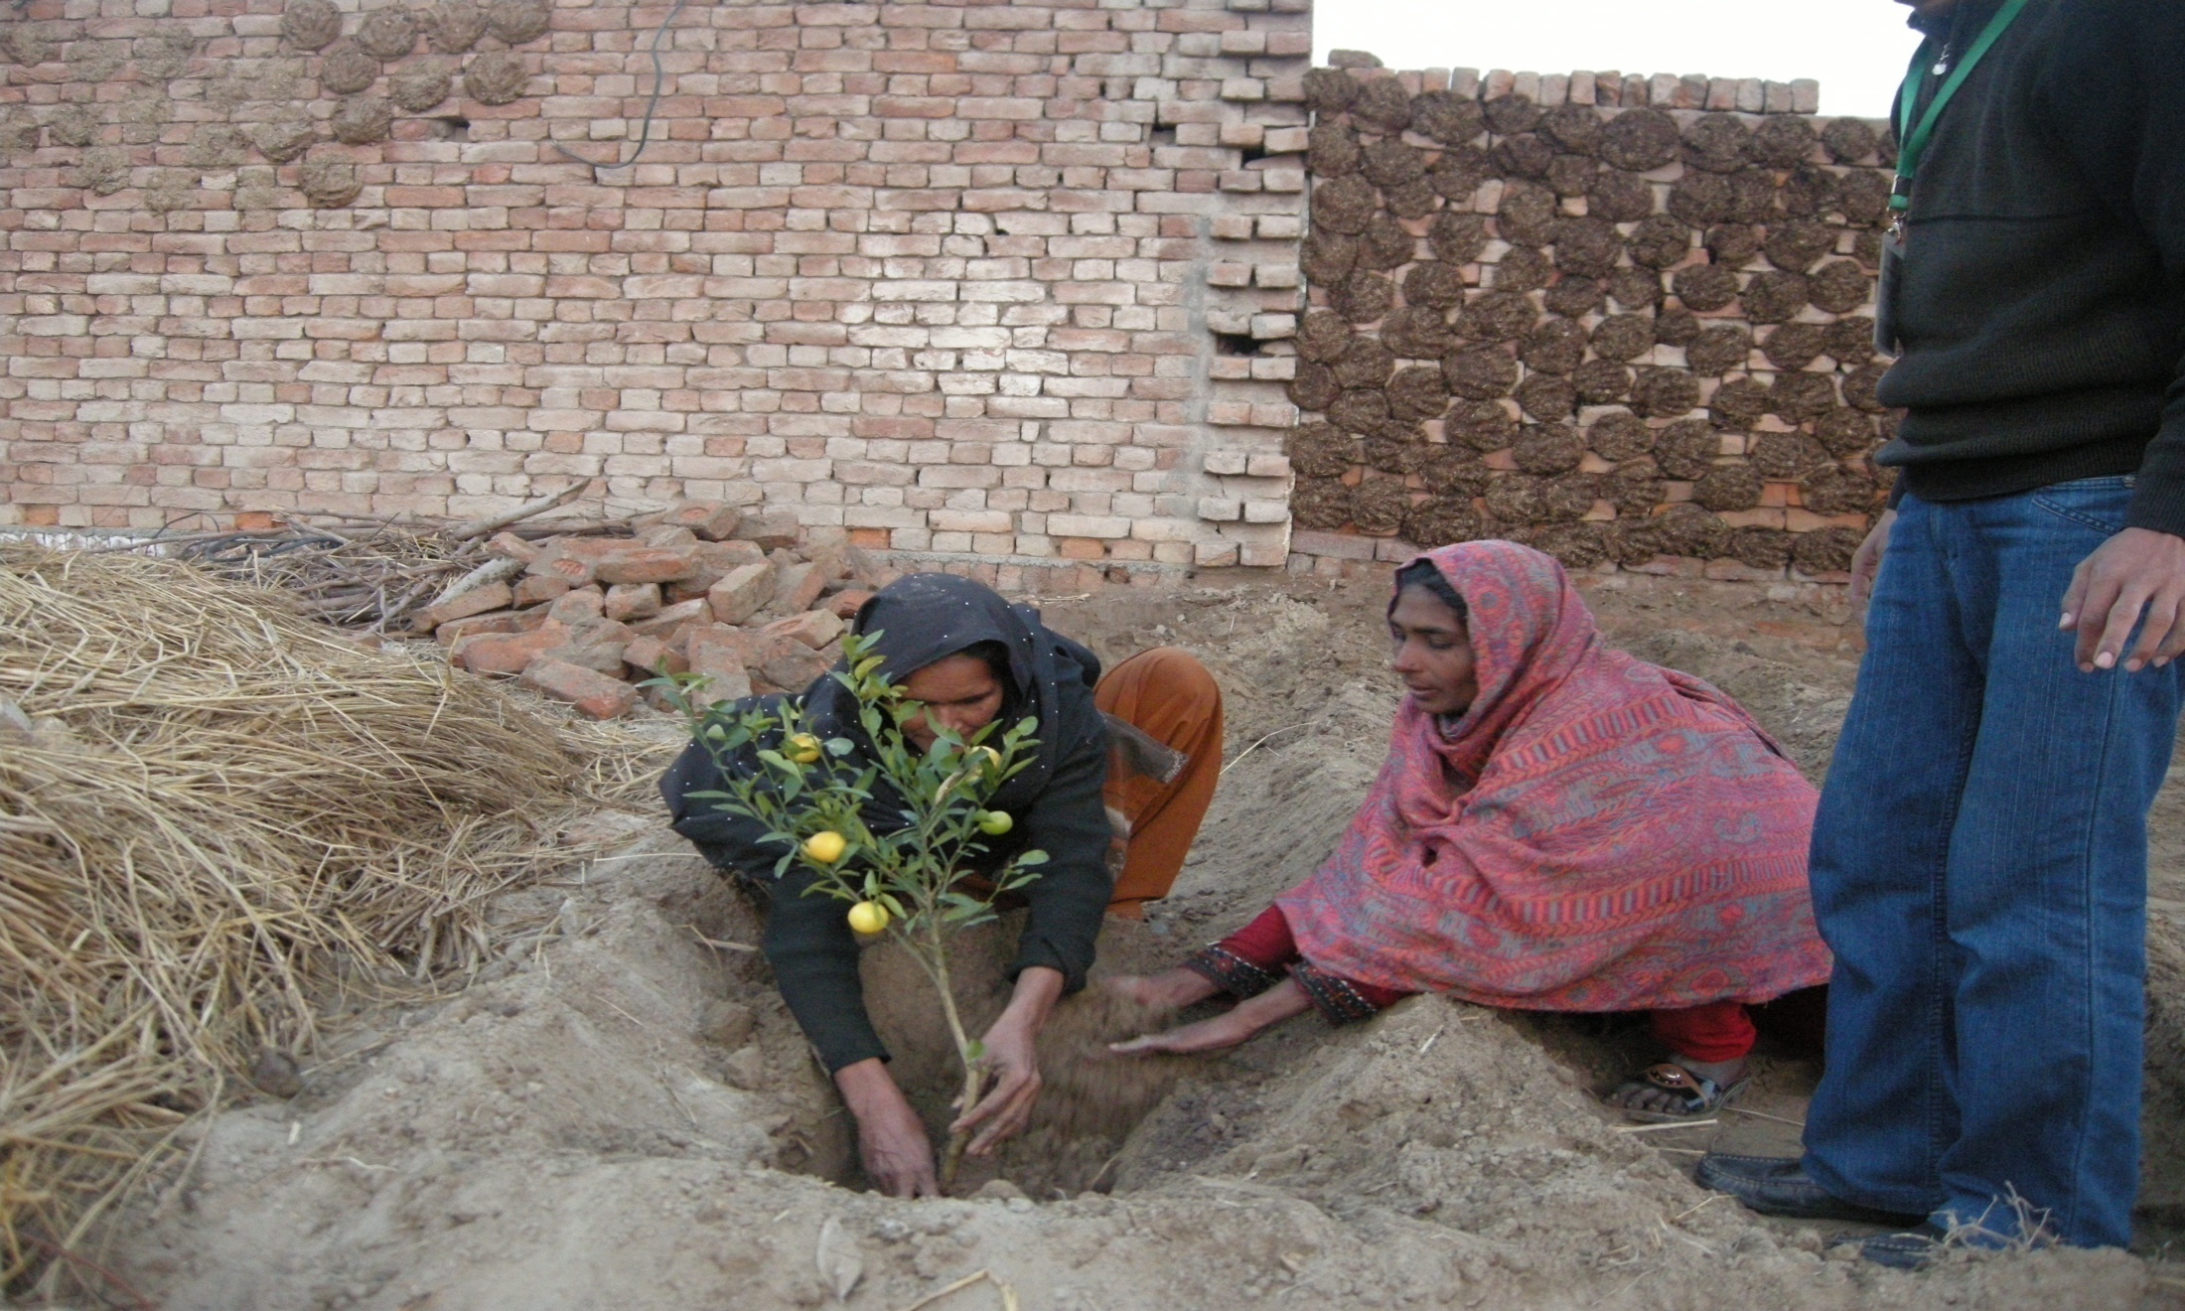
Plantation
of
Lemon & Kronta Plants

Slide 20
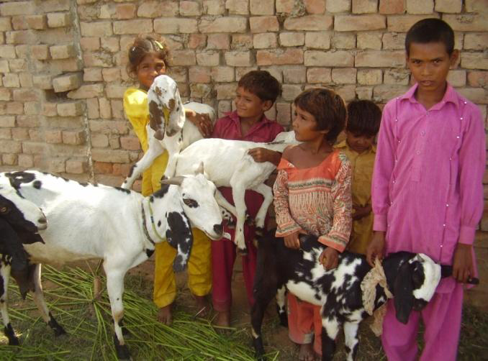
Breeding of Goats
Objectives:
Regular livestock asset
building
To meet nutritional value of their children
To get regular income through goat milk production
Self confidence and ownership building

Slide 21
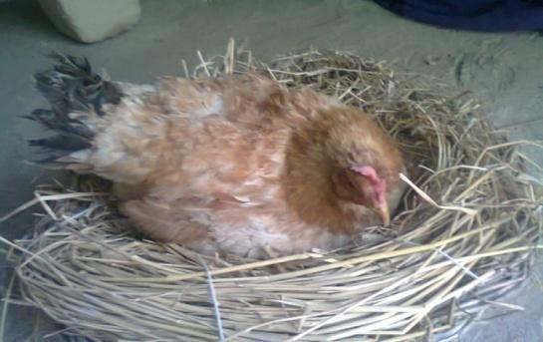
Breeding of Hens
Regular poultry asset building
To meet nutritional value of their children
To get regular income through poultry ,
egg production & chicken.
Self confidence and ownership building

Slide 22
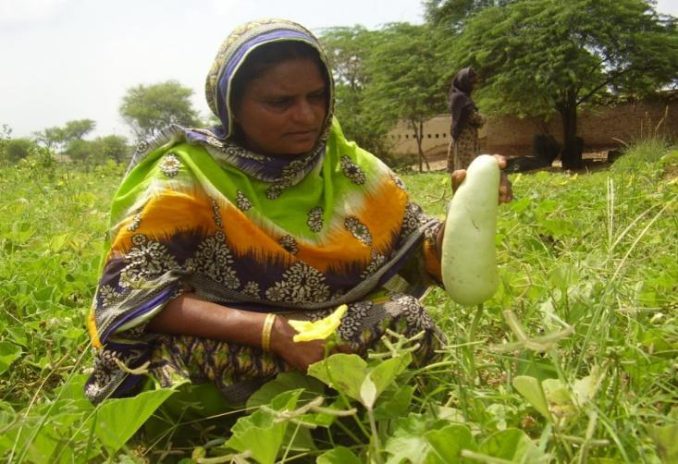
Progress of Kitchen Gardening
Regular organic farming
To meet nutritional value
of their children
To get regular income
through vegetable production
Marketing linkages and networking
Self confidence and ownership building

Slide 23
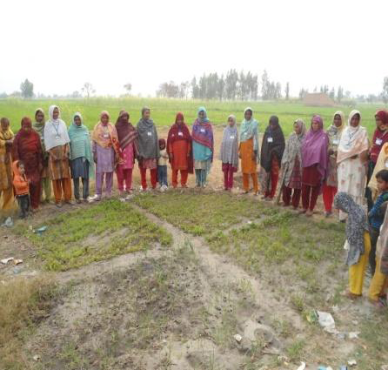
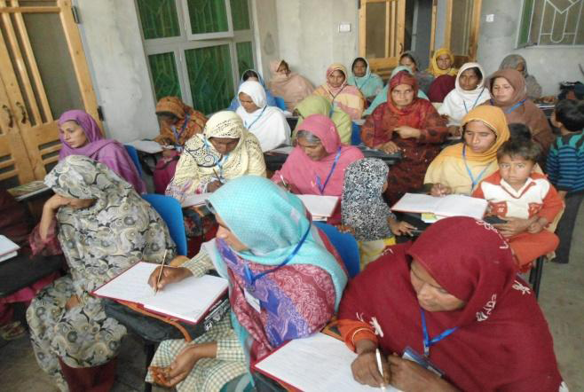
Trainings

Slide 24
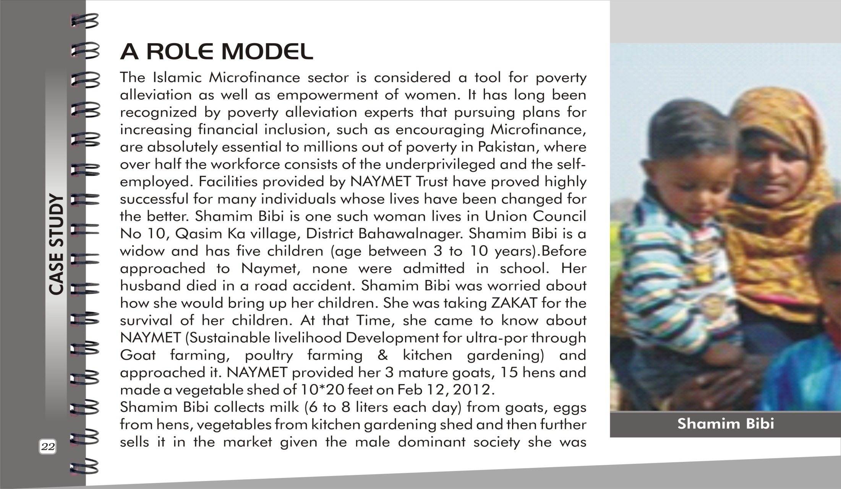
Case Study

Slide 25
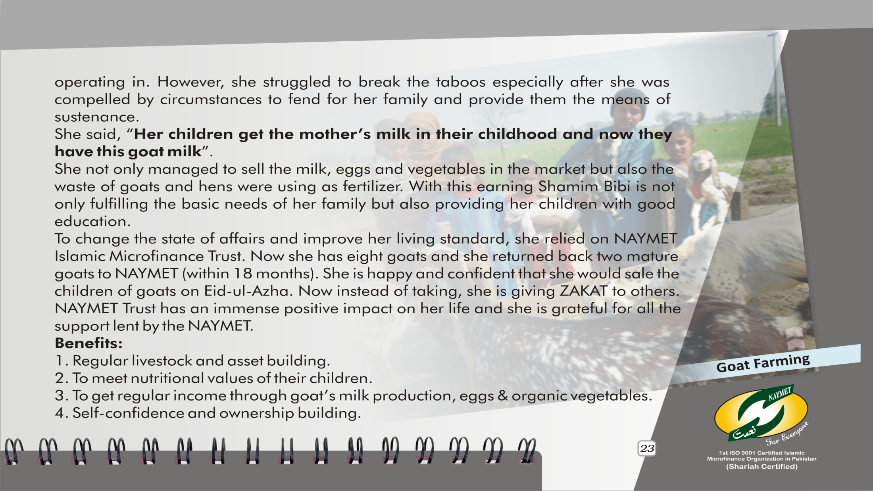
Case Study

Slide 26
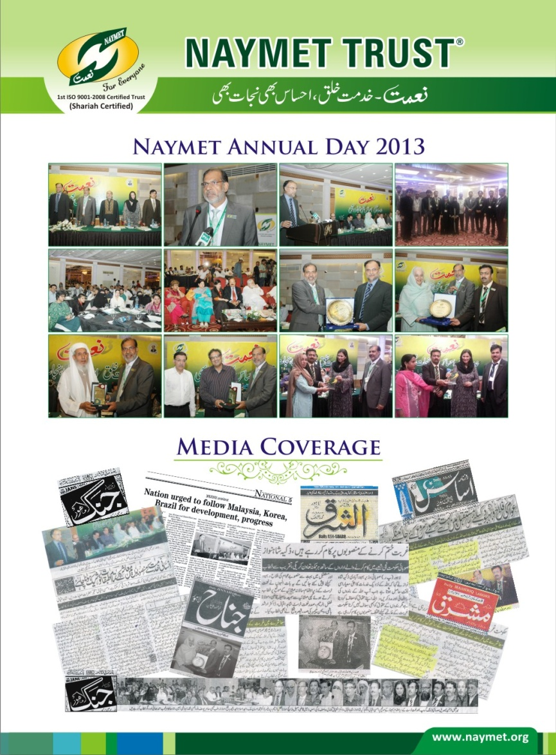

Media Highlights

Slide 27

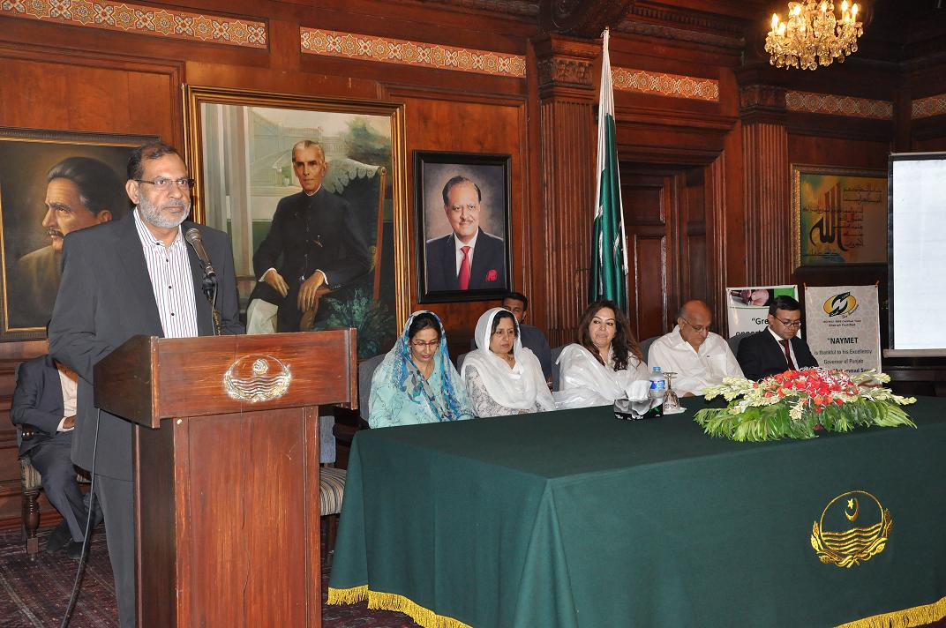
Naymet Annual functions /events

Slide 28










Our Partners

Slide 29












Our Network

Slide 30
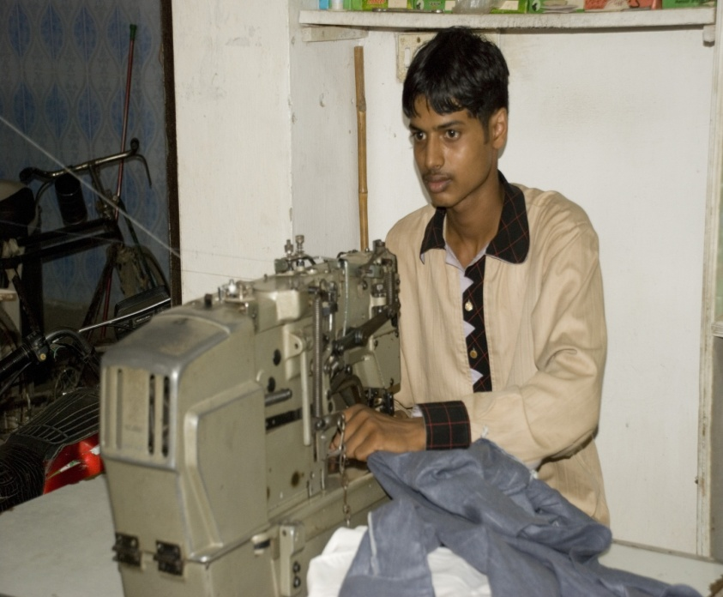
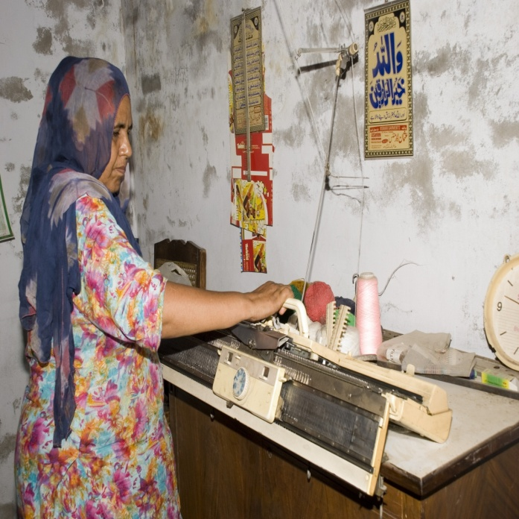
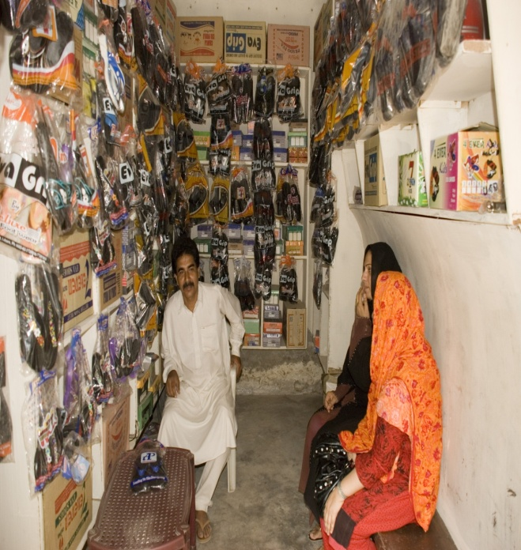
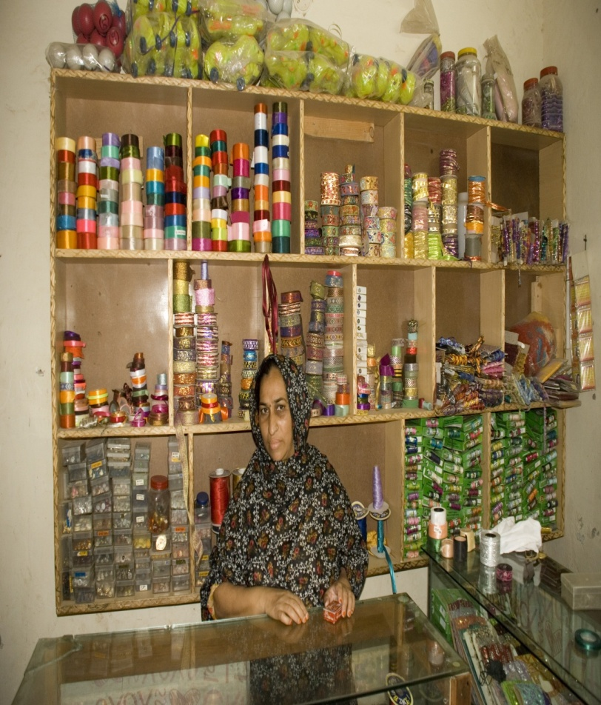
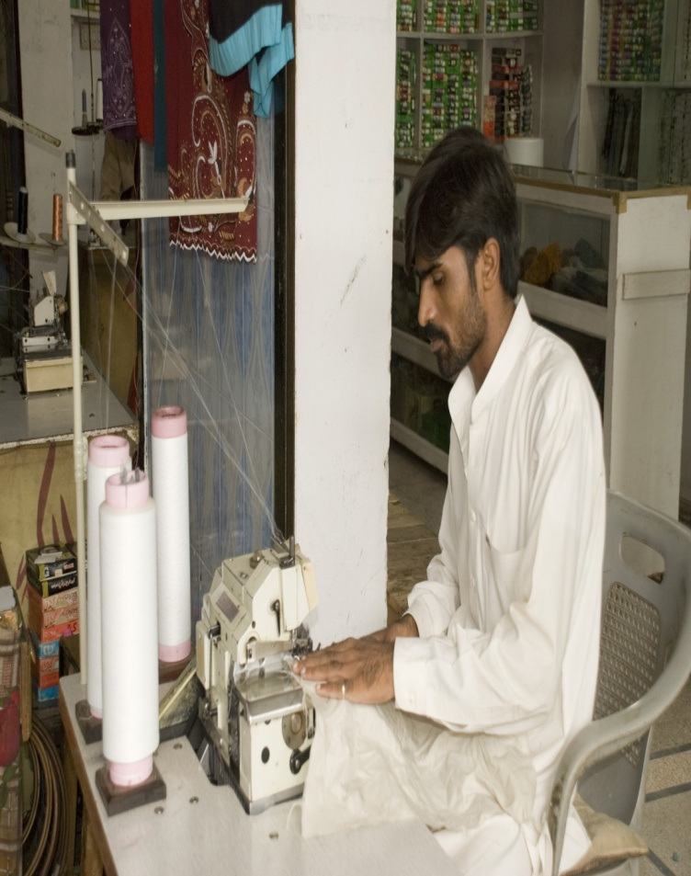
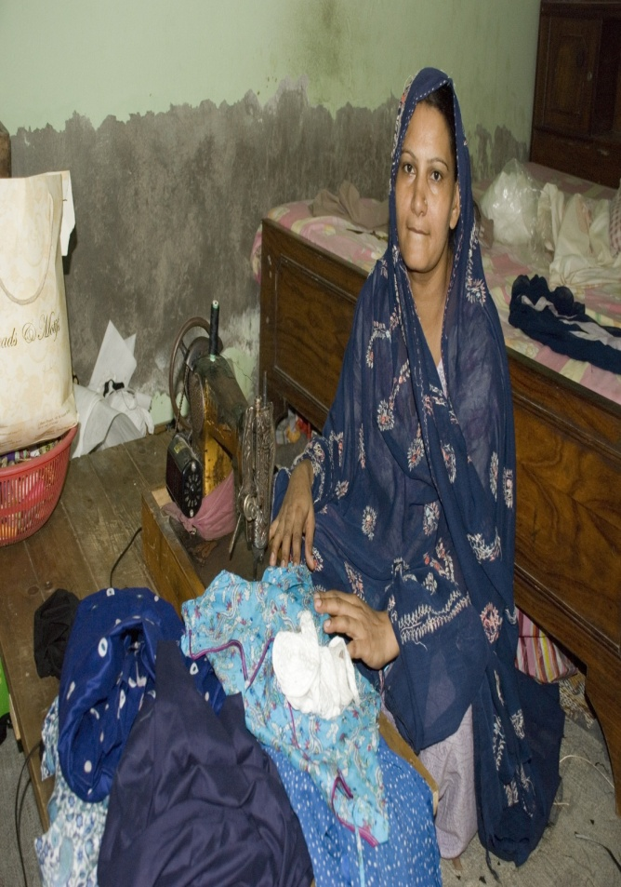
s
Thank You

