Slide 1
“Islamic microfinance at the crossroads”
Issues and Challenges in Sharia-compliant Financial Inclusion
Dr Mohammed Kroessin
Head, Islamic Microfinance Unit
Islamic Relief Worldwide

Slide 2
Issues and Challenges in Sharia-compliant Financial Inclusion
Assessing the ‘state of affairs’ as a platform to move forward
CRITICAL SUCCESS FACTORS:
  Delivery mechanisms
    Business models
    Products
  Capital mobilisation
    Funding sources
    Performance data / ratings
  Standards
    Regulatory & Shariah compliance
    Financial and social performance indicators
  Human capital
    Recruitment & retention
    Training & CPD
  Knowledge & technology
    R&D
    Systems

Slide 3
Islamic microfinance at the crossroads
Reference points:
Conventional microfinance sector
Islamic finance industry
  Help in avoiding mistakes and improve planning for the future
$ 50 BILLION (portfolio outst.)
$ 1.5 TRILLION (AuM)
Phase 1
Experimental
Phase 2
Replication of good practice
Phase 3
Expansion and full commercialisation
1950 1960 1970 1980 1990 2000 2014
Rural credit Mit Ghamr Dubai IB Grameen MiX Sovereign Sukuk Compartamos

Slide 4
IR’s microfinance portfolio
Start year: 1994 (Bangladesh & Albania)
Total clients: 45,813
Active loan portfolio: $10 million
Avg .recovery rate: >95%
Products: Qard Hassan, Murabaha, Mudharaba, Diminishing Musharaka, Salam
Business model: from village-banking to fully regulated NBFI

Slide 5
IR’s global outreach
ME-EE:
Bosnia
Kosova
Chechnya
Palestine
Yemen
Asia:
B’desh
China
Pakistan
Africa:
Chad
Ethiopia
Kenya
Malawi
Mali
Niger
Sudan

Slide 6
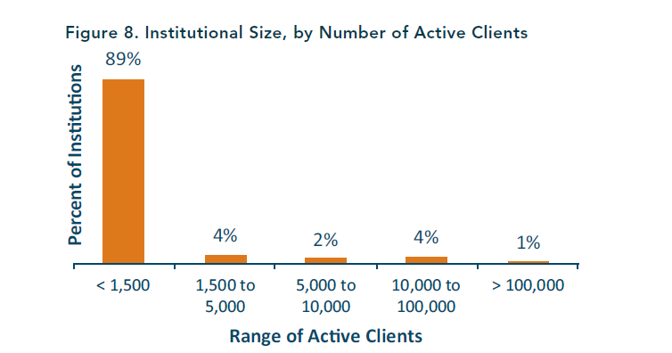
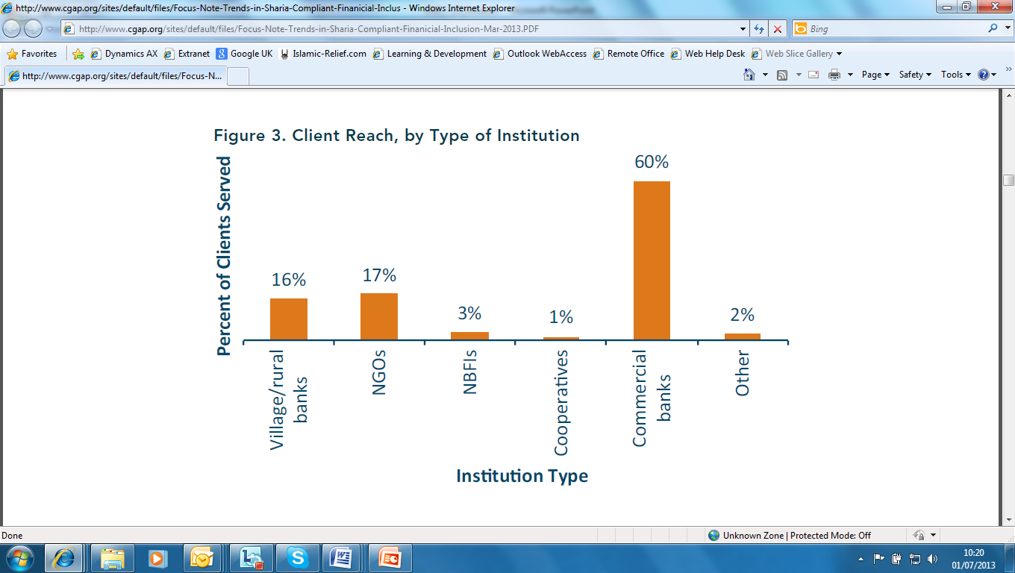
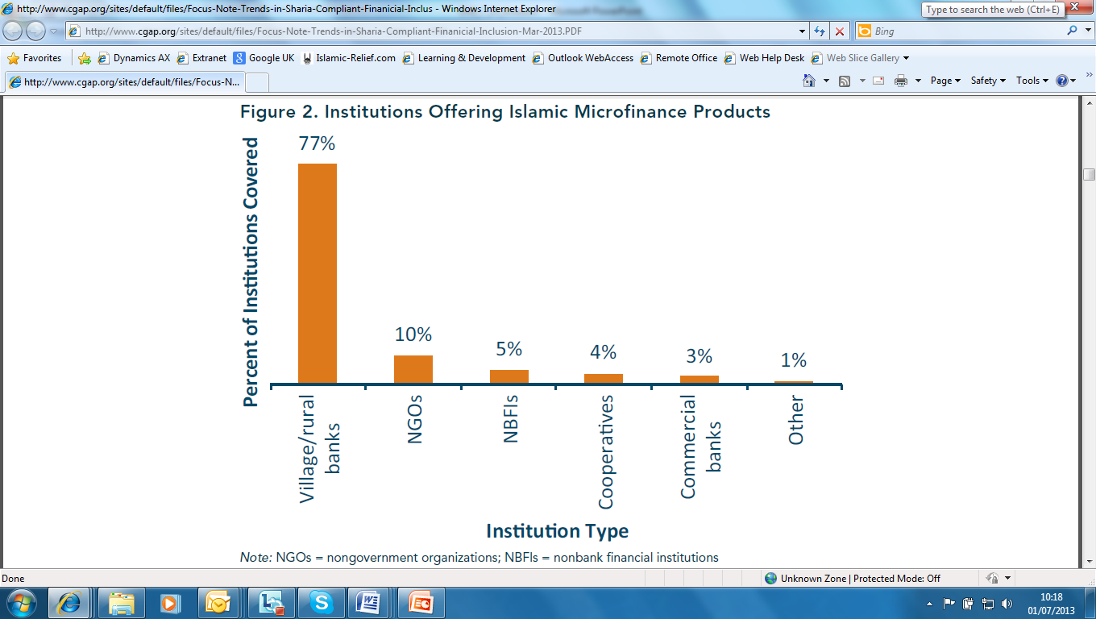
  The I-MF industry
Business models

Slide 7
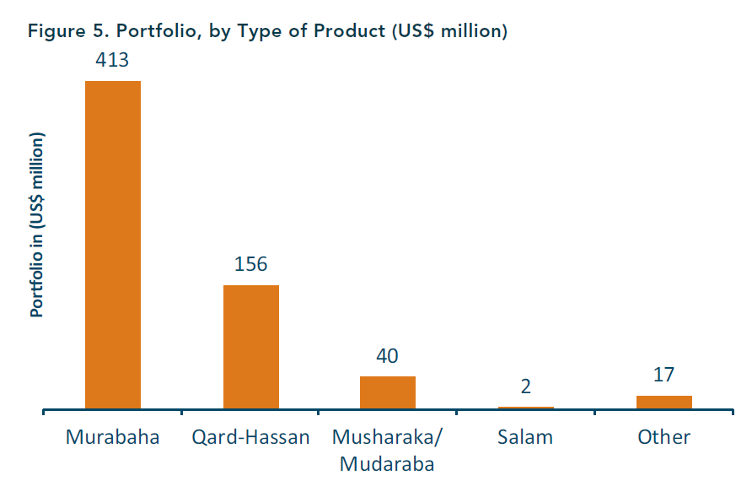
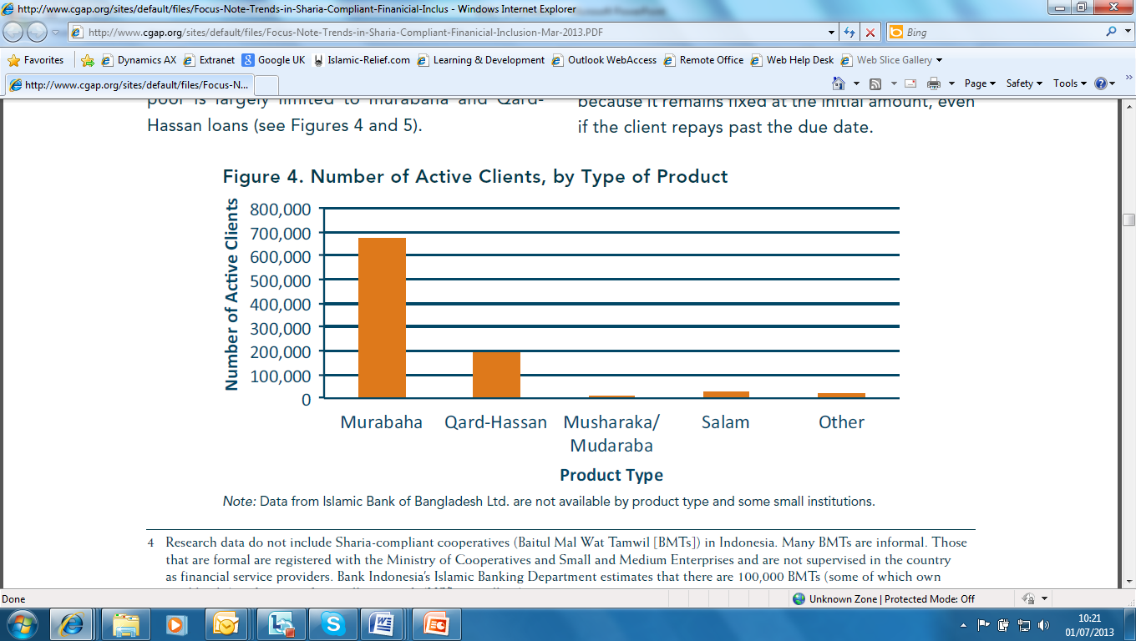
  The I-MF industry
Products

Slide 8

  The I-MF industry: Capital mobilisation
Current funding sources
Donations (NGO/co-op business model)
Deposits (co-op, village banks, NBFI)
Financial markets (commercial banks)
Very common in cMF:
MF Investment Vehicles
  Ratings agencies: MicroRate
  Performance data: MiX Market

Slide 9
  Standards 1
  CGAP Principles (2004):
Poor people need not just loans but also savings, insurance and money transfer services.
Microfinance must be useful to poor households: income, assets & against external shocks.
Microfinance can pay for itself.
Microfinance also means integrating the financial needs of poor people into a country's mainstream financial system.
The job of government is to enable financial services, not to provide them.
Donor funds should complement private capital, not compete with it.
Donors should focus on capacity building.
Interest rate ceilings hurt poor people by preventing microfinance institutions from covering their costs, which chokes off the supply of credit.
Microfinance institutions should measure and disclose their performance—both financially and socially.

Slide 10
Standards 2
Financial reporting
  SEEP
Social performance indicators
  Social Performance Task Force (SPTF)
Regulatory
  Banking industry: capital adequacy ratio etc
Shariah compliance
  AAOIFI, IFSB

Slide 11
The I-MF industry: Human capital 1
A. Lending Services
Loan/self-help group formation
Loan assessment and approval (both for peer-based lending and assessment-based lending)
Financing/credit delivery & recovery
Portfolio and risk management
B. Business Development
Business consulting/advisory
C. Marketing and Customer Service
Marketing strategy development and implementation
Promotion
Customer service
D. Research, Product Development and Knowledge Management
Client research/analysis
Product development and innovation
Capturing knowledge
Knowledge dissemination
E. Finance
Accounting
Financial reporting
Budgeting and budget control
Financial analysis
Funds management, treasury and cash management
Funds mobilization
F. Internal Control
Internal control
Sharia compliance
G. Management Information Systems (MIS)
Design of and delivery of MIS
Database management
Hardware/network management
I. Corporate Affairs
Legal services & corporate governance
Stakeholder management & regulatory requirements

Slide 12
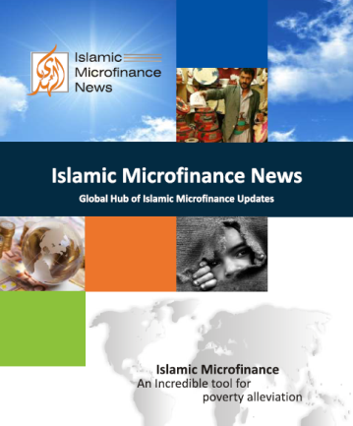
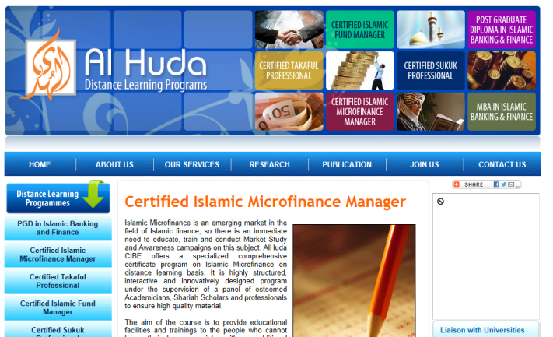
The I-MF industry: Human capital 2
Recruitment & retention
Lack of specific recruitment channels
  Al Huda’s ‘I-MF News’
Training & CPD
  Al Huda’s Certi-
  fied I-MF Manager
Skills shortages: absolute (competence) & relative (competition)

Slide 13

  The I-MF industry: Knowledge & technology
Knowledge
Islamic microfinance research
  Many attempts but no systemic exploration of I-MF as a field of knowledge
  The first SR of the literature on the impact of I-MF now being conducted by the El Sharaani Centre for Islamic Finance at Aston Business in the UK
  R&D
Technology
MIS
Mobile payments
Crowd-funding

Slide 14
State of affairs: summary
  I-MF industry
    Business models
    Products
 | cMF | IF | I-MF
Effective business model/ product | √ √ √ | √ | (√)
Capital mobilisation | √ √ | √ √ √ | (√)
Standards | √ √ | √ √
Human capital | √ √ √ | √
Knowledge & technology | √ √ | √ √ √

Slide 15
Why is I-MF at the cross-roads and what next?
Cross-roads:
Competition from crowd-funding & mobile tech
Insufficient scale (capital & model)
Not attracting & retaining talent
Establish a global working group on:
Standards & strategies
  Financial reporting to attract investors
  Sharia compliance
  Social performance

Slide 16
A platform for future action
Support services
Local poor communities
Savings mobilisation
Development agencies
Promote & facilitate economic growth
Governments & multi-laterals
Conducive policies, incentives & regulation
Islamic financial institutions
Invest and collaborate with social development agencies
Put values first
IF literacy
Social performance
Financial performance

