Slide 1
Housing and Housing finance challenges in OIC Member Countries, with a focus on housing Microfinance".
4rd Global Islamic Microfinance Forum
Nov 01-02, 2014
Dubai, UAE
Zaigham M. Rizvi
Secretary General,
Asia-Pacific union for Housing Finance
zaigham2r@yahoo.com

Slide 2
Contents
The thesis is covered in four sections:
Housing Scenario and Challenges in the Muslim World
Urbanization, Slums and HMF
HMF Issues to be addressed
Case of Afghanistan

Slide 3
World Population today is 7.12 bn, and by 2050 will be 8.92 bn plus.
Almost half of the World lives on less than $ 2.50 a day. Nearly 80% under $10 a day
Worldwide, some 830 million people live in urban slums and by 2020, it is estimated the world slum population will cross 1 bn.
Every second person on the globe lives in Urban areas. Expected to reach more than three out of four (70%) by 2050
World needs 4,000 houses an hour to keep up with demand (UN-Habitat)
In view of this population and urbanization explosion:
The percentage of people without access to decent, stable housing is rising.
Adequate housing is vitally important to the health of the world’s economies, communities and populations.
If we are to succeed in the fight against poverty, we must support the expansion of housing both as policy and as practice.
GLOBAL SNAPSHOT

Slide 4
asian Snapshot
Asia-Pacific represents:
1/4th of the world’s population, and including China nearly half of the world population
Nearly ½ of the World’s Poor
Awareness: Housing has become a popular political slogan.
“Housing for all”;
“Slum Free Cities”
“Maang Raha hai har Insaan - Roti, Kapra, aur Makan” (Every human demands food, clothing and shelter); etc.
Delivery: In few countries it is SOME, but in most there is NONE
Each country in the region has its own geo-socio-economic parameters, while all face a common issue of “shelterless poor”

Slide 5
OIC Member Countries and challenge of HMF
57 countries are OIC members out of 193 UN members on a global scene
The population of IDB member Countries was 1.6 Bn in 2009 (23% of he globe), whereas the total Muslim population on the Globe is 2 Bn plus.
The Muslim world represents more than 1 of 4 humans on the planet.
Nearly the same share in number of countries.
Irony is that it represents 1 of 2 poor on the planet. Thus facing the Major challenge of Housing Microfinance (HMF)
An acute challenge of widening demand/supply gap and rising housing backlog … leading to Social Unrest.
Most of the housing backlog and short supply is in low-income segment of the population.
Population growth and urbanization are further compounding the existing huge backlog.
Rising costs (land, construction, construction materials) are making housing unaffordable for the poor.

Slide 6
Housing is a ‘Numbers’ game – The Muslim World is no exception!
IDB member Countries need around 8.2 mn new housing units/year. To meet this yearly demand they will need US$ 15.5 Bn/year of investment in housing sector.*
The yearly requirement of housing in Muslim World is growing at 2.83% p.a.
Sharia-Compliant Housing Finance in Muslin Countries is around 20% only.
Muslim Population: Africa-53.0 %, Asia-32. 2%, Europe-7.6 %, N. America-1.8 %**
Urban population of IDB member countries is growing at 2.8%/year (Worldwide growth 0.5%).
The total urban population of IDB member Countries was 731 Mn in 2010, representing nearly half of total population of IDB member countries
MD to GDP ratio is highest in Malaysia (32%), and lowest in Pakistan and Egypt(below 1%), almost nil in Afghanistan.
* IRTI-IDB Occasional paper, 2012. OIC and IDB membership is the same. **www.IslamicPopulation.Com

Slide 7
Housing Supply Challenge – The figures speak
IDB/IRTI* study suggests housing needs of the Muslim World are at 8.2 mn units, nearly all in the Low-Income Segment. The estimate needs further analysis and breakdown
MENA 3.2 mn;
Asia 2.7 mn; and
Africa/others 2.3 mn.
Shortage: Egypt 1.5 mn, Iraq 1.0 mn, Morocco 0.6 mn, Saudi Arabia 0.4 mn
Need for new housing for 8.2 mn plus due to population growth is based on 5-5.5/HH and population growth rate of 2.8%
Significant oversupply is in upscale or luxury housing only, while low income segments/ communities remain neglected
Urbanization and population growth further increases the annual housing needs in major metropolitans
On the other side, supply is 30-40% of new demand, all for high income segment.
*Islamic Development Bank/Islamic Research and Training Institute Report on Housing-2012

Slide 8
Housing Finance Challenges in Muslim World
As most of housing shortage is in low income segment, these segments/communities need empowerment through housing finance.
Nearly 1/5th of population in the Muslim World is a candidate for HMF.
Faith- Sharia-Compliant Financing Models are needed. Poor prefer Sharia-Compliance schemes.
Institutional Housing Finance is either non-existent or in infancy stages in most of the Muslim World (Afghanistan and some African Countries).
Slightly advanced in some others (Malaysia, Turkey, Egypt, Morocco, Indonesia, Pakistan and Saudi Arabia).
Regulatory Framework needs strengthening.
Additional challenges include:
Role and responsibilities of Specialized Housing Finance Institutions (HFIs) and Commercial Banks (CBs).
Long Term Liquidity Facility Institutions and Instruments.
Role of Capital Markets

Slide 9
Sharia-Compatible Housing Finance
An issue of faith e.g. Afghanistan with nearly 100% Muslim Population
Also an issue of Financial Inclusion. Even if conventional finance is available, Faith-Based clients do not avail it
Standardization and Diversification of Real Estate/Housing Products both on Asset Side and Liability Side
Limited supply and wide scope of Islamic REITS and MBS Products
Role of Islamic Banks and Windows Islamic finance at Conventional Banks
Need for Research and Development Center

Slide 10
Urbanization, Unban Congestion, Slums
and
Housing Microfinance

Slide 11
Urbanization:
World Urbanization in 2010 – 51%, and by 2030 – 61%
Cities in developing countries are expected to absorb 95 per cent of urban population growth in the next two decades, increasing the slum population by nearly 500 million between now and 2020.
Slums:
One billion people live in slums. That's one out of seven of us. Unless urgent action is taken, 1.4 billion people will live in slums by 2020
Cities account for some 70 per cent of global GDP and city slums are often economically vibrant; around 85 per cent of all new employment opportunities around the world occur in the informal economy
Slum dwellers grew from 777mn to 850mn during 2000-2010
Positive factor: 227 million moved from slums during this period; doubling MDG goals
Source: Homeless International http://www.homeless-international.org/About-Slums
Unplanned Urbanization leads to Slums

Slide 12
Urbanization and Slums

Slide 13
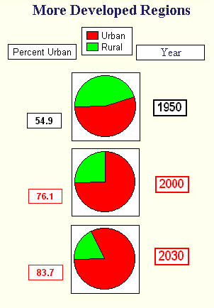
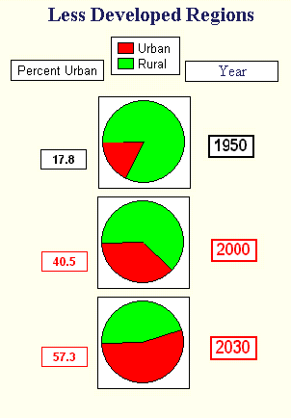
Source: http://www.faculty.fairfield.edu/faculty/hodgson/Courses/so11/population/urbanization.htm
URBANIZATION OF THIRD WORLD SOCIETIES

Slide 14
Slums Prevalence in Asia
Afghanistan: 80% of Kabul’s population (total 5 mn+) live in slums, hill housing or in houses damaged/destroyed during decades of wars
Bangladesh: 2,100 slums. In Dhaka, 2 mn people live either in slums or are without any proper shelter
India: 52,000 slums provide housing to 8 mn people (about 14% of the total urban population)
Pakistan: Karachi alone has between 600-800 slums sheltering 7.6 mn people (1 million households) out of the total city’s population of 15.1 mn people
Sri Lanka: A considerable share of the population of Sri Lanka lives in plantations, slums or shanties
Mongolia: 51% of the population residing in temporary ‘ger’ dwellings
Indonesia: 17.2 mn families live in approximately 10,000 slum areas

Slide 15
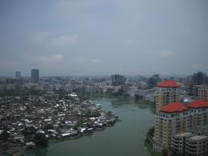
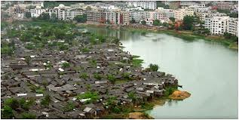
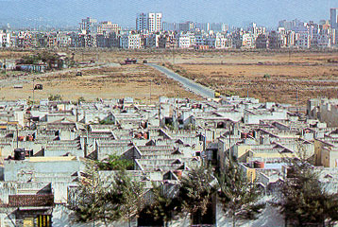
Urban Realities – A glimpse into reality

Slide 16
Characteristics of slums
Poor structural quality and non-durability of housing
Insufficient living areas and indecent living conditions
In Kibera-Nairobi, at times, on a 40 Sq.mt plot, three bedrooms accommodate three families, with an average persons/room density of 6+
Situation is similar in slums of Afghanistan, India, Pakistan, Bangladesh and many other countries of Asia-Pacific
Lack of secure tenure, thus no motivation to make improvement in the shelter
Poor access to water, sanitation, sewerage etc
Diseases like cholera, pneumonia, malaria, HIV and diarrhea are prevalent in many slums
A slum is more than an area of concentrated poverty; it is an area of physical and social deterioration
High crime rates. Slum dwellers are considered to be involved in serious crimes like drug and alcohol abuse, juvenile delinquency, gang violence etc.

Slide 17
Biggest slums around the world
Some of these slums are:
DHARAVI SLUM IN MUMBAI, INDIA
ORANGI TOWN, KARACHI, PAKISTAN
KIBERA SLUM, NAIROBI, AFRICA
Favela (Slums) of RIO DE JANEIRO, BRAZIL
KABUL, AFGHANISTAN
*Source: http://factspy.net/biggest-and-dirtiest-slums-from-around-the-world/

Slide 18
Dharavi Slum in Mumbai, India
Mumbai slum Dharavi in India is one of the biggest in the world. It used to be the largest slum in Mumbai at one time, but as of 2011, there are four other slums in Mumbai appearing to be larger than Dharavi.
Poverty, alongside increasing crime, unhygienic conditions, pollution, black spots, illegal business, drugs, prostitution, women crime, drug trafficking, child labor and abuse, diseases, AIDS*
Dharavi’s 600,000-1,000,000 persons inhabit 0.67 square miles.
Dharavi household industry exports goods around the world. The total (and largely informal) turnover is estimated to be between US$500-650 million per year. Actual may be more, since a large section of produce is sold to large scale exporters.
As of November 2006 there was only one toilet per 1,440 residents in Dharavi
The main trade/handicrafts, and migrants who brought them here in Dharavi, are Pottery (Gujratis), Tannery (Tamils), Garments (UP) etc
*Source: http://factspy.net/biggest-and-dirtiest-slums-from-around-the-world/

Slide 19
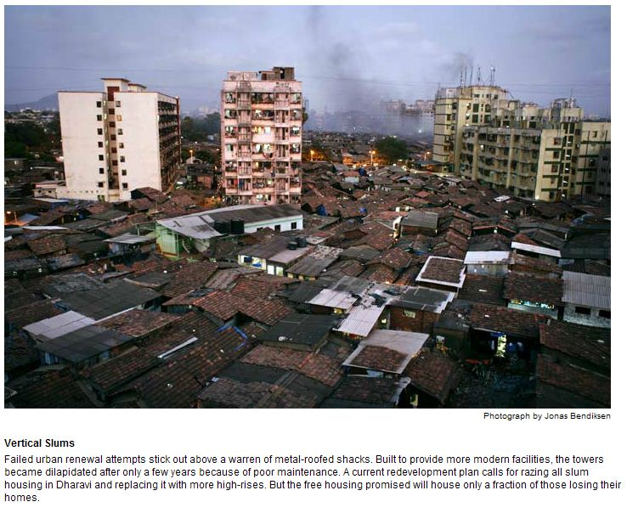
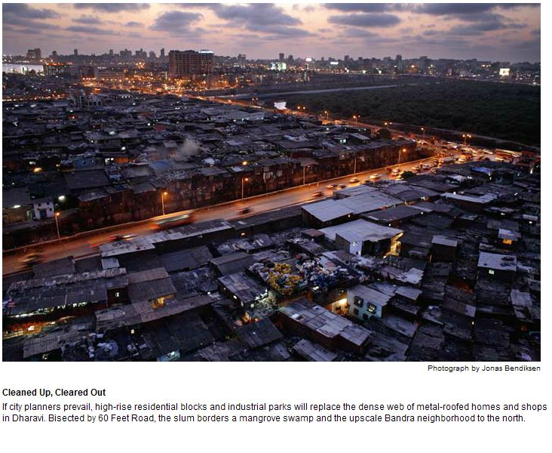
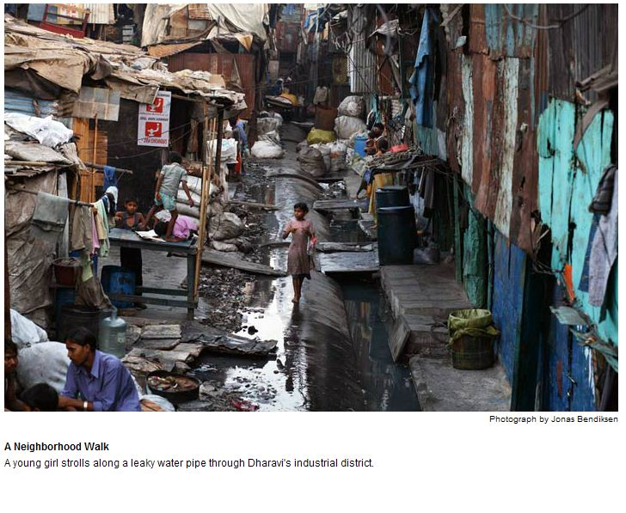
Dharavi-Mumbai

Slide 20
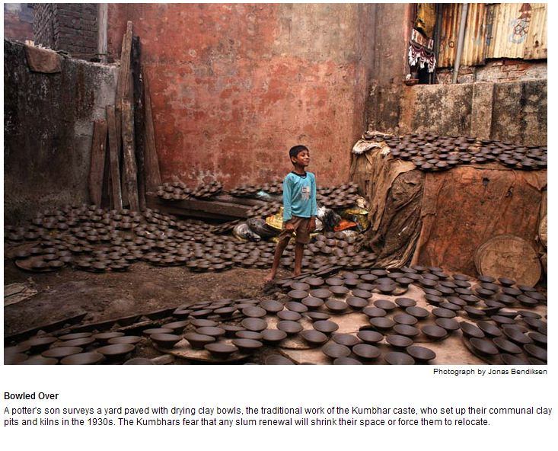
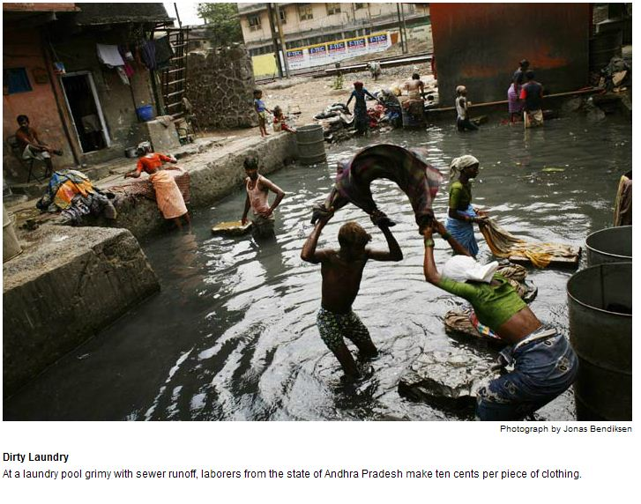
Dharavi - Mumbai

Slide 21
Orangi Town - Karachi Pakistan
Orangi Town is a town in the northwestern part of Karachi, Sindh, Pakistan, spreading over 22 square miles
Orangi town has a population of approximately 2.5 million although government records report 720,000 inhabitants (1998 census). It could be the largest slum in Asia, possibly surpassing Mumbai’s Dharavi in terms of population.
The population began to grow from 1965 onwards as a residential extension to the Sindh Industrial and Trading Estate (SITE)
Orangi also comprises of several new developed middle class areas and housing-societies that are still considered slums for statistical purposes, since they lack basic facilities that are provided to most homes.
Orangi received the world’s attention when local community financed, designed and built their own low-cost sewerage system, since the city municipality refused to allow the sewer system to be connected to the existing city sewers due to Orangi's unauthorized status
(Orangi Pilot Project was initiated by Akhtar Hameed Khan in 1980 )
Source: http://en.wikipedia.org/wiki/Orangi_Town

Slide 22
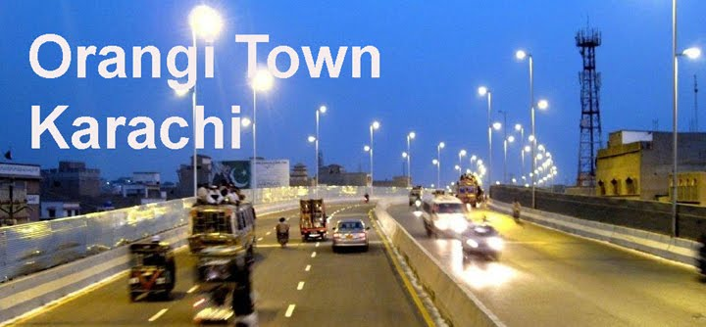
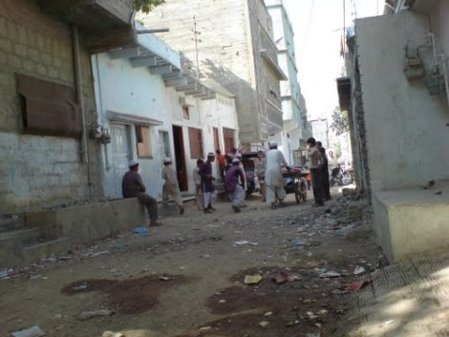
Orangi-Karachi Pakistan
Source:https://www.google.com/#q=sewerage%20system%20of%20Orangi%20Karachi

Slide 23
Kibera Slum - Nairobi, Africa
There are approx. 2.5 million slum dwellers in about 200 settlements representing 60% of Nairobi’s population, occupying just 6% of the land
Kibera houses almost 1 Million people. Kibera is the largest slum in Nairobi, and the second largest urban slum in Africa
Government owns all the land. 10% of “people” are shack owners and these “people” own many other shacks and sub-let them. The rest are tenants.
Until recently, Kibera had no water. Only about 20% of Kibera has electricity
In Kibera there are no government clinics or hospitals. The providers are the charitable organizations. People are dying from cholera even in the 21st century
In most of Kibera there are no toilet facilities. One latrine (pit in the ground) is shared by 50 shacks. At times 2,000 people share these community toilets
Alcohol (Changaa-50% alcohol), cheap drugs and glue sniffing is common.
Kibera is near the industrial area of Nairobi where up to 50% of the available workforce are employed (usually in unskilled jobs). However, there is still an unemployment rate of 50%. That is why the training and teaching of skills is very important.
Watch this video on YouTube “Famous and Rich- in the slums-2011”
Source: http://www.kibera.org.uk/Facts.html

Slide 24
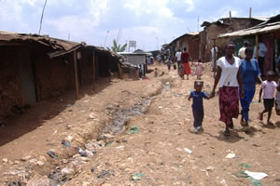
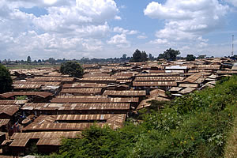
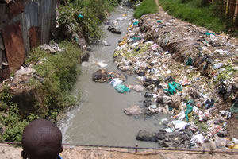
Kibera Slum, Nairobi, Africa

Slide 25
Rio de Janeiro, Brazil
A favela is the term for a shanty town in Brazil, most often within urban areas.
Unable to find a place to live, many rural/urban migrants end up in a favela.
Census data released in December 2011 by the IBGE (Brazilian Institute of Geography and Statistics) shows that in 2010, about 6 percent of the population lived in slums in Brazil.
Most of the current favelas began in the 70s, due to a construction boom in the more affluent districts of Rio de Janeiro. It initiated an exodus of workers from rural poorer states in Brazil
Favelas are built around the edge of the main city; thus expanding city in circles. The cocaine trade has affected Brazil and in turn its favelas, which tend to be ruled by drug lords.
It is said that until recently, there were parts of these favelas where police could not enter for more than 10 years, and now with the Olympics coming up in 2016, they are trying to clean these up.
Source: Wikipedia http://en.wikipedia.org/wiki/Favela

Slide 26
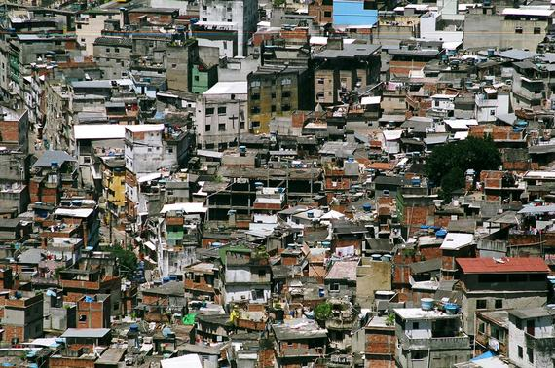
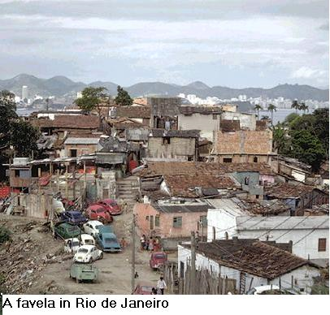
Rio de Janeiro, Brazil

Slide 27
Kabul - Afghanistan
Massive urbanization in 4 major cities, mostly in Kabul, for economic and other reasons
51% of total urban population of Afghanistan is in Kabul with a large and growing young population, seeking housing
Of the total population of 31 mn in Afghanistan, Kabul has 5 mn
Challenge of Returnee Immigrants from Pakistan and Iran, mostly resettling in Kabul
Growing informal settlements including Informal Hill Housing on mountains surrounding Kabul
A large part of existing housing is in need of an upgrade
Kabul’s informal settlements shelter 80% of the population and cover 69% of the residential land in Kabul

Slide 28
Needs of Housing Microfinance
The vast majority of the population in the low income category, relies on informal sources of finance like friends, relatives, and moneylenders, as is prevalent in over 85% of economic activity in Afghanistan
These considerations and large market potential suggests a micro and low-income housing finance approach, mostly oriented towards home improvement loans.
The microfinance sector, which is gaining momentum in Afghanistan, is making initial efforts to expand into low-income housing
Potential demand in Micro and SME finance is considerable, since four out of five people fall at bottom of income/affordability pyramid
Estimates suggest a total financing need of $276 million per year for home improvement and new construction in Kabul’s informal housing sector

Slide 29
Microfinance Investment Support Facility for Afghanistan (MISFA)
MISFA commenced its operations in 2003, with the primary objective to promote and support microfinance lending and entrepreneurship development in Afghanistan.
MISFA provides funding support to MFIs, NGOs and other institutions in their lending operations.
It also serves as supervisory agency for its clients
In 2009-2010 MISFA decisively entered into housing microfinance business.
MISFA is operating in 80 Districts of 23 Provinces
Its outstanding housing portfolio was Afs 135 million as of March 2010, and by May 2013 it had reached Afs 745 million

Slide 30
First Micro-Finance Bank (FMFB)
FMFB started its operations in 2004 under a commercial banking license, with a business focus on microfinance
With an equity capital of $6 million, it is 51% owned by Aga Khan Foundation, along with IFC, KFW and others
FMFB’s individual loans include consumption loans, loans for trade finance, services, agriculture, SME, and housing finance.
FMFB has a network of 45 branches, 17 of which are located in rural areas, covering 14 provinces
With support from the IFC, FMFB has developed a housing microfinance loan product
FMFB is the only financial institution that has successfully launched a rural housing microfinance product in 2010/11 with Technical Assistance and support of USAID, IFC and Aga Khan Foundation
Percentage of women borrowers: 19%
Average loan size in urban areas: $ 1,801
Average loan size in rural areas: $ 801

Slide 31
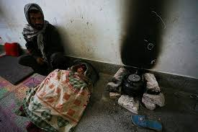
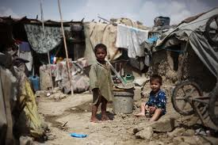
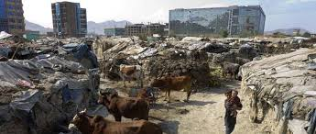
Afghanistan: Slums of Kabul

Slide 32
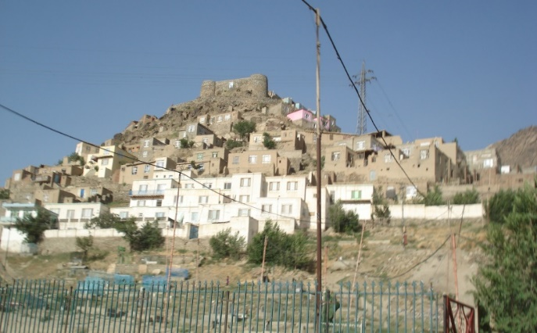
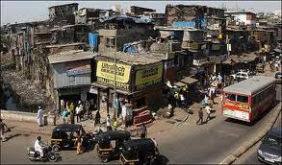
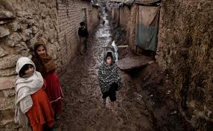
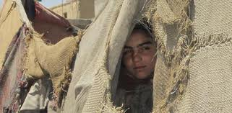
Afghanistan: Slums of Kabul

Slide 33
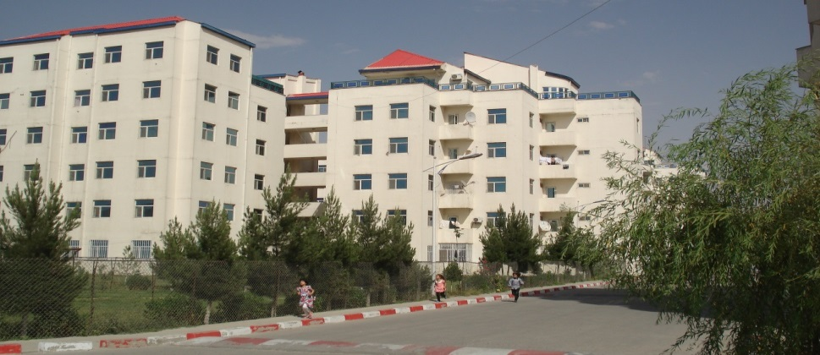
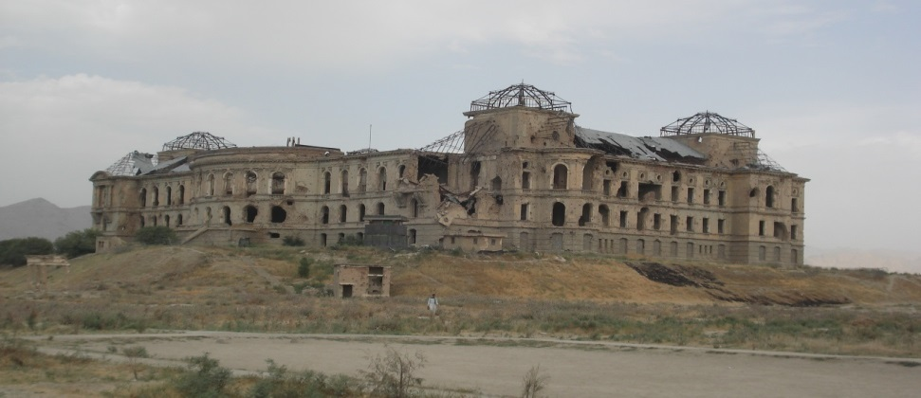
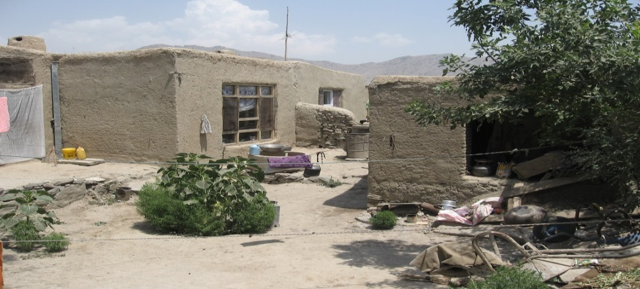
Kabul Housing: From Luxury to BoP

Slide 34
Possible Answers
Urban Planners to work on:
Slums improvement and up-gradation Programs.
Slums Resettlement Programs.
Incremental Housing business model.
Plan and develop new settlements in suburbs equipped with physical, social and economic infrastructure.
Linking urban periphery with urban centers of commerce and business with suitable mode of communications.
Business Models of Private-Public Partnership.
Compile and process data on urban-rural migration and measures to regulate/control urbanization (Model of China).

Slide 35
Housing Micro-Finance (HMF)
Nearly 1/5th of population (BoP) in the Muslim World is a candidate for HMF
At BoP income segment, people are more concerned for Faith-Based Finance
Issues with HMF are:
Product Design, Outreach, Housing Microfinance Regulations
Income Assessment, sustainability and seasonality issues
Appraisal, Surveillance , Delivery; and
Recovery
Challenges include:
Cost-efficient Finance , Loan Surveillance , and timely loan recovery
Manufacturing scale of production, Community-based finance etc
Credit Guarantee, Management of Default and Loan Realization

Slide 36
Issues we know – Answers we need
Generally Political Sloganism
“Housing for all”,
“Slums Free Cities”,
“Maang Raha hai har Insaan-Roti, Kapra, aur Makan” (every individual is demanding for bread, clothe and house), and so on……
In some countries delivery on these slogans is SOME, and in most it is NONE
Every country is facing a common issue of “shelter less poor” with an ever increasing backlog
Recent uprising in the ME has shown that even affluent economies are no exception
Regional successful models are to be shared and indigenized
Islamic Development Bank may play a pivotal role in promoting sharia-compliant housing finance, more so in housing micro-finance

Slide 37
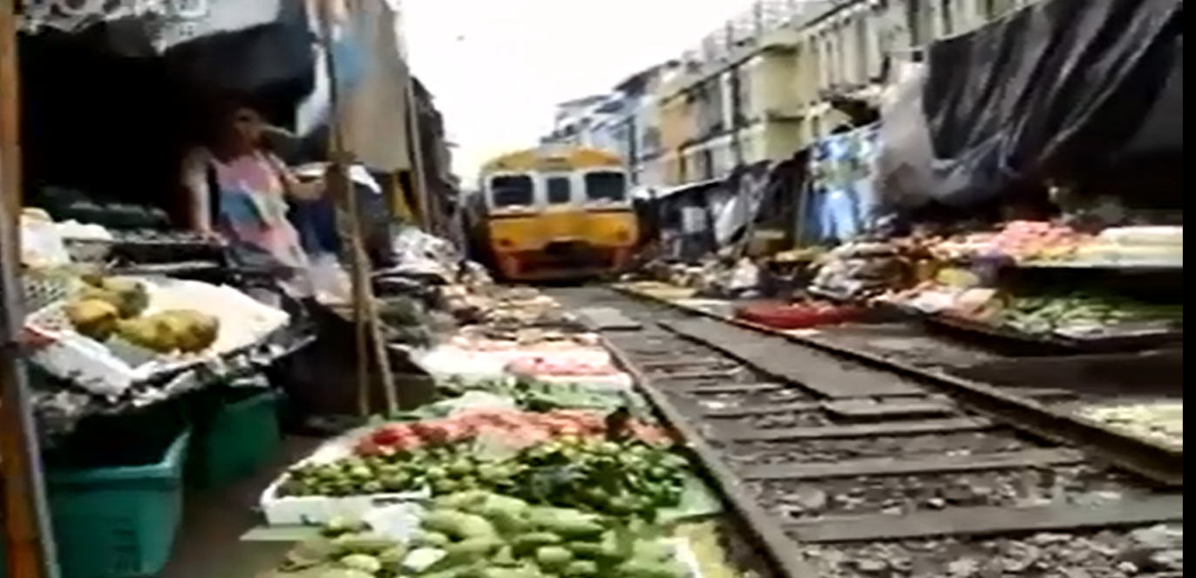
Urban congestion: hard to imagine
Railway Train-track Veggie Market
http://www.youtube.com/watch?v=MENjFkEAj9g

Slide 38
The information has been compiled by Mr. Rizvi from self study and from different sources. He is grateful to all those serving this noble cause in some form or the other.
Issues we know, Answers we need
Zaigham M. Rizvi
zaigham2r@yahoo.com
Secretary General: Asia-Pacific Union for Housing Finance-APUHF (www.apuhf.info)
Housing Consultant World Bank, UNHABITAT, CMHC-Canada
Senior Advisor Housing Encludes-USA (ShoreBank Int’l )
Advisor Housing, State Bank of Pakistan

